Slide 1
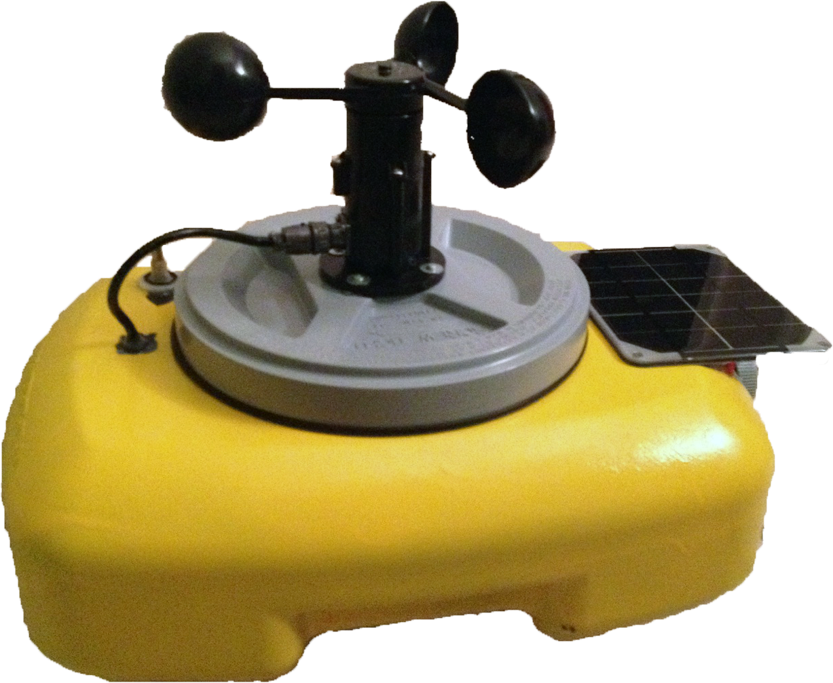
SMART BUOY
Group 11
BRYAN MCCOMBS EE
DANIEL ROSABAL EE
MATT CROUCH PSE
JULIAN ROJAS CE

Slide 2
Motivation
CREOL team member
Living in Florida
Surrounded by water
Recreational use as well as commercial use
Boating, Fishing, Surfing
Surveying
Notes:
Br

Slide 3
Goals and Objectives
Goal
Design a small scale, cost efficient data buoy that can be monitored through a mobile app with ease of operation
Functionality of the data buoy system
Surrounding air and water temperatures
Wind Speed
Salinity Detection
Realtime 3D Movement View
Solar Power Charging
Mobile application for easy user interface
Notes:
Br

Slide 4
Specifications
Buoy Specifications
Component | Parameter | Specification
Housing | Dimension | <20”Lx20”Wx20”H
Wireless Communication | Range | ≥20 ft
Sensor | Range | Accuracy
Wind Speed | up to 60 mph | ±1 mph
Water and Air Temperature | up to 120°F | ±1°F
Notes:
Br

Slide 5
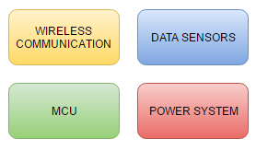
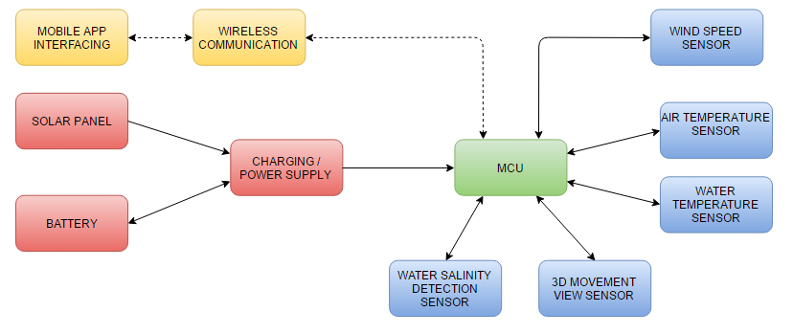
Overall Block Diagram
Notes:
Br

Slide 6
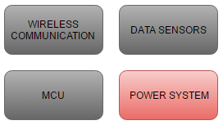
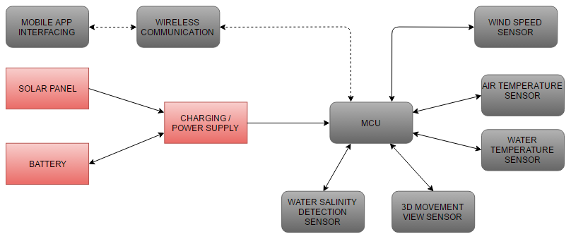
Power System
Notes:
Da

Slide 7
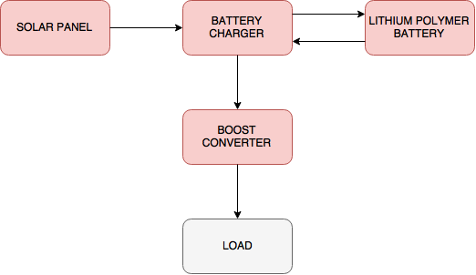
Power System
Notes:
Da

Slide 8
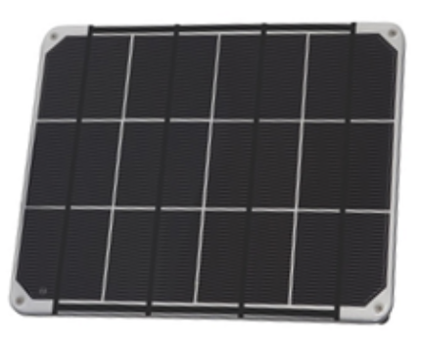
Solar Panel
Adafruit Solar Panel
6V output at 330mA
2W
Durable and lightweight (90g)
Waterproof
Supplier | Adafruit
Product ID | 200
Size | 4.4” x 5.4”
Cost | $29
Notes:
Da

Slide 9
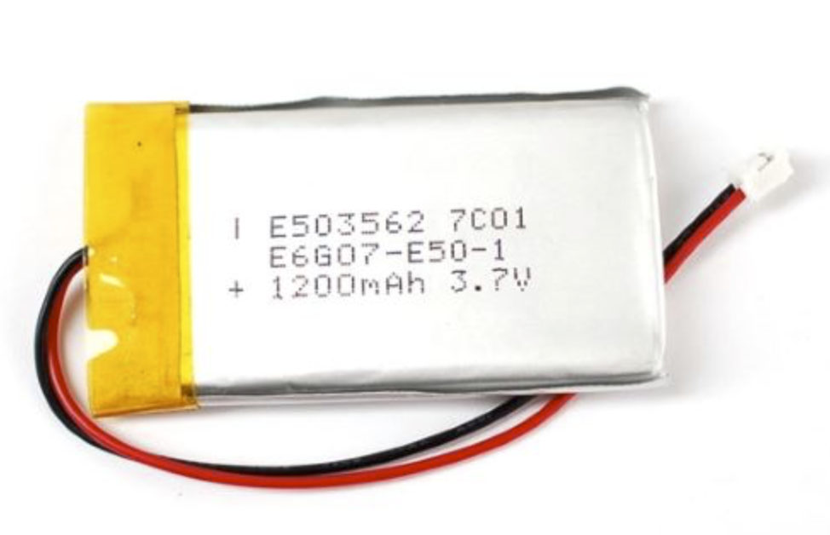
Battery
Lithium Polymer Battery
3.7V nominal voltage
1200mAh nominal capacity
Lightweight (22g)
Supplier | Adafruit
Product ID | 258
Size | 1.3” x 2.4”
Cost | $9.95
Notes:
Da

Slide 10
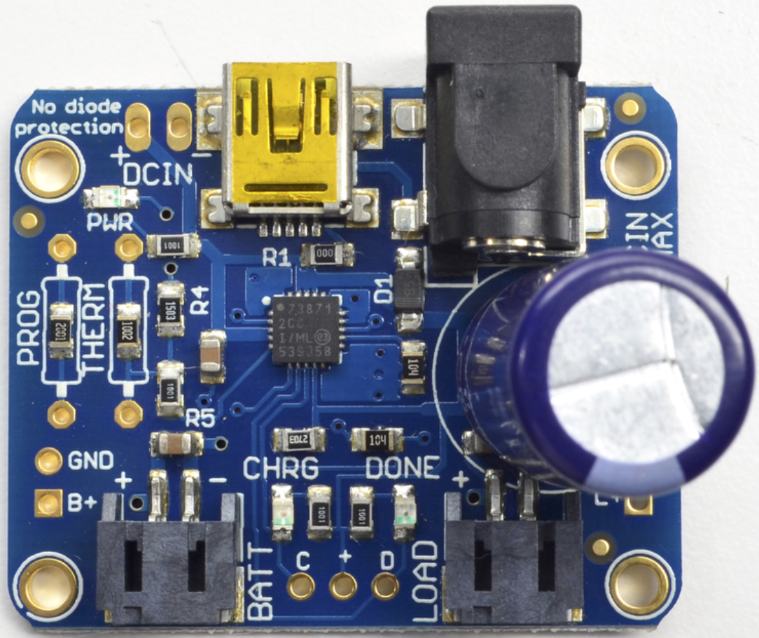
Battery Charger
Based on the MCP73871 microchip
Temperature monitoring
Three indicator LEDs
Power
Charging status
Charging complete
Lightweight (5.7g)
Too dark?
Supplier | Adafruit
Product ID | 390
Size | 1.6” x 1.3”
Cost | $17.50
Notes:
Da

Slide 11
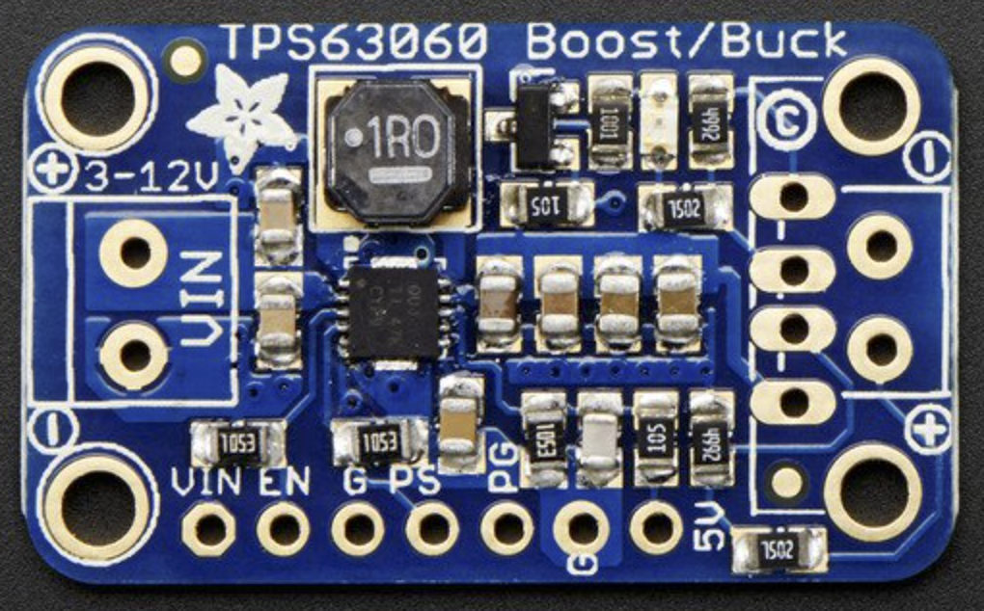
Power Converter
Based on TI’s TPS63060
3 to 12V input
5V output
90%+ operating efficiency
Lightweight (2.5g)
Supplier | Adafruit
Product ID | 2190
Size | 0.7” x 1.3”
Cost | $9.95
Notes:
Da

Slide 12
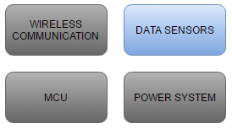
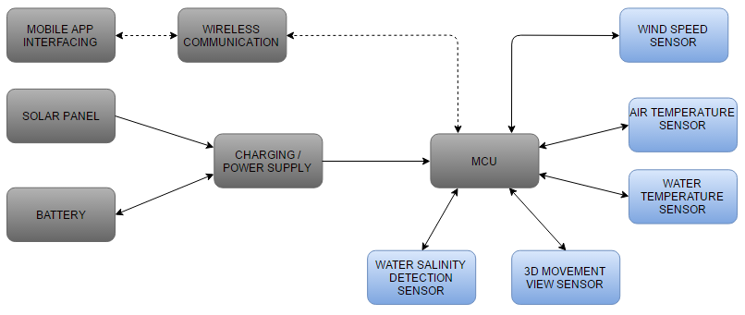
Sensors
Notes:
DANI

Slide 13
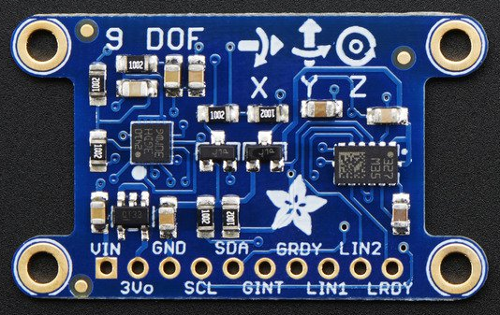
3D Movement View
Adafruit 9-DOF Breakout
Regulated supply voltage 1.71 to 3.6 V
L3GD20H 3-axis gyroscope: ±250, ±500, or ±2000 dps scale
LSM303 3-axis compass: ±1.3 to ±8.1 gauss magnetic field scale
LSM303 3-axis accelerometer: ±2g/±4g/±8g/±16g selectable scale
I2C/SPI digital output interface
16 bit data output
Lightweight (2.8g)
Supplier | Adafruit
Product ID | 1714
Size | 1.5” x 0.9”
Cost | $19.95
Notes:
DAN

Slide 14
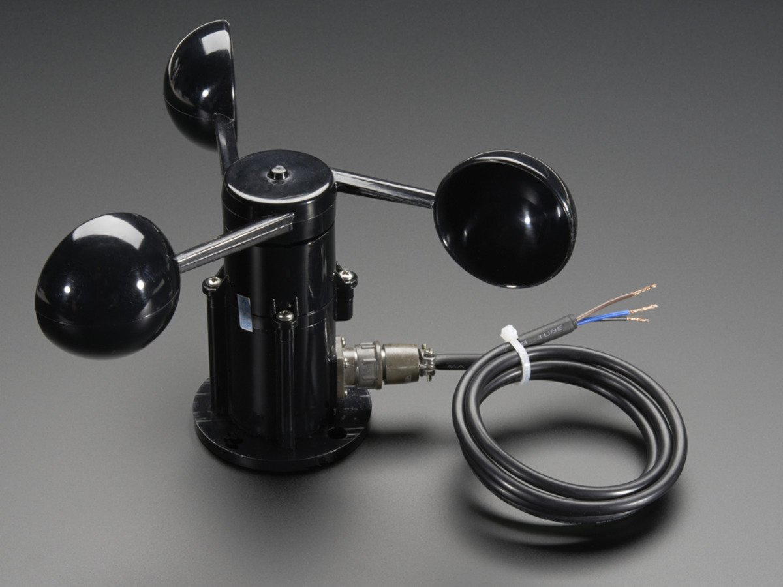
Wind Speed
Adafruit Anemometer
Supply Voltage 5-24V
Analog output
0.4V (0 mph) -2.0V (72 mph)
Every 50 mV ~ 2 mph
Accurate
Within ±1 mph
Durable
Waterproof
Manufacturer | Adafruit
Product ID | 1733
Size | 4” x 5.6”
Cost | $44
Notes:
BRY

Slide 15
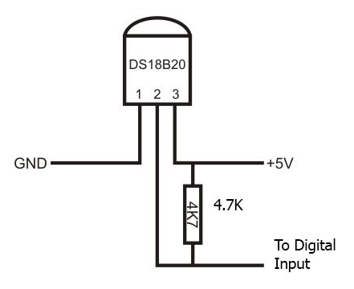
Water and Air Temperature
DS18B20 Digital Temperature Sensor
Wide range, Good accuracy
-55° - 125° C (-67°-257°F)
±0.5° over -10°- 85° C range (±1°F over 50°-185°F)
Simple Implementation
Single data wire
Parasitic Power
Each sensor has a unique 64 bit address
9-12 bit programmable resolution
Able to use for both functions
Available in Waterproof Casing
Manufacturer | Adafruit
Product ID | 381
Size | T0-92
Supply | 3-5.5 V
Cost | $4
Notes:
BRY

Slide 16
Waterproof Configuration
Connecting Wires
Stainless Tubing
Heat Shrink
PVC Coating
Vcc (5V)
0.15”
4.7kΩ
DATA
1.2”
GND
Notes:
BRY

Slide 17
Water Salinity
Design a sensor that measures salt content using light
Laser Diode
Mirror
Quadrant Cell Photodiode
Measure distance moved
Use set voltages to create ranges of salinity
Notes:
MAT

Slide 18
Water Salinity
Supplier | Lightinthebox.com | Edmunds Optics | Mouser Electronics
Part | Laser Diode | Mirror | Quad Cell
Product ID | 02187190 | #46-618 | 718-QP5.8-6-TO5
Size | 6mm x 10mm | 12.5mm Diam | 9.2mm x 3.2mm
Cost | $4.99 | $22.50 | $44.54
Laser Diode
635nm wavelength
Visible light for alignment
Mirror
95% reflection at chosen wavelength
Quadrant Cell Photodiode
1.19x1.19mm Area with 0.50mm Gap
Notes:
MAT

Slide 19
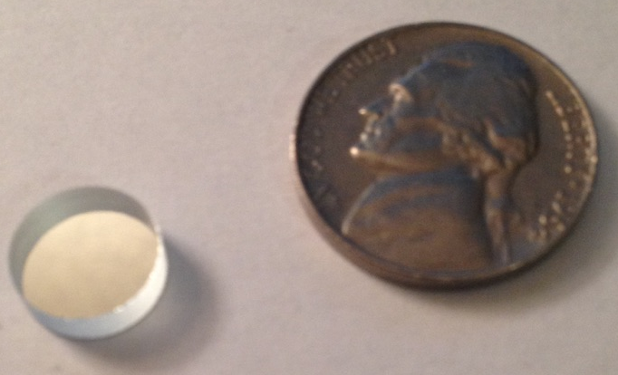
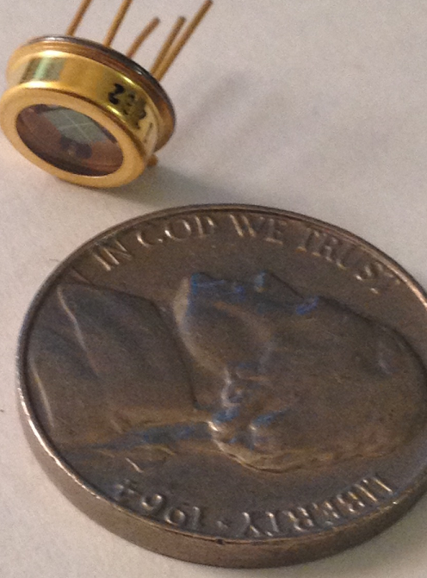
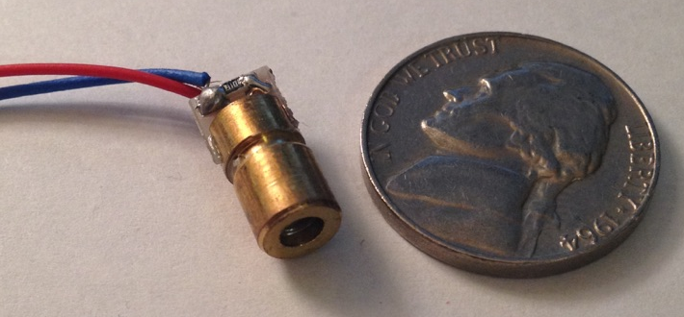
Salinity Components

Slide 20
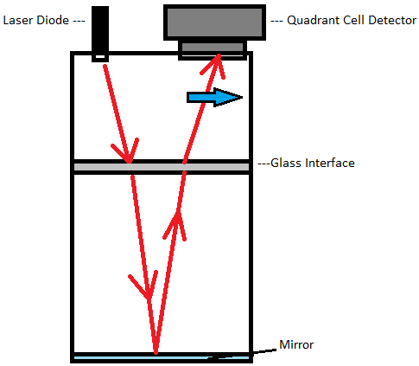
Salinity Sensor Configuration
Notes:
MAT

Slide 21
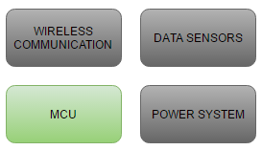
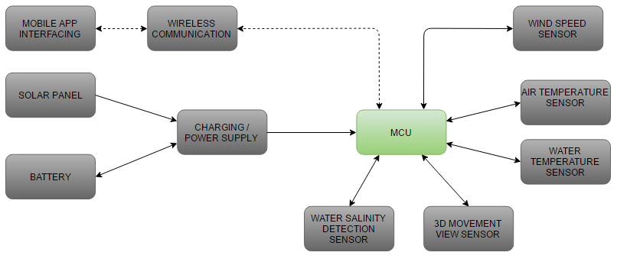
Microcontroller
Notes:
Ju

Slide 22
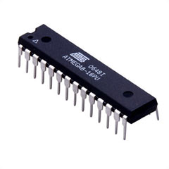
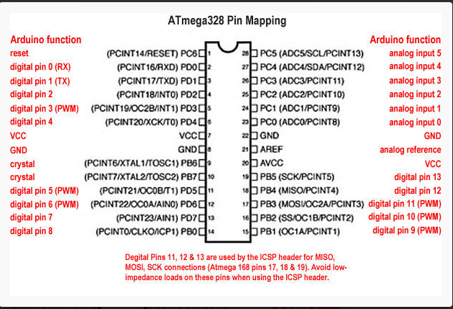
Microcontroller
Atmel ATmega328
Used in Arduino UNO Boards
23 I/O Pins
Low-Power uC
3 Timers (Interrupts)
SPI and I2C capable
Ease of use
Notes:
JU

Slide 23
Software Development
Arduino IDE
Programming Microcontroller in C.
Arduino Libraries.
Adafruit and Dallas-Temperature.
Runs on Windows and MAC OS.
Open Source.
Android Studio IDE.
Android Official Development Environment.
Programming Mobile App in Java .
XML for Android GUI.
Notes:
JU

Slide 24
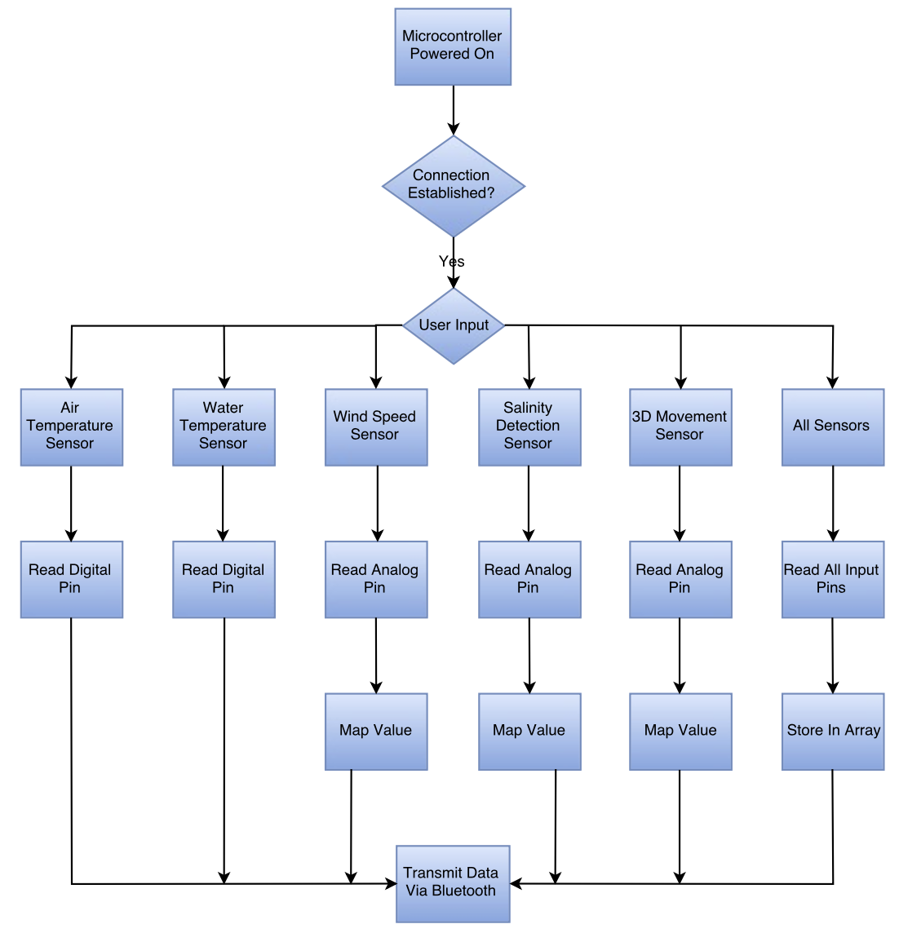
Microcontroller FlowChart

Slide 25
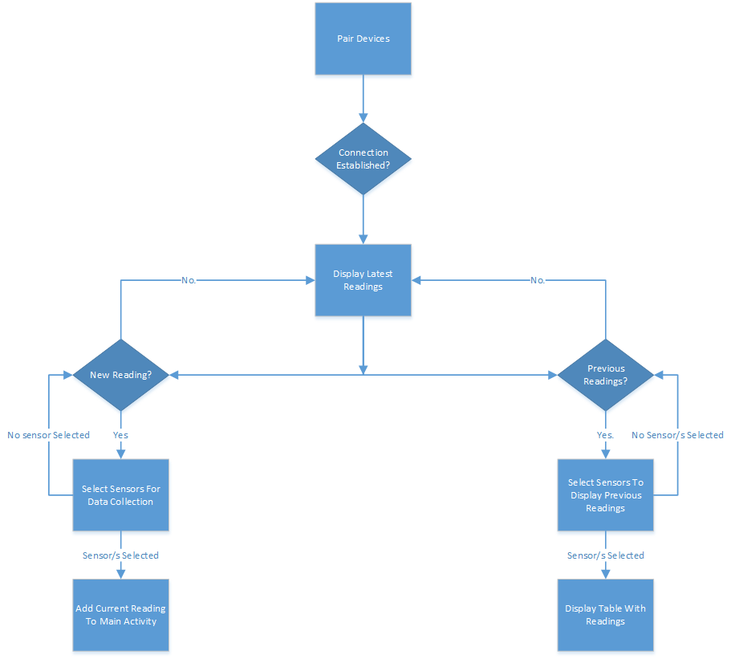
User Interface

Slide 26
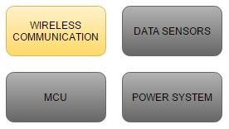
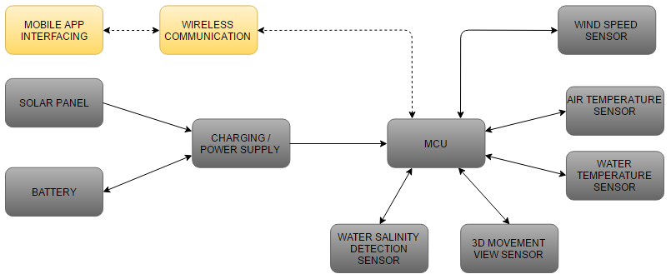
Wireless Communication
Notes:
JULI

Slide 27
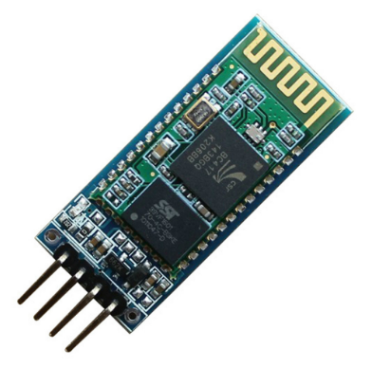
Wireless
HC-06 Bluetooth Module
Inexpensive.
Ease of Use.
Master and Slave Mode.
Low-Power Consumption.
Range up to 30ft
Perfect for in the field research.
Supplier | Ebay
Size | 0.6” x 1.7”
Vcc | 3.3-5 V
I/O pins | 4 (Vcc, Gnd, Tx, Rx)
Cost | $4
Notes:
JUL

Slide 28
Printed Circuit Board
Notes:
BRY

Slide 29
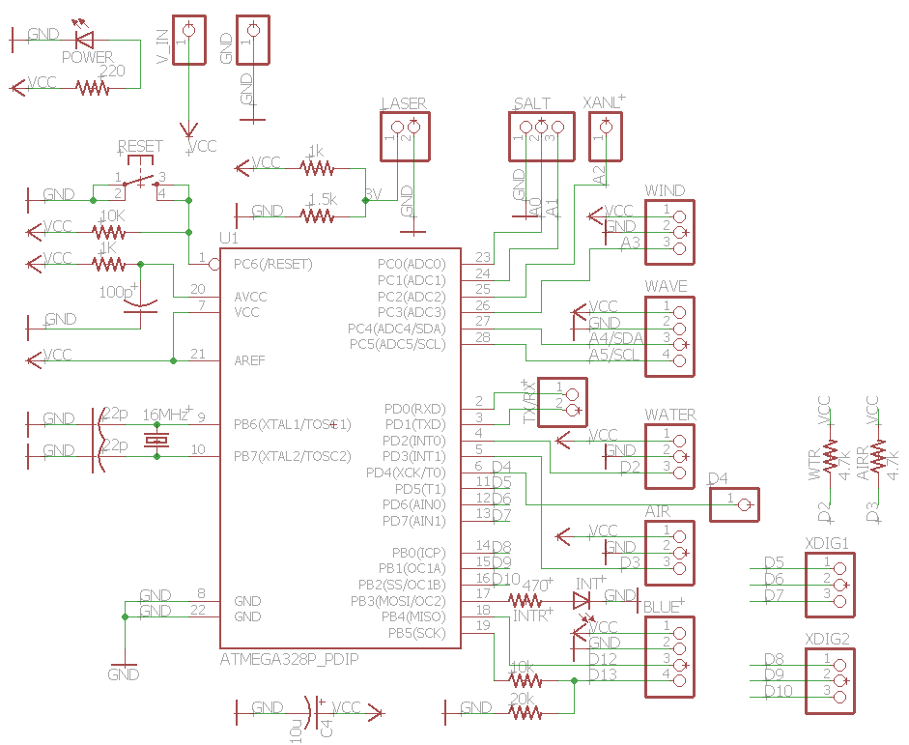
Schematic
EAGLE
ATmega328
Headers for Sensors
LED’s for power and
Wireless connection
Notes:
BRY

Slide 30
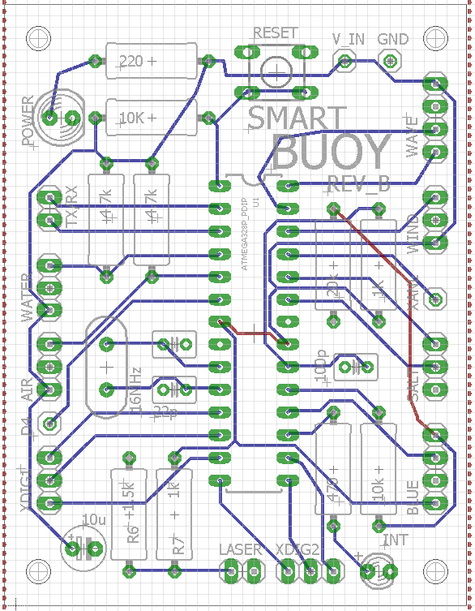
Eagle Board
Second Revision
5.2 cm x 7.3 cm
Few vias
Ordered from Elecrow
10 5x10cm for $11
Fast Shipping
Notes:
BRY

Slide 31
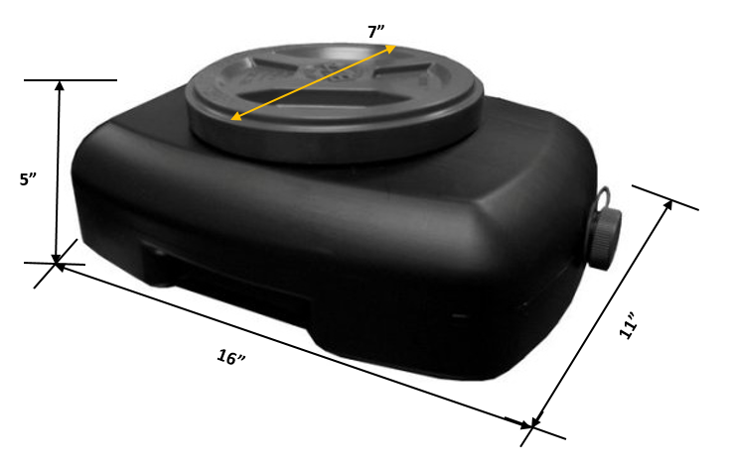
Buoy Housing
Oil disposal container
Wal Mart
Water tight
Durable
Small Design
Large enough to house
all components
Notes:
DANI

Slide 32
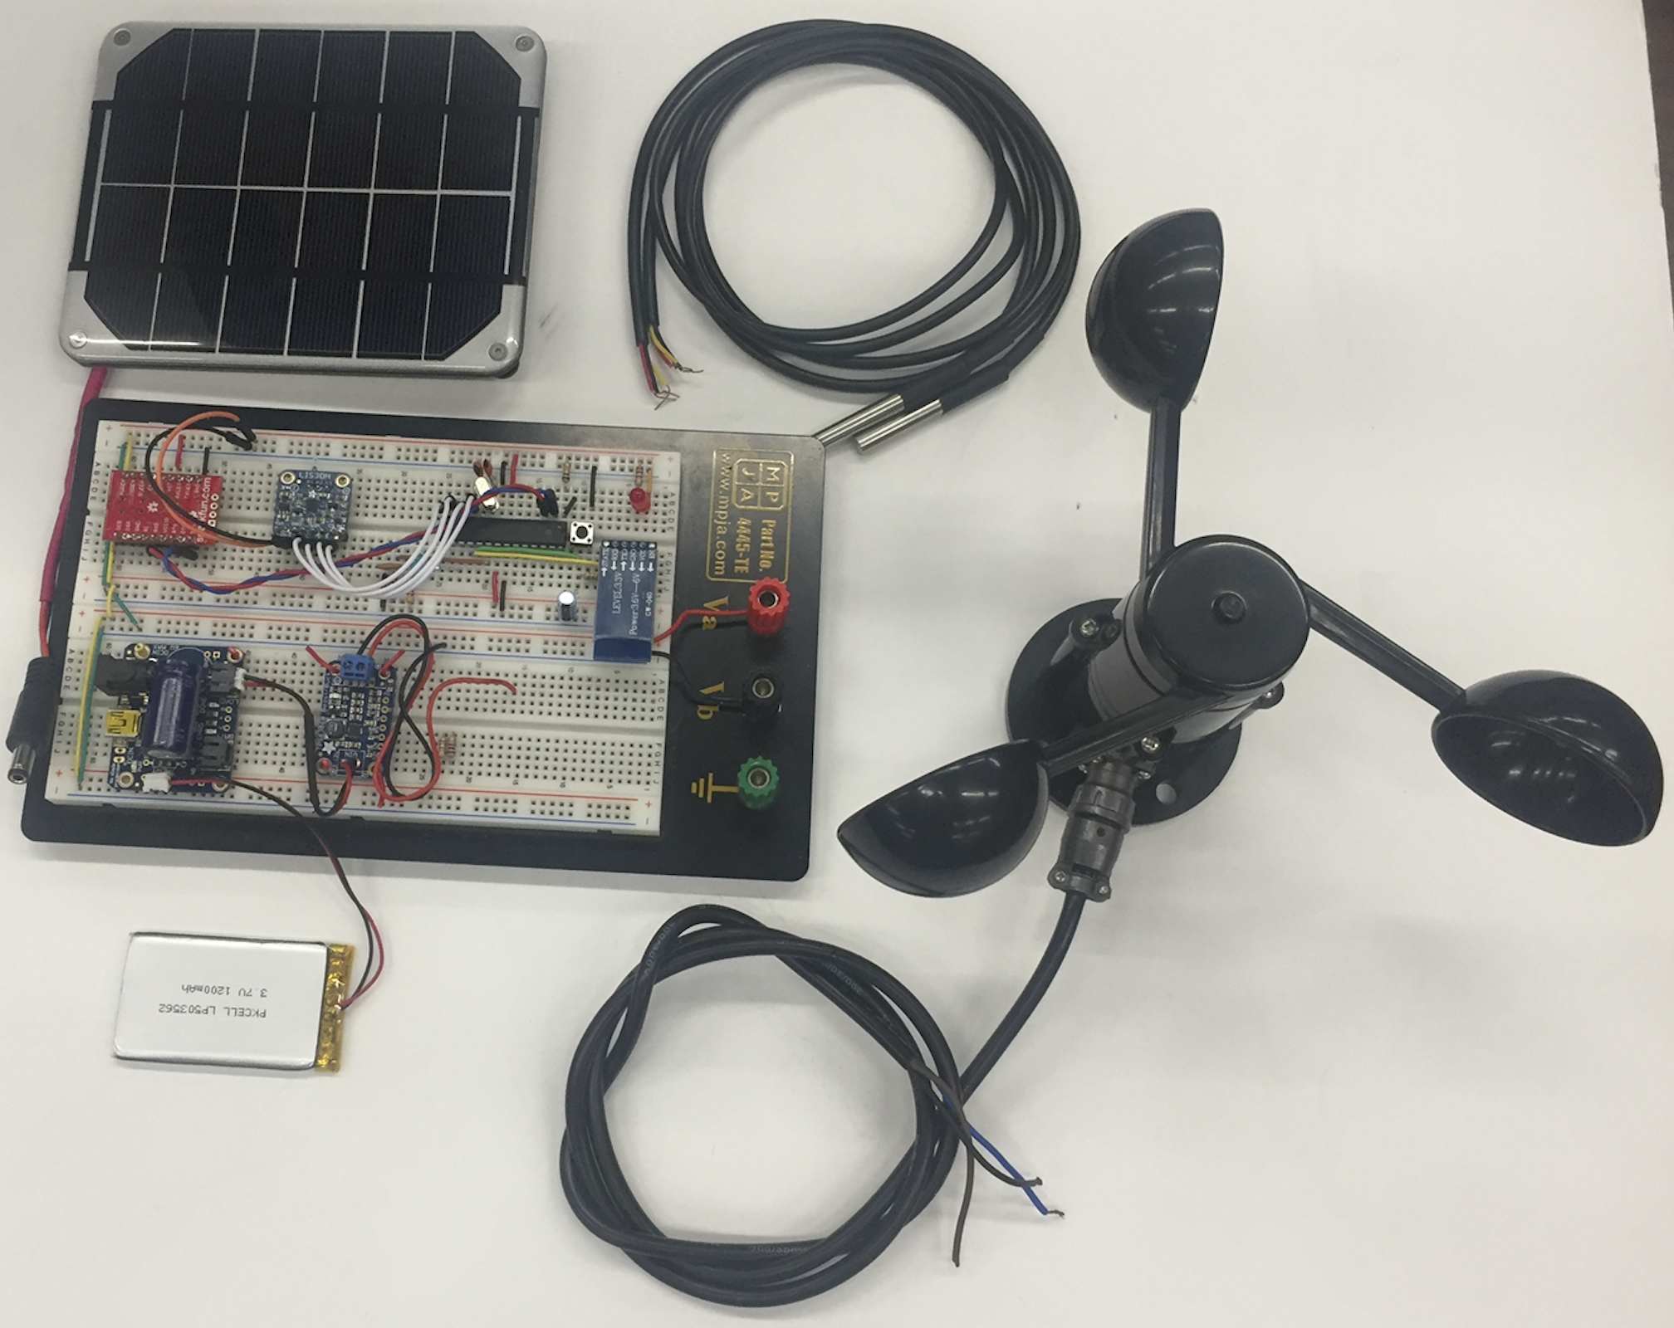
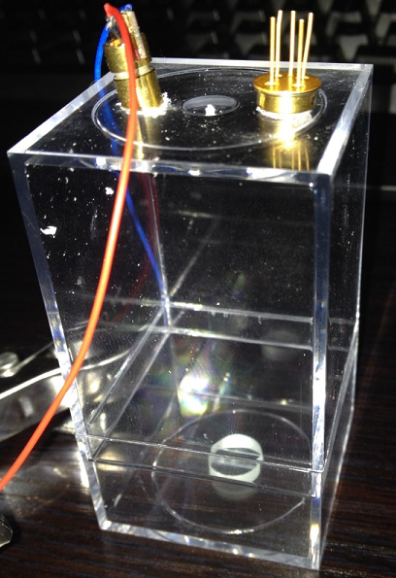
Prototyping
Notes:
DAN

Slide 33
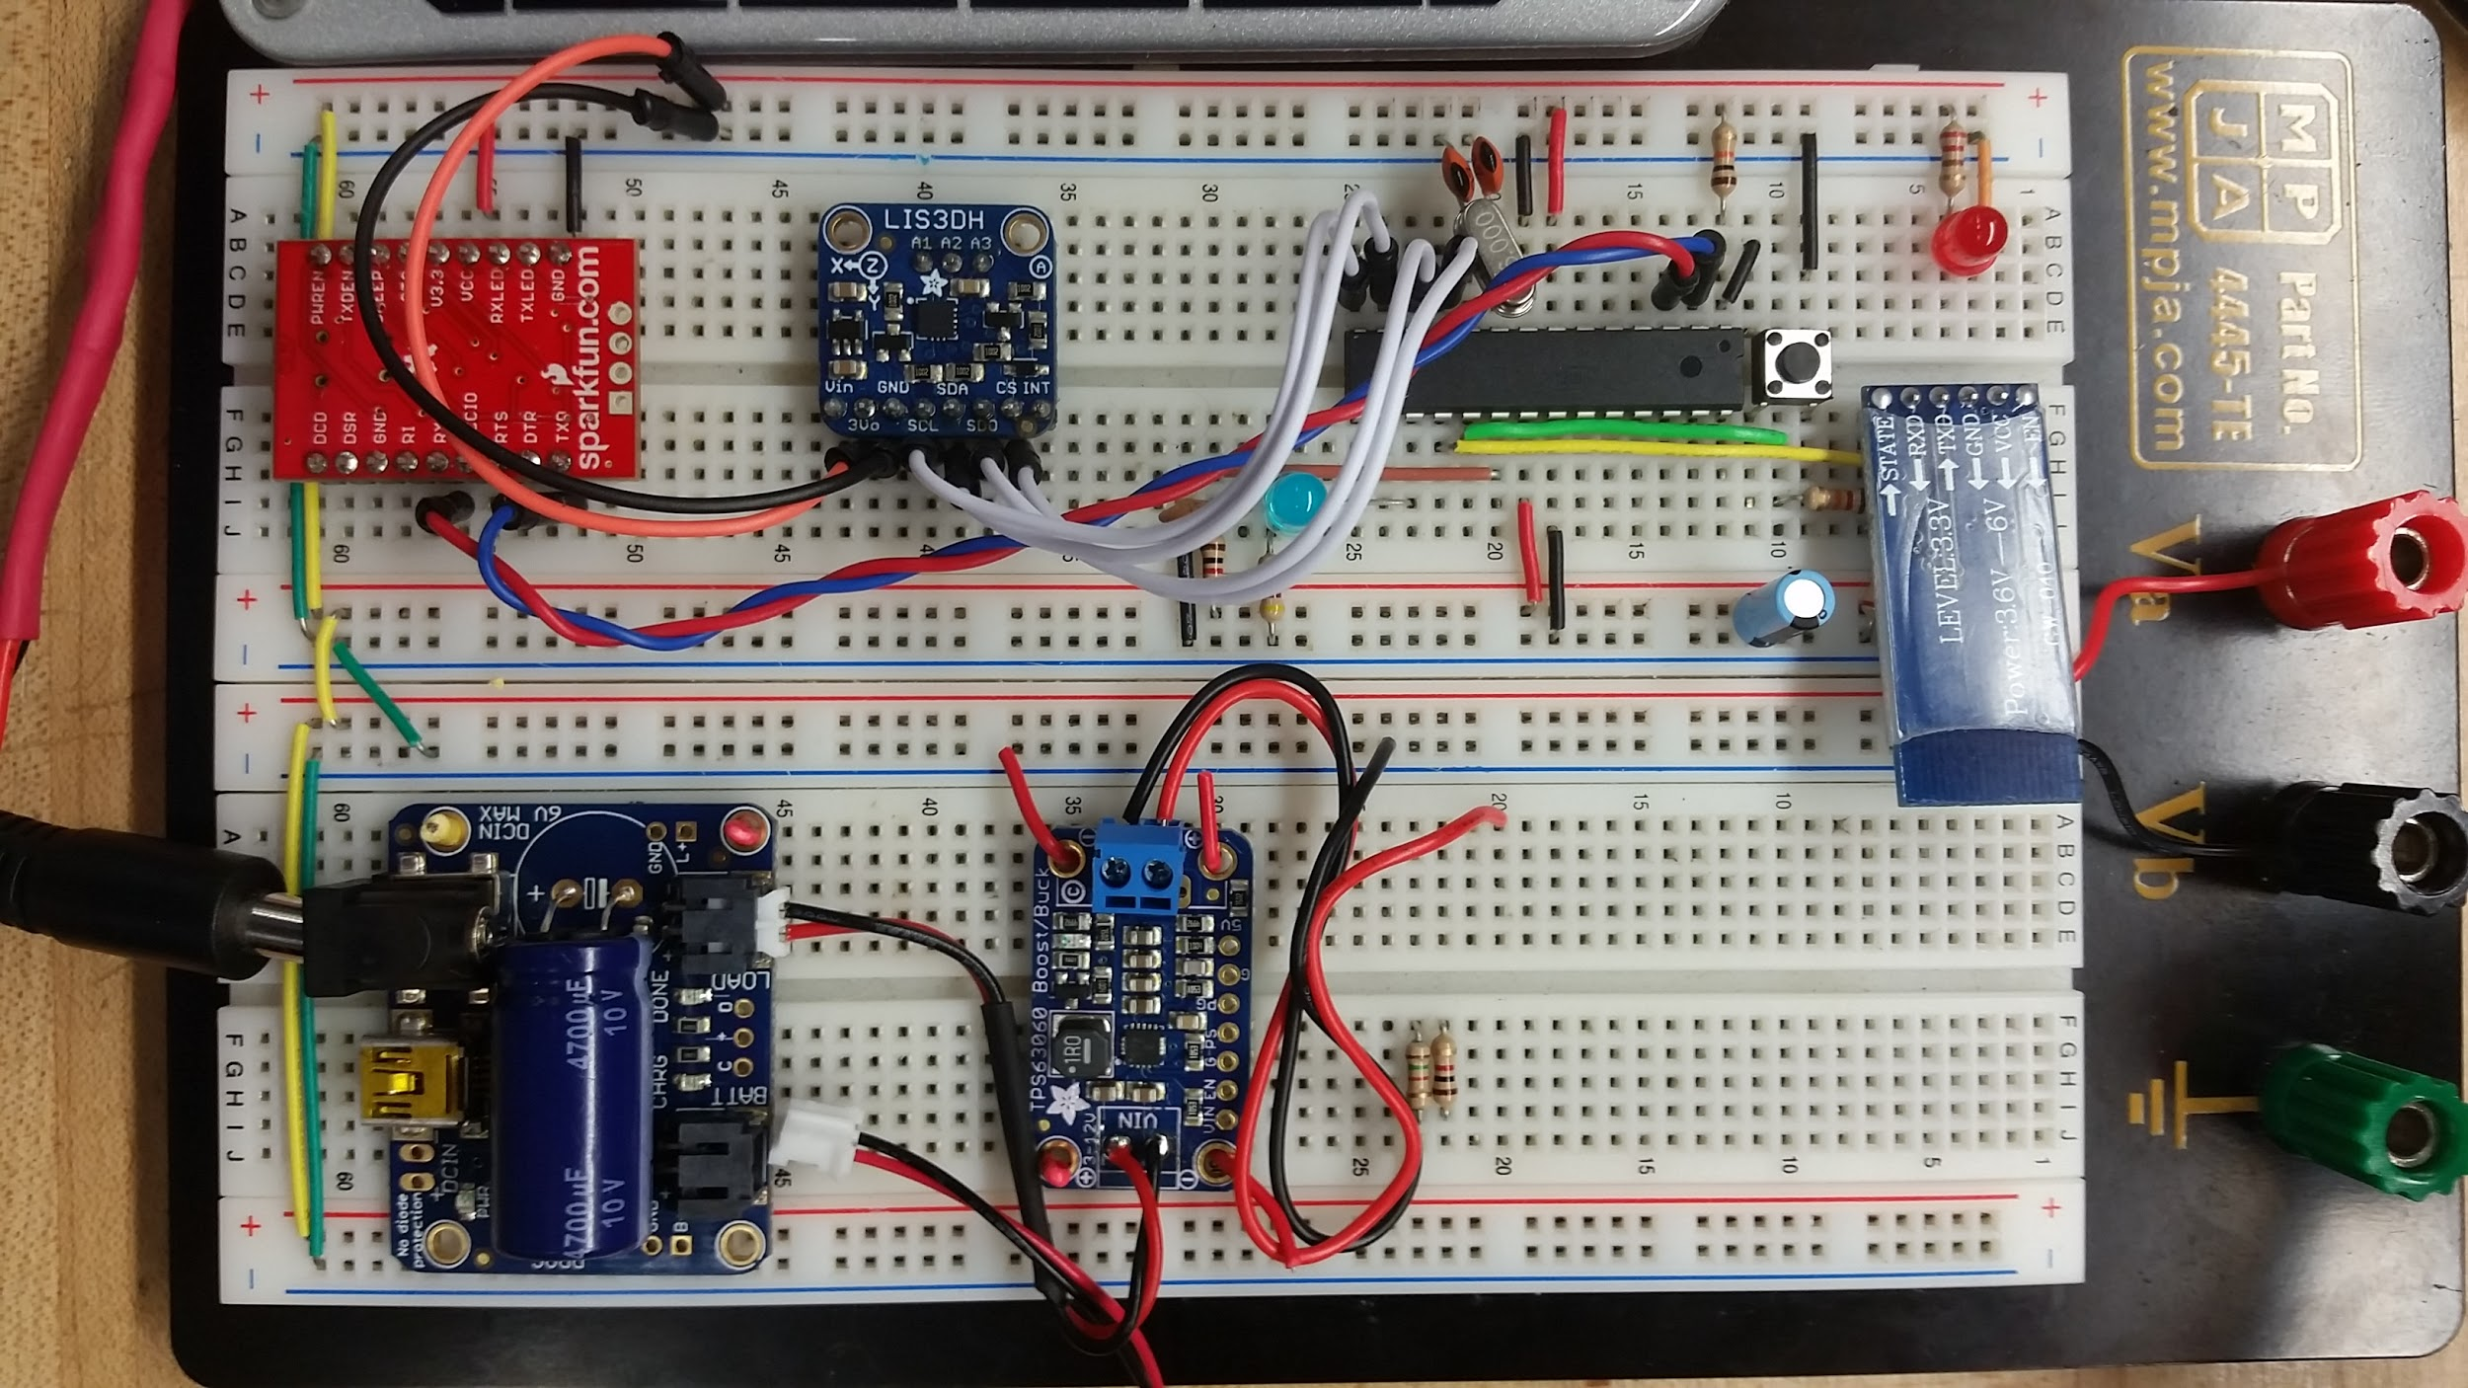
Breadboard Overview
Accelerometer
MCU
ATmega328p
Wireless
HC-06
LiPo Battery Charger
Buck Converter
Notes:
DAN

Slide 34
Administrative Content
Notes:
MAT

Slide 35
Work Distribution
Notes:
MAT

Slide 36
Financing
Self Financed
Initial budget of $100 per team member
Using as much personal inventory as possible
Notes:
MAT

Slide 37
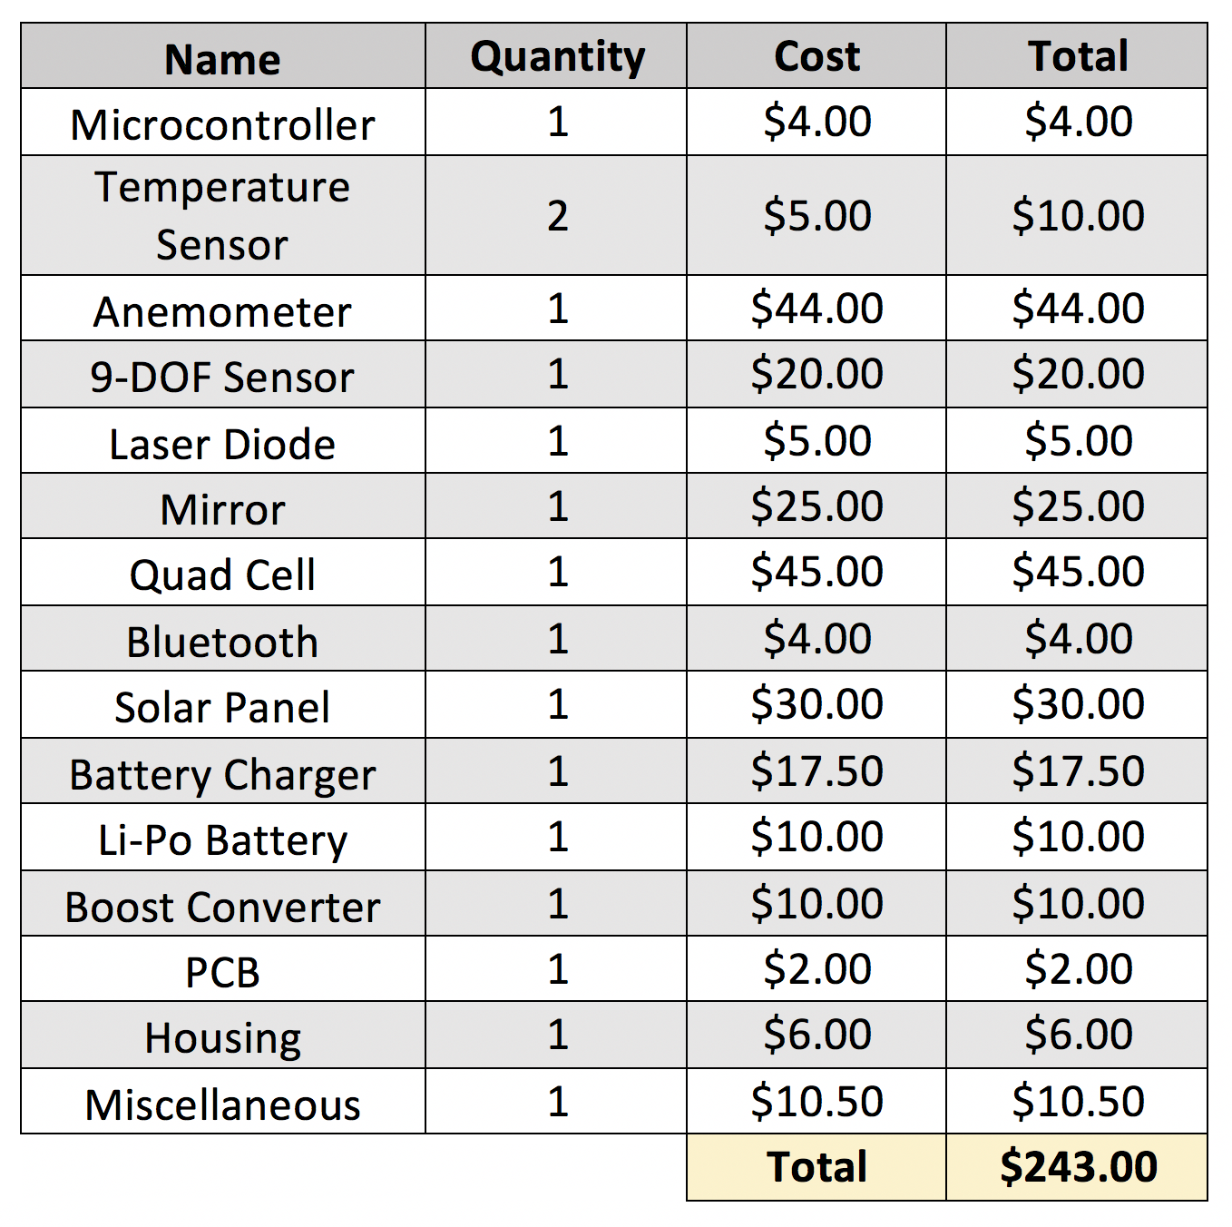
Budget
Notes:
MAT

Slide 38
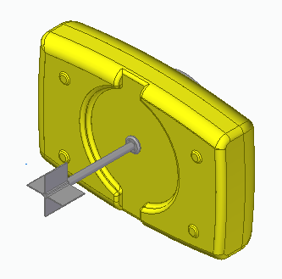
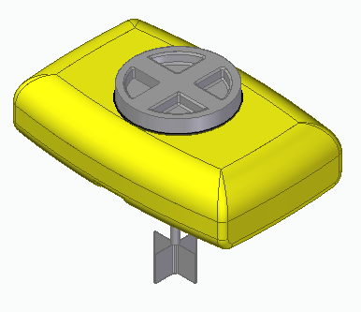
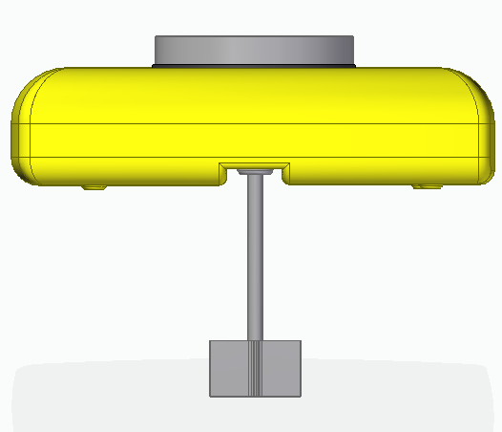
Future Development
Adding a counter-balance for use in rougher waters.
*Drawn using Solid Edge

Slide 39
Issues
Notes:
MAT

Slide 40
Questions?

