Slide 1
MAGLEV
Critical Design Review
Group 2
Julio Arias
Sean Mawn
William Schiller
Leo Sell

Slide 2
Motivation
Increase awareness of related technology
Clean technology
Next step in land transit evolution

Slide 3
Motivation
Speed

Slide 4
Specifications
9V power source
2x 2’ track straightaways
2x 1’ curved sections w/ 90 ° angle of curvature
150+ N45 – N50 grade NdFeB drive and levitation magnets.
3x A1301 Hall – effect sensors
RN-42 Bluetooth module
Android mobile device
3x Solenoid constructs
7”x 7” vehicle

Slide 5
Goals and Objectives
Main goal is to demonstrate a mechanically frictionless method of transportation using magnets.
Three objectives
Magnetic levitation
Magnetic propulsion
Wirelessly controlled

Slide 6
Levitation
Passive design
Two rails North and South
Opposing polarity rails to minimize motor gap magnetic field interference.
Each rail is constructed of non-conductive material and fitted with 2” x ½” x 3/16” N45 grade Neodymium magnets
Levitation achieved through like-pole repulsion

Slide 7
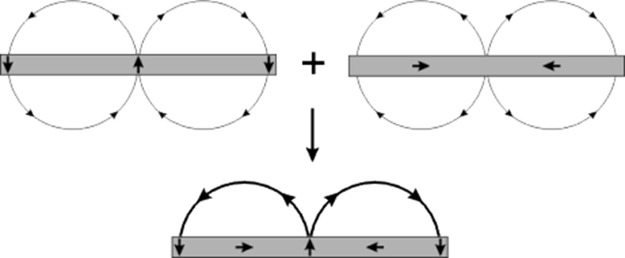
Propulsion – The Halbach Array
Propulsion will be achieved by fitting the sides of the track with alternating polarity “drive” magnets with spacer magnets to reinforce and direct magnetic field.

Slide 8
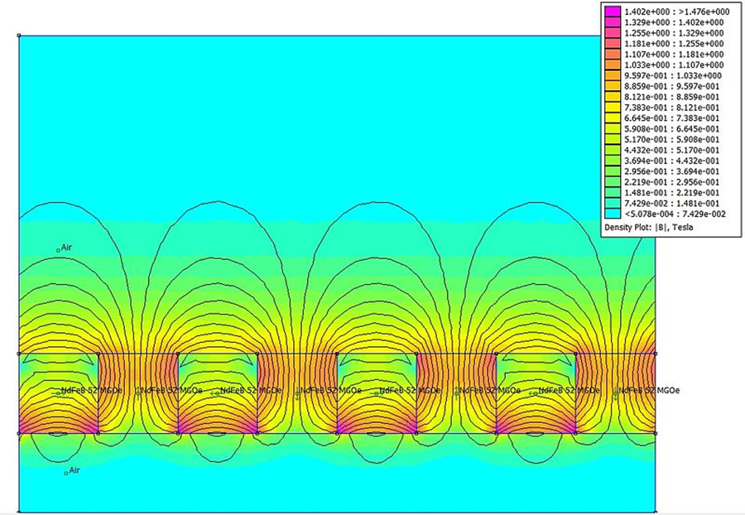
Halbach Array cont.
Field on the other side of the Halbach field is reduced to near zero
By directed the field towards the motor gap in the track, the solenoid motor is saturated by the drive magnet field

Slide 9
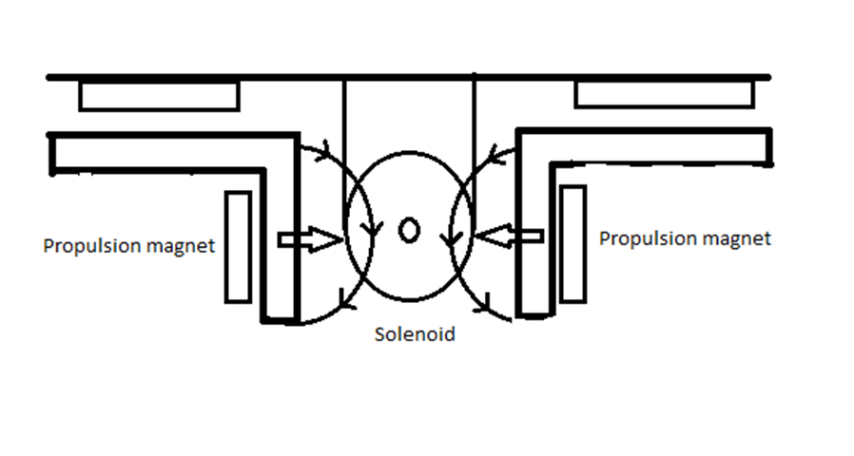
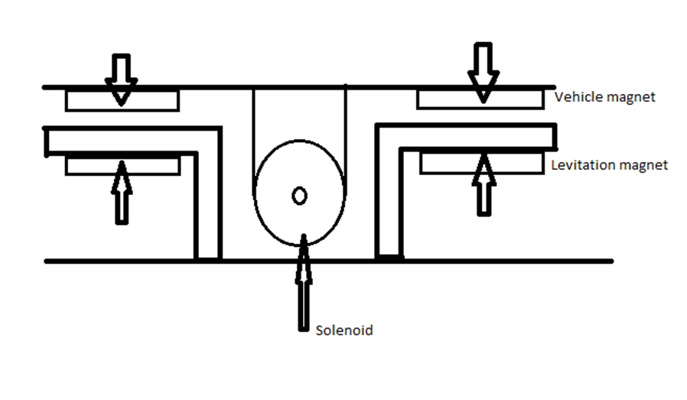
Ideal Maglev configuration
Sides of the vehicle outfitted with identical polarity magnets as track.
Like-polarity creates repulsion.
Solenoid sits in the center of the motor gap of track.
Sides of track lined with drive magnets and amplifying magnets.

Slide 10
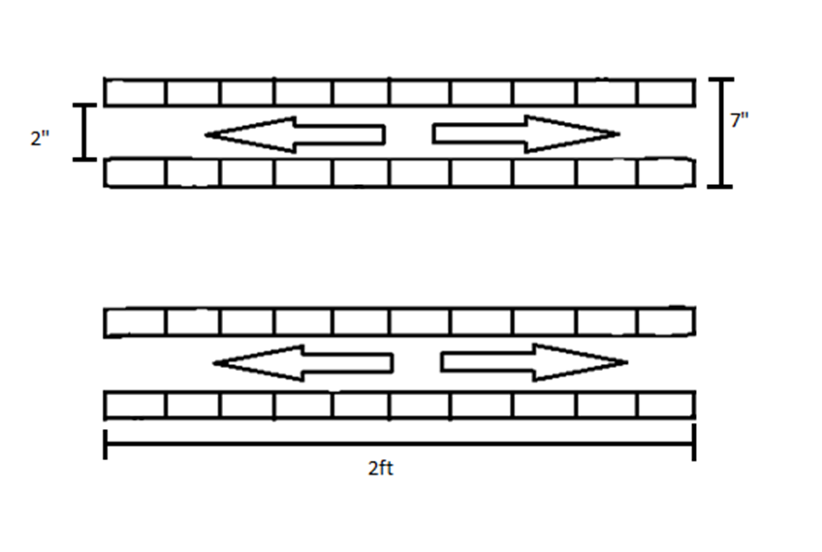
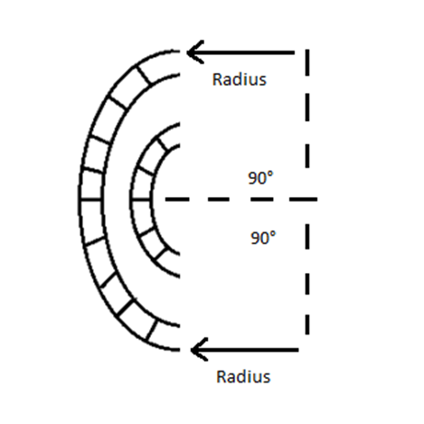
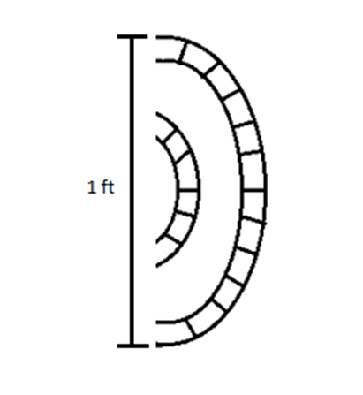
Ideal Track
2ft straightaways made from non conductive material with 7” width and 2” motor gap
Curved sections of 1’ diameter with angle of curvature = 90°

Slide 11
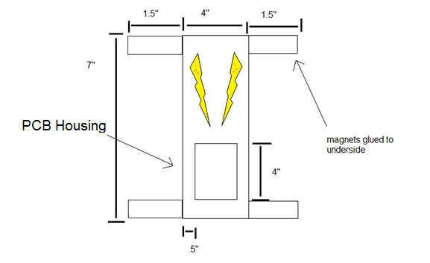
Vehicle
4 Neodymium rectangular N45 magnets (glued to underside of four corners)
Roughly 7’’ x 7’’ dimensions
Aluminum channel underside houses three solenoids and hall effect sensors.
PCB on top side of vehicle

Slide 12
Hardware Block Diagram
Solenoids
ATmega328
H-Bridge IC’s
Hall Effect Sensors
9V Battery
Android App
5 Volt regulator
3.3 Volt regulator
Bluetooth

Slide 13
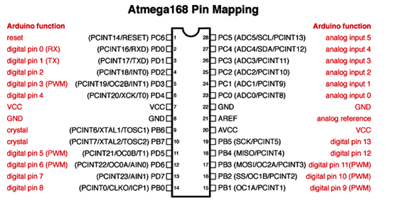
MCU
Atmega328P same pin mapping as 168
Sensors use 3 analog inputs (5 analog inputs total)
H-Bridge’s use 9 Digital I/O’s (14 total, 2 reserved for serial connection)
16 MHz crystal
Programmed using a Breakout Board for FT232RL USB to Serial

Slide 14
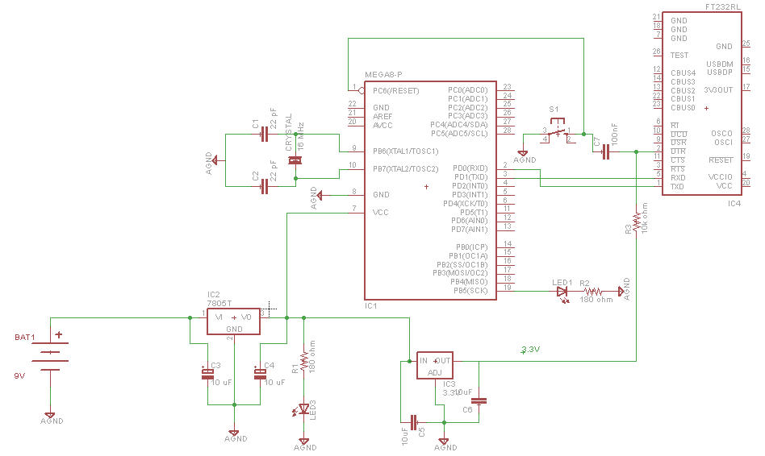
MCU Circuit Design

Slide 15
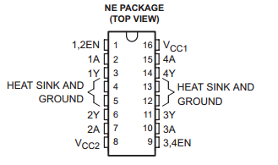
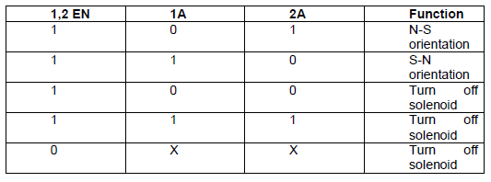
H-Bridge IC Usage
TI SN754410
4.5V – 36V operating range
1A output-current per driver
3 state outputs
Cost: $2.35 ea

Slide 16
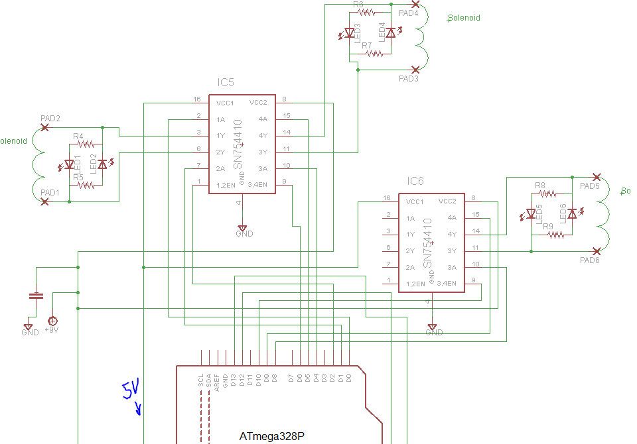
H-Bridge Hardware Interface

Slide 17
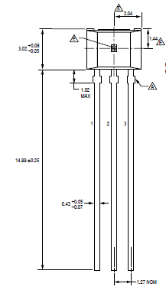
Hall-Effect Sensors
Linear Vs. Bi-Polar
  We decided on Linear sensors due to more control.
Allegro A1301 IC
  Converts magnetic field readings into output voltages
  VCC 5V
  Field sensitivity rating of 2.5mV/G
  Output voltage range 0 – 5 V
    Half of VCC - 2.5V when no magnetic field present
    5V when adjacent to S-Pole magnet
    0V when adjacent to N-Pole magnet

Slide 18
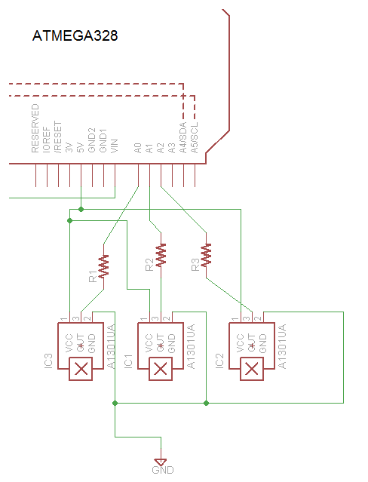
Sensor Hardware Interface
Hall-Effect sensors interface directly to the ATmega328 Analog I/O pins.

Slide 19
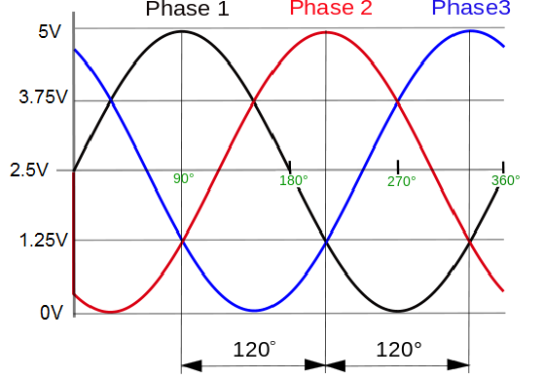
Three - Phase Drive system
Sensor orientation sends a three phase voltage signal back to MCU
Ideally 120 degrees apart
Each phase represents one sensor coupled with a solenoid
Sensor output voltage ranges depict solenoid polarity

Slide 20
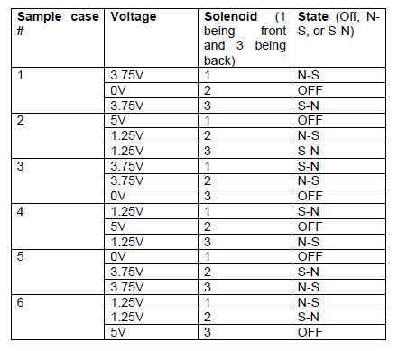
Ideal Drive System Test Cases

Slide 21
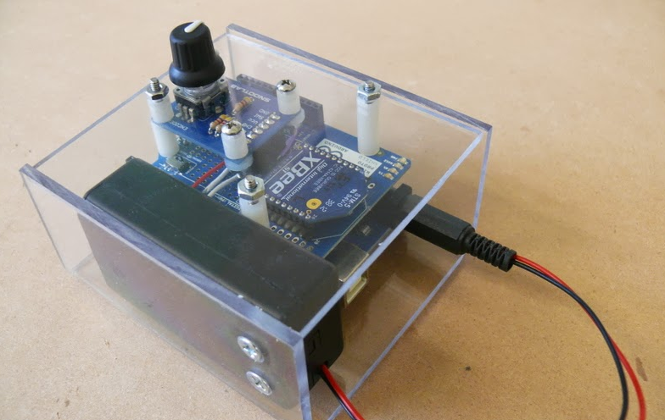
Controlling the System
Analog Controller
Arduino Uno R3 (MakerShed # MKSP11, Sparkfun # DEV-11021)
Arduino Wireless Protoshield (Maker Shed # MKSP13)
XBee Series 01 802.15.4
Wireless Module (Maker Shed # MKAD14)
SnootLab Encoder
9V Battery (logic)
Jumpers of various lengths
Approximate Cost = $75.00

Slide 22

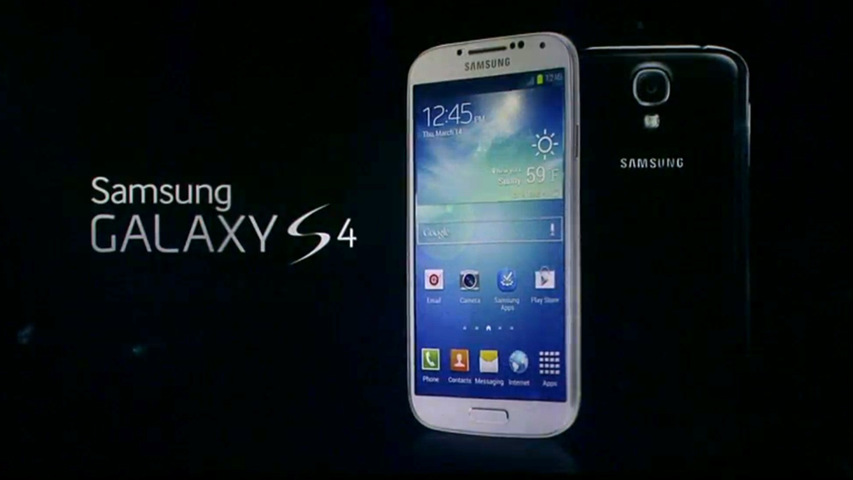
Controlling the System
Smartphone Controller
Application Development
Bluetooth/Wifi Capability
Approximate Cost =$0.00

Slide 23
Android vs IPhone
Developing | IPhone | Android
Machine | MAC/Apple Laptop only | Any laptop (HP, Leneovo, Asus, MAC, Toshiba, etc.)
Environment | XCode only | Eclipse, Netbeans, Intellij, etc.
Cost | $99.00 Developer Fee | $00.00
Programming Language | Objective-C | Java
Interfacing with Peripherals | Apple Only devices | Any viable device

Slide 24
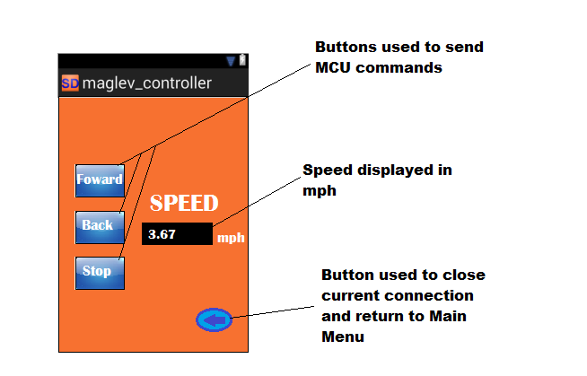
User Interface

Slide 25
Tracking the speed
  Distance will be calculated by the vehicle’s MCU
  Time will be measured by an internal System timer
  Speed will be calculated and displayed in the user interface
-new CountDownTimer(30000, 100)
-System.nanoTime()

Slide 26
Testing Application with Bluetooth Module and MCU
Ex:
Set up an LED on port 8 of Microcontroller
Set port to output
Set port to High when value read from smartphone remote
Establish Connection through Android App
Send integer through button press
Analyze correct output

Slide 27
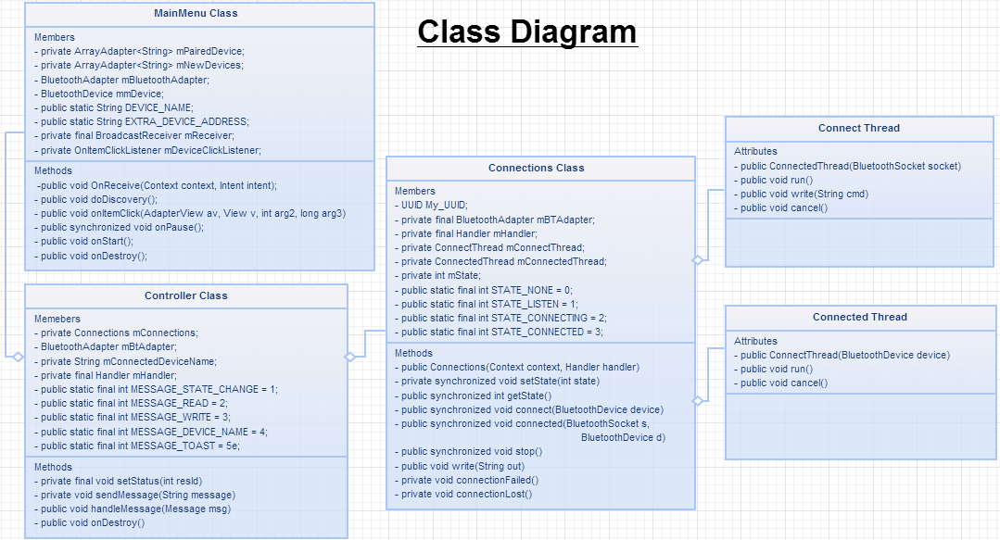

Slide 28
Microcontroller Diagram
Bluetooth
Hall Effect Sensors
ATmega328
Android App
H-Bridge IC’s

Slide 29
Microcontroller Signals
Input: A1,A2,A3 (From Allegro A1301 )
Input: D12,D13,D14 (From RN-42)
Output: D0-D2 (To TI SN754410 #1)
Output: D4-D6 (To TI SN754410 #2)
Output: D8-D10 (To TI SN754410 #3)

Slide 30
Class Diagram - MCU
Main
App_Direction: Int App_Speed: Int HesVal: float LED_val: int Magnet_count: int
get_direction() get_speed() LED_Show() Movement() Count_mag() Calc_Speed()
Movement
HesVal: float Hes_compare:float HES_previous: float Dig_out: int Pass_N: int Pass_S: int Aligned: int Clockwise:int
Get_HesVal() save_Hes() Calc_Dout() Delay() Brake() Move()

Slide 31
MCU Movement Control
Determine signaled speed and direction
Determine value of Hall effect sensors
Based on Value of HES sensors, determine solenoid polarity
Set outputs to values needed in order to achieve correct polarity
Loop until the speed and direction signal changes.

Slide 32
Input Output expectation
App_Direction | App_Speed | MCU result
0 | 00 | STOP
0 | 01 | Counterclockwise speed 1
0 | 10 | Counterclockwise speed 2
0 | 11 | Counterclockwise speed 3
1 | 00 | STOP
1 | 01 | Clockwise Speed 1
1 | 10 | Clockwise Speed 2
1 | 11 | Clockwise Speed 3

Slide 33
MCU HES Usage
Example Code
for(;;) HES_1 = Get_HES(A1); if(HES_1 > 4.95) Pass_S=1; // Solenoid just // passed S Magnet Break; if(HES_1 <0.05) Pass_N=1; // Solenoid just // passed N Magnet Break; if(Pass_S=1) Dig_out0 = 0 // Sets solenoid Dig_out1 = 1 // to N-S if(Pass_N=1) Dig_out4 = 1 // Sets solenoid Dig_out5 = 0 // to S-N
After the HES reads 5V it has just passed a S polarized magnet
After the HES reads 0V it has just passed a N polarized magnet
Until the HES reads 2.5V, the solenoid will be oriented opposite of the magnet it just passed.

Slide 34
Possible MCU HES Usage
Multiple Test Cases
More memory and coding
More reliable

Slide 35
Braking and speeds
In order to brake, the solenoids will be set to the same polarity as the nearest magnet
Different speeds will be adjusted in the timing for the solenoids to be changed.
Using less solenoids at one time to create less pull

Slide 36
Counting Magnets
Whenever the HES passes 5V or 0V the MCU will increase a counter
The counter keeps track of the distance the car has traveled.
We keep track of the distance in order to determine speed and position.

Slide 37
Administrative Content
Project Progress
Budget and Financing
Work Distribution
Issues

Slide 38
Project Progress

Slide 39
Budget and Financing

Slide 40
Work Distribution
 | Track Design | Vehicle Design | MC Coding | Remote Controller | Circuit Design
Julio Arias |  |  |  | X
Leo Sell |  |  | X
Sean Mawn | X | X
William Schiller |  | X |  |  | X

Slide 41
Issues
Originally planned Circular track design was not be feasible for our team due to budget and costs
Manual variable speed wasn’t implemented due to final track length
Working with magnets presented magnetic interference issue in testing affecting circuit, power, and Bluetooth Module Connection

Slide 42

Questions

