Slide 1


Eco-Sense
Group 7:
Neil Northcutt
Jamie Olheiser
Daniel Haggerty

Slide 2
Eco-Sense
System to automate the lawn watering process through the use of
  Climate sensors
  Ground sensors
  Weather prediction
Three subsystems
  Sensor subsystem
  Central HUB subsystem
  Solenoid subsystem

Slide 3
Goals/Motivation
Conserve water by reducing the wasteful watering of traditional watering methods
  Hand watering
  General sprinkler system
  Timer, automated system
Promote a healthier, greener lawn

Slide 4
Hardware Specifications
Component | Parameter | Specification
Wireless Module | Range | 20ft to 1 mile
Sensors | Voltage | 3.3 or 5 V
Microcontroller | Power consumption Storage RAM/Flash Clock Speed I/O Pins | <10mW sleeping, <50mW on 128B+, 8kB+ 8 MHz 4+ Analog, 5+ Digital
Sensor Node | Power consumption | <50mW sleeping, <300mW on
Temperature Sensor | Sensing Range | 0°F to 120°F.
Humidity Sensor | Accuracy | <± 5%
Pressure Sensor | Accuracy | <± 5 hPa (mB)

Slide 5
Water Efficiency

Slide 6
Water Efficiency
Primary goal of Eco-Sense
Reduce the waste of water by not watering under certain climate conditions
  Soil Moisture
  Temperature
  Humidity
Allows watering only when rain is not predicted

Slide 7
When to Water Algorithm
Within USWT limits?
Soil Field Capacity below 75%?
Temperature below 5˚C?
Sensor
Data
Yes
Yes
No
No
Yes
No
Water
Do Not Water
Temperature above 32˚C
Yes
No
No
Yes
No
Raining/Rain detected soon?
Humidity below 50%?
Temperature above 25˚C?
USWT: User Specified watering times.
Yes
Yes
No

Slide 8
Weather Prediction
Not an exact science
Uses barometric pressure, temperature, and humidity sensors
Most weather prediction algorithms are proprietary so we had to create our own

Slide 9
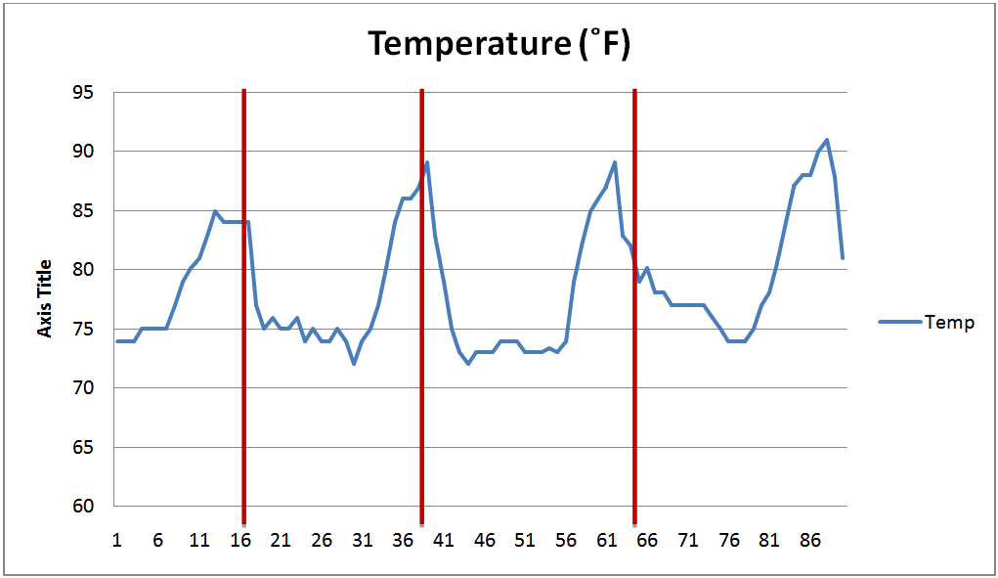
Weather Prediction - Temperature
Generally, temperature increases before the onset of rain (red lines)

Slide 10
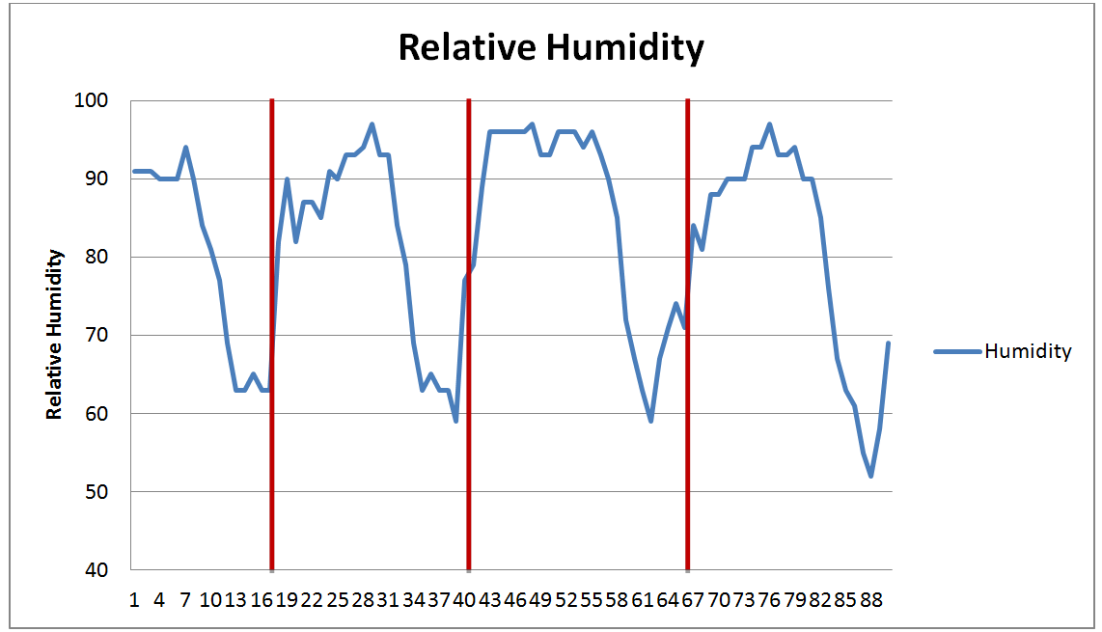
Weather Prediction - Humidity
Generally, relative humidity rises before the onset of rain

Slide 11
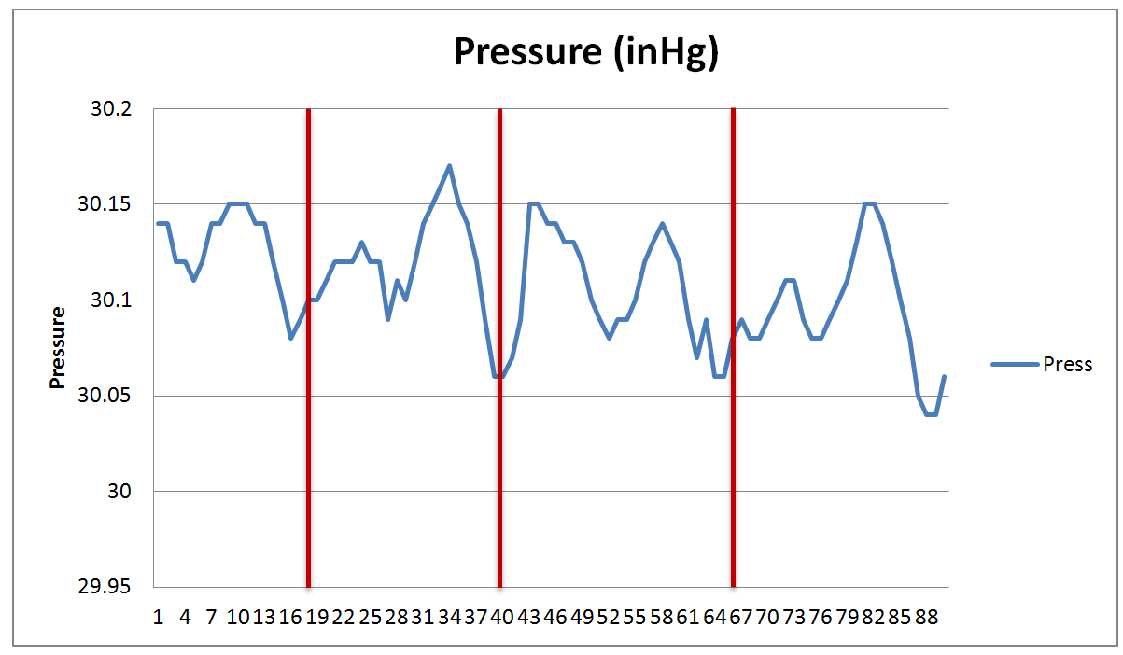
Weather Prediction - Pressure
Generally, barometric pressure drops before the onset of rain

Slide 12
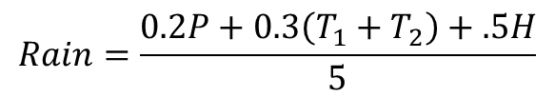
Weather Prediction Algorithm
$$Rain=\frac{0.2P+0.3\left(T_{1}+T_{2}\right)+.5H}{5}$$
When Rain is above 0.4 a rain storm is predicted in the next hour
  70% rain prediction
  15% false prediction of rain
This algorithm was developed from over 200hrs of Orlando weather data
Notes:
After several attempts to create an algorithm to detect the onset of rain, we eventually settled on an algorithm that assigns weighted values on the slope or change of each of the three parameters measured.

Slide 13
Hardware

Slide 14
Solenoid S.S.
Sensors S.S.
Transmitter
Receiver
Micro-Controller
Solenoid
Rain Detection
Sensor
Barometric Pressure Sensor
Ambient Temp.
Sensor
Power Source
Humidity
Sensor
Micro-Controller
User Interface
Transmitter
Receiver
Ground Moisture
Sensor
Transmitter
Receiver
Micro-Controller
LCD Display
Power Source
Power Source
Central HUB S.S.

Slide 15
Humidity Sensor
Measures the absolute humidity of the surroundings.
Used for weather prediction and when to water algorithms
Needs to be exposed to the elements for accurate readings

Slide 16
Humidity Sensor
Part | Supply Voltage | Current | Humidity Range | Accuracy | Shutdown Current | Cost
DHT11 | 3 to 5.5 V | 0.5 to 2.5mA | 20 - 90% | ± 5% | 100μA | $5
DHT22 | 3 to 5 V | 0.5 to 2.5mA | 0 to 100% | ± 2% | 40-50μA | $15
SHT10 | 2.4 to 5.5 V | 28μA | 0 to 100% | ± 4.5% | 1 to 2μA | $20
SHT11 | 2.4 to 5.5 V | 28μA | 0 to 100% | ± 3% | 1 to 2μA | $30
SHT15 | 2.4 to 5.5 V | 28μA | 0 to 100% | ± 2% | 1 to 2μA | $35
HH10D | 2.7 to 3.3 V | 120 to 180μA | 0 to 99% | ± 3% | - | $10
HIH-4000 | 4 to 5.8 V | 200 to 500μA | 0 to 100% | ± 3.5% | - | $20
HIH-4030 | 4 to 5.8 V | 200 to 500μA | 0 to 100% | ± 3.5% | - | $18

Slide 17
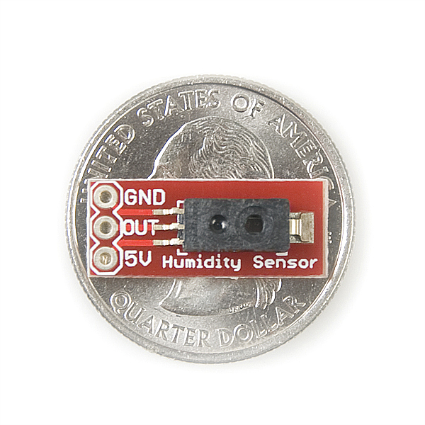
Humidity Sensor
Inexpensive breakout board
Good power usage
Reasonable sensor accuracy
.75 inch
.3 inch
HIH-4030

Slide 18
Solenoid S.S.
Sensors S.S.
Transmitter
Receiver
Micro-Controller
Solenoid
Rain Detection
Sensor
Barometric Pressure Sensor
Ambient Temp.
Sensor
Power Source
Humidity
Sensor
Micro-Controller
User Interface
Transmitter
Receiver
Ground Moisture
Sensor
Transmitter
Receiver
Micro-Controller
LCD Display
Power Source
Power Source
Central HUB S.S.

Slide 19

Rain Detection Sensor
Detects the presence of rain
Used for when to water algorithm and shutting off watering if rain starts
Uses a PCB board and resistivity properties
2 Inch
3 Inch

Slide 20
Solenoid S.S.
Sensors S.S.
Transmitter
Receiver
Micro-Controller
Solenoid
Rain Detection
Sensor
Barometric Pressure Sensor
Ambient Temp.
Sensor
Power Source
Humidity
Sensor
Micro-Controller
User Interface
Transmitter
Receiver
Ground Moisture
Sensor
Transmitter
Receiver
Micro-Controller
LCD Display
Power Source
Power Source
Central HUB S.S.

Slide 21
Barometric Pressure Sensor
Measures ambient pressure caused by weather patterns
Used with the weather prediction algorithm
Needs to be exposed to the elements
Part | Supply Voltage | Average Current | Pressure Range | Accuracy | Shutdown Current | Cost
BMP085 | 1.8 to 3.6 V | 3 to 12μA | 300 to 1100hPa | ±1hPa | 0.1μA | $20
MPL115A1 | 2.4 to 5.5 V | 5μA | 500 to 1150hPa | ±10hPa | 1μA | $25
HP03M | 2.2 to 3.6 V | - | 300 to 1100hPa | ±3hPa | 1μA | $30

Slide 22
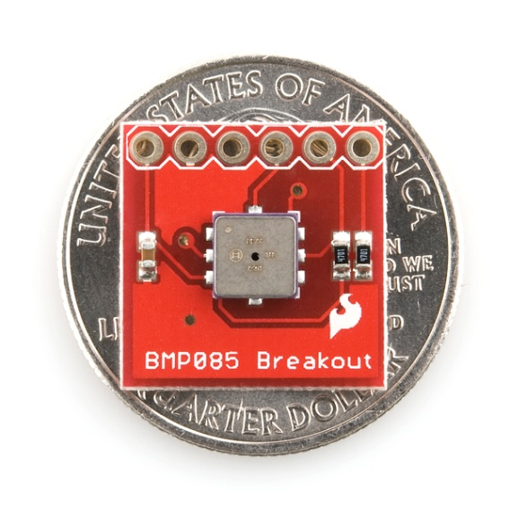
Barometric Pressure Sensor
Low current
Breakout board
Contains a thermometer used as the ambient temperature sensor needed
for the sensor system
I2C connection
.65 inch
.65 inch
BMP085

Slide 23
Solenoid S.S.
Sensors S.S.
Transmitter
Receiver
Micro-Controller
Solenoid
Rain Detection
Sensor
Barometric Pressure Sensor
Ambient Temp.
Sensor
Power Source
Humidity
Sensor
Micro-Controller
User Interface
Transmitter
Receiver
Ground Moisture
Sensor
Transmitter
Receiver
Micro-Controller
LCD Display
Power Source
Power Source
Central HUB S.S.

Slide 24
Ground Moisture Sensor
Used to measure the water content in soil.
Necessary for the when to water algorithm.
General resistive method

Slide 25
Solenoid S.S.
Sensors S.S.
Transmitter
Receiver
Micro-Controller
Solenoid
Rain Detection
Sensor
Barometric Pressure Sensor
Ambient Temp.
Sensor
Power Source
Humidity
Sensor
Micro-Controller
User Interface
Transmitter
Receiver
Ground Moisture
Sensor
Transmitter
Receiver
Micro-Controller
LCD Display
Power Source
Power Source
Central HUB S.S.

Slide 26
Wireless Communication
Transmission Range: > 20 feet
Low power consumption: < 100mW (on)
Concurrent transmissions without interference

Slide 27
Wireless Communication
 | Xbee | Xbee pro | Zigbee 802.15.4 | Bluetooth 802.15.1 | WIFI b/g 802.11b/g
Battery Days |  |  | 100-1000 | 1-7 | .1-5
Power transmitting | 1mW | 63mW | 100 mW | 160 mW | 1600 mW
Current sleeping | <1uA | <1uA | .3 mA | .2 mA | 20 mA
Nodes/Network |  |  | 255/65K+ | 7 | 30
Bandwidth | 250 kbps | 250 kbps | 20-250 kbps | 720 kbps | 11-54 mbps
Range (m) | 30(indoor) 90(outdoor) | 90(indoor) 1600(outdoor) | 75+ | 10+ | 100
Key attribute | Low cost, Low power | Low power | Low power, reliable | convenience | speed

Slide 28
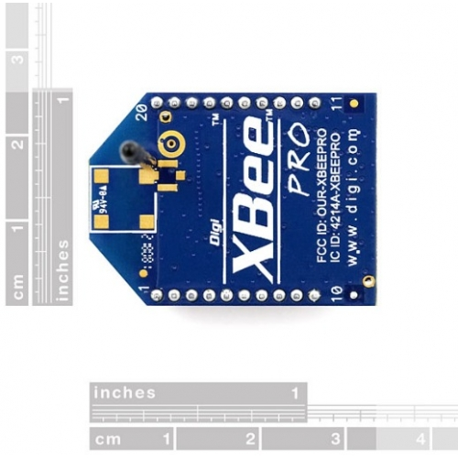
Xbee
Inexpensive $17
Transmission Range: 400 ft
Data Rate: 250 kbps
Transmit Power: 1.25 to 2 mW
Voltage: 2.1 - 3.6 VDC
1 inch
1.25 inch

Slide 29
Solenoid S.S.
Sensors S.S.
Transmitter
Receiver
Micro-Controller
Solenoid
Rain Detection
Sensor
Barometric Pressure Sensor
Ambient Temp.
Sensor
Power Source
Humidity
Sensor
Micro-Controller
User Interface
Transmitter
Receiver
Ground Moisture
Sensor
Transmitter
Receiver
Micro-Controller
LCD Display
Power Source
Power Source
Central HUB S.S.

Slide 30
Microcontroller
Low power consumption
Communicates with the computer via serial connection
Inexpensive
Easily programmable
I/O for all sensors

Slide 31
Microcontrollers
Item | AT90L S8535 | Atmega 103L | PIC16F8X | MSP430 F149 | StrongARM SA-1100 | At91M 42800A | MC68HC05PV8A | 80C51RD | EM6603 | MC9328MX1 | ATMega328
Bits | 8 | 8 | 8 | 16 | 32 | 16 | 8 | 8 | 4 | 16 | 8
Flash kB | 8 | 128 | 68 | 60 |  |  |  | 64 |  |  | 32
RAM B | 512 | 4k | 1 | 2k |  | 8k | 192 | 1k | 96x4 | 128k | 2k
ADC bits | 10 | 10 |  | 12 |  | 08 |  |  |  | 13 | 2x8
Timers | 3 | 3 | 1 | 3 |  | 6 | 1 | 1 | 1 | 2 | 2+1
Operating Voltage | 4-6v | 2.7-3.6v | 2-6v | 1.8-3.6v | 3-3.6v | 2.7-3.6v | 3.3-5v | 2.7-5.5v | 1.2-3.6v | 1.62-3.3v | 1.8-5.5v
Current Active | 6.4 mA | 5.5 mA | 2 mA | .4 mA | 230 mA |  | 4.4 mA | 16 mA | 1.8 μA | 90 mA | .2 mA
Current Idle Mode | 1.9 mA | 1.6 mA |  | 1.3 μA | 50 mA |  | 1.95 mA | 4 mA | .35 μA | .16 mA | .75 μA
Powered Down Current | 1 μA | 1 μA | 1 μA | .1 μA | 25 μA |  | 485 μA | 50 μA | .1 μA |  | .1 μA

Slide 32
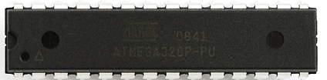
ATmega 328P
Inexpensive $4
14 digital I/O pins
6 Analog I/O pins
Programmable over serial using USB to serial converter
Has I²C capability
Low power
Different power modes
1.32 inch
.28 inch

Slide 33
Solenoid S.S.
Sensors S.S.
Transmitter
Receiver
Micro-Controller
Solenoid
Rain Detection
Sensor
Barometric Pressure Sensor
Ambient Temp.
Sensor
Power Source
Humidity
Sensor
Micro-Controller
User Interface
Transmitter
Receiver
Ground Moisture
Sensor
Transmitter
Receiver
Micro-Controller
LCD Display
Power Source
Power Source
Central HUB S.S.

Slide 34
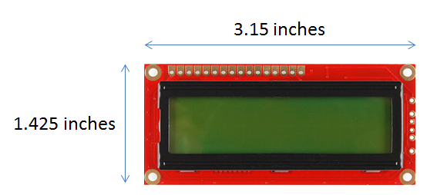
LCD Module
The LCD module that fits Eco-Sense:
Low power mode
LED backlighting GDM1602K
16x2 character display
Image provided under Creative Commons (CC) by Sparkfun

Slide 35
Solenoid S.S.
Sensors S.S.
Transmitter
Receiver
Micro-Controller
Solenoid
Rain Detection
Sensor
Barometric Pressure Sensor
Ambient Temp.
Sensor
Power Source
Humidity
Sensor
Micro-Controller
User Interface
Transmitter
Receiver
Ground Moisture
Sensor
Transmitter
Receiver
Micro-Controller
LCD Display
Power Source
Power Source
Central HUB S.S.

Slide 36
Power
High efficiency: > 70%
DC-DC from 7.4 volts to 3.3 volts and 5 volts
Low Cost
Rechargeable, high energy density battery

Slide 37
Power- Battery
Specification | Ni-Cad | Ni-MH | Li-ion / Li-poly | Rechargeable Alkaline | Lead Acid
Charge/Discharge life cycles | 500-700 | 300-400 | 300-1000 | 100+ | 500-800
Memory Effect | High effect | Little effect | No effect
Operating Temperature | -22 to +140°F | -4 to +122°F | +14 to +140°F | -20º F to 130º F | -85º F to 149º F
Self-Discharge | 20% loss of charge/ month at 77°F | 30% loss of Charge/ month at 77°F | Self-discharge 3% loss of charge/ month at 77°F | (5/12)% loss per month
Energy density (Wh/kg) | 40-60 | 30-80 | 150-250 (Li-poly 130-200) |  | 30-40
Power W/kg | 150 | 250-1000 | 1800 (Li-poly 3000+) |  | 180

Slide 38
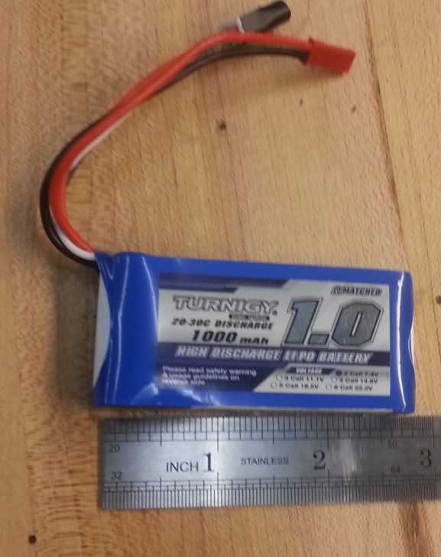
Batteries
Turnigy 1000mAh Lipo Pack
2-Cell, 7.4V output
Sensor and Solenoid sub-systems contain batteries

Slide 39
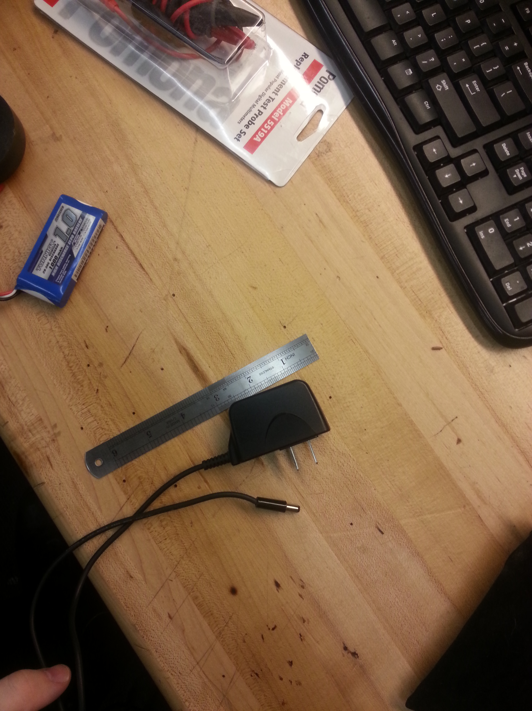
AC Adapter
AC wall adapter
4.6V Output
Central HUB uses wall adapter

Slide 40
Regulators
Linear Regulators
Easy to use
Heat sink usually required
50% efficiency
Clean voltage
Switching Regulators
  Requires more components
  Smaller heat sink required
  80% efficiency
  Some ripple voltage on the output

Slide 41
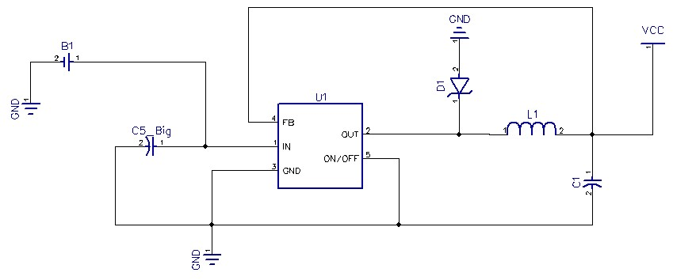
Switching Regulator Circuit

Slide 42
Solenoid S.S.
Sensors S.S.
Transmitter
Receiver
Micro-Controller
Solenoid
Rain Detection
Sensor
Barometric Pressure Sensor
Ambient Temp.
Sensor
Power Source
Humidity
Sensor
Micro-Controller
User Interface
Transmitter
Receiver
Ground Moisture
Sensor
Transmitter
Receiver
Micro-Controller
LCD Display
Power Source
Power Source
Central HUB S.S.

Slide 43
Water Solenoid
Used to control distribution of water
GHT (Garden Hose Threaded) for US standards
Operates with minimum power

Slide 44
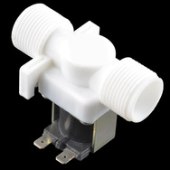
Water Solenoid
AQT15SP
12V water solenoid valve
Operates on 7.4V to 12V
Non-Latching solenoid allows for fail-safe condition
CC BY-NC-SA 3.0

Slide 45
Sub-System Circuits

Slide 46
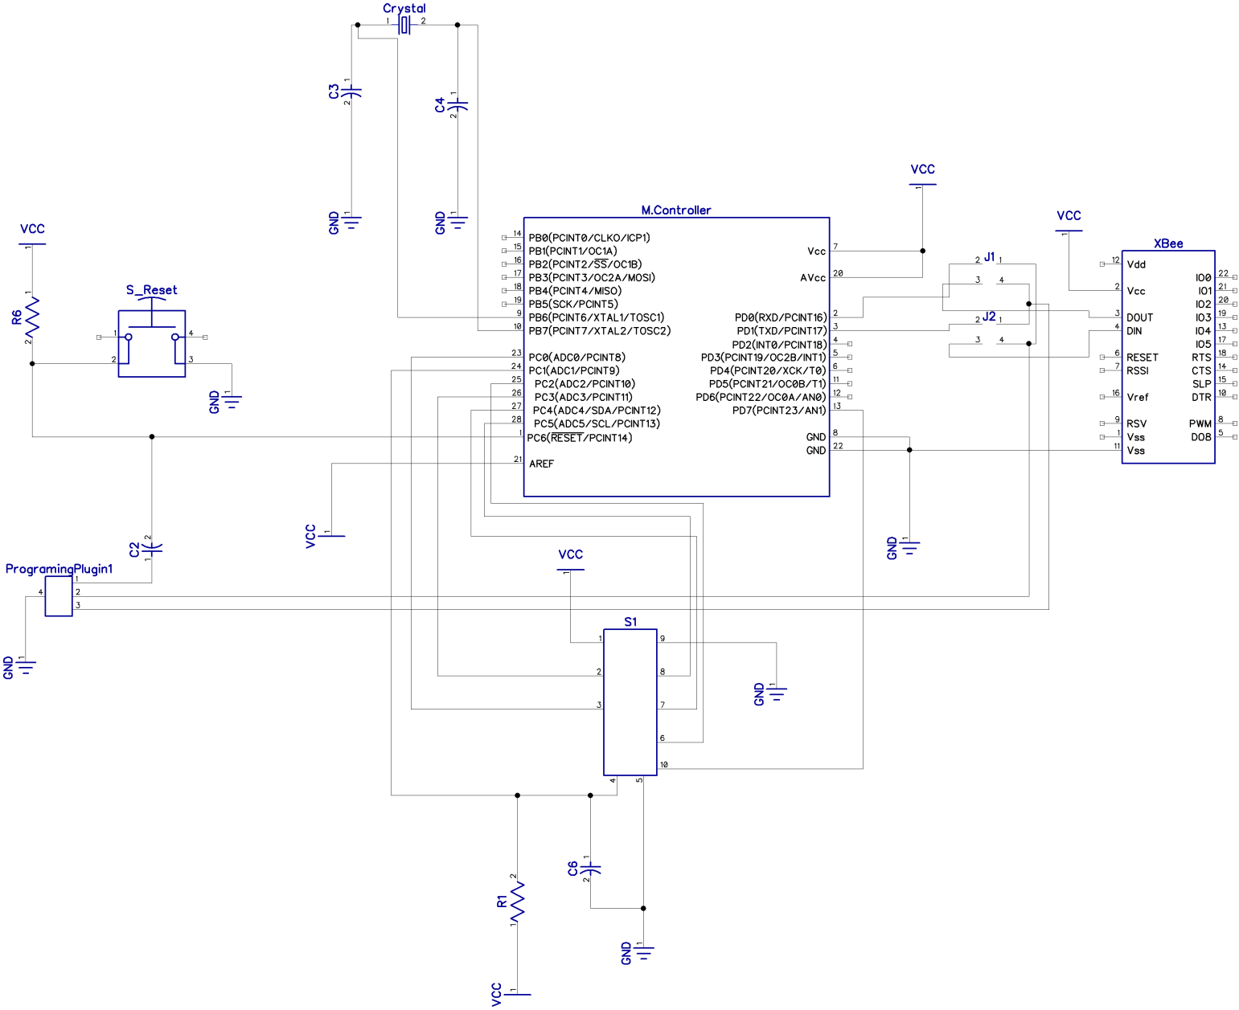
Sensor Subsystem Schematic

Slide 47
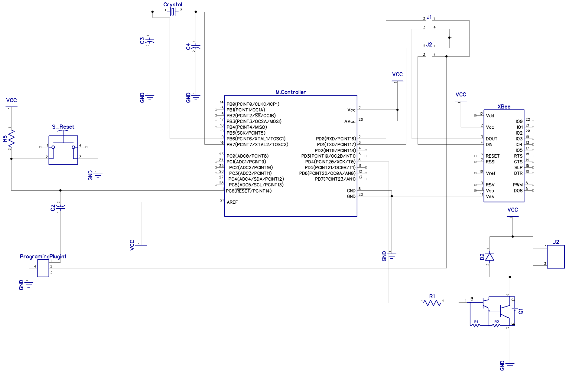
Solenoid Subsystem Schematic

Slide 48
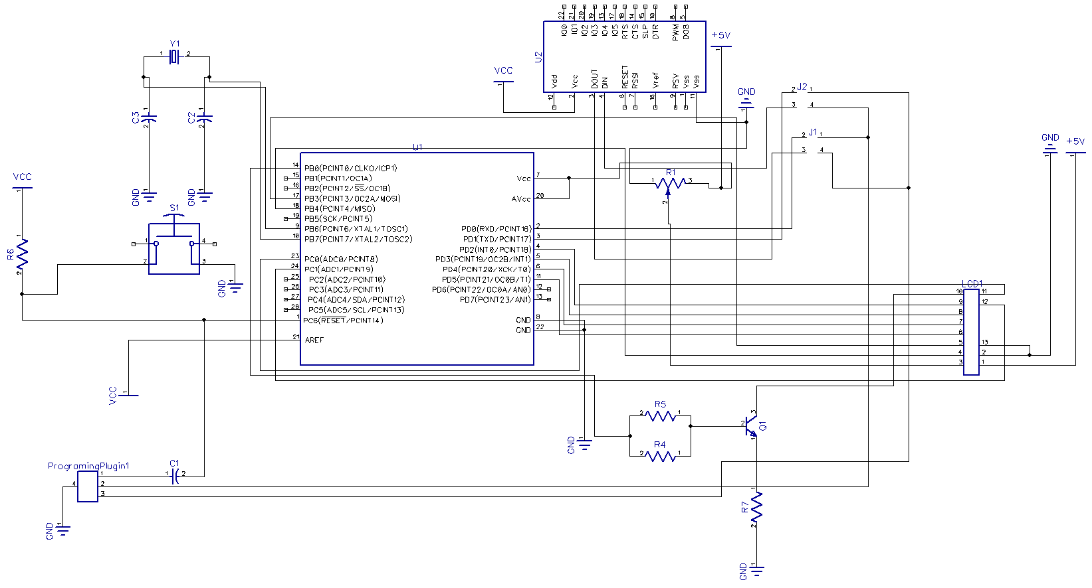
Central HUB Schematic

Slide 49
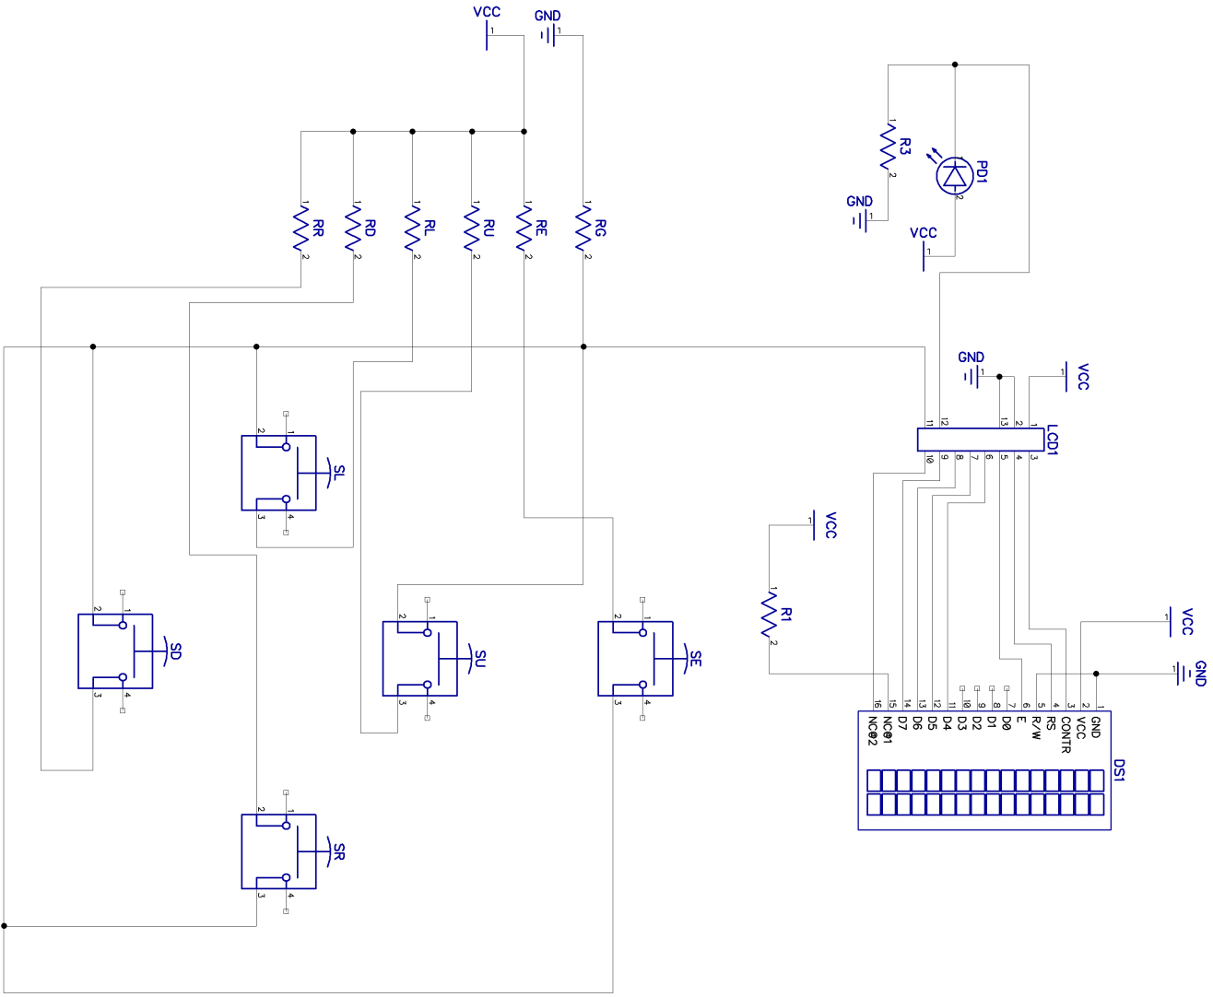
Central Hub Schematic - UI

Slide 50
Subsystem Software

Slide 51
Subsystem Software Design
2 different approaches, one for each subsystem
Each Sub-System can communicate to and from the central HUB
Minimal memory usage for code

Slide 52
Subsystem Software Design
Central Subsystem
Sensor Subsystem
Solenoid Subsystem

Slide 53
Sensor Software
Sensor Data
Collection
Memory Store
Data Storage
Read Moisture
Convert / Compress
Reset Timer
Read Temperature
Receive Data
Read Humidity
Fetch Memory
Data Transfer
Read Pressure
Transmit Data
Read Rain Status
System Timer
Clear Memory

Slide 54
Subsystem Software Design
Central Subsystem
Sensor Subsystem
Solenoid Subsystem

Slide 55
Central Software
Receive Data
Extract Data
Moisture Flag
Sum Flags
Temp Flag
Water Signal
Store in Memory
Humidity Flag
Display Statistics
Pressure Flag
Override
Rain Flag
Button Input
Manual Input
Transmit Data
Water Algorithm
System Timer
Data Transfer

Slide 56
Subsystem Software Design
Central Subsystem
Sensor Subsystem
Solenoid Subsystem

Slide 57
Solenoid Software
Receive Signal
Open Valve
Countdown Timer
Data Transfer
Close Valve
Solenoid Controller

Slide 58
Software Design Overview
Sensor subsystem collects data at set intervals
Central subsystem requests data, computes water signal, transmits water signal to solenoid
Solenoid subsystem controls the operation of the valve and water distribution

Slide 59
Solenoid S.S.
Sensors S.S.
Transmitter
Receiver
Micro-Controller
Solenoid
Rain Detection
Sensor
Barometric Pressure Sensor
Ambient Temp.
Sensor
Power Source
Humidity
Sensor
Micro-Controller
User Interface
Transmitter
Receiver
Ground Moisture
Sensor
Transmitter
Receiver
Micro-Controller
LCD Display
Power Source
Power Source
Central HUB S.S.

Slide 60
User Interface
The user interface (UI) allows the user to access the system in an efficient manner
Provides overriding actions for user
Provides data feedback to the user
Displays system status
Provides users with the ability to enter in allowed watering times

Slide 61
User Interface
The UI includes the following:
LCD module
Pushbuttons
Protective box

Slide 62
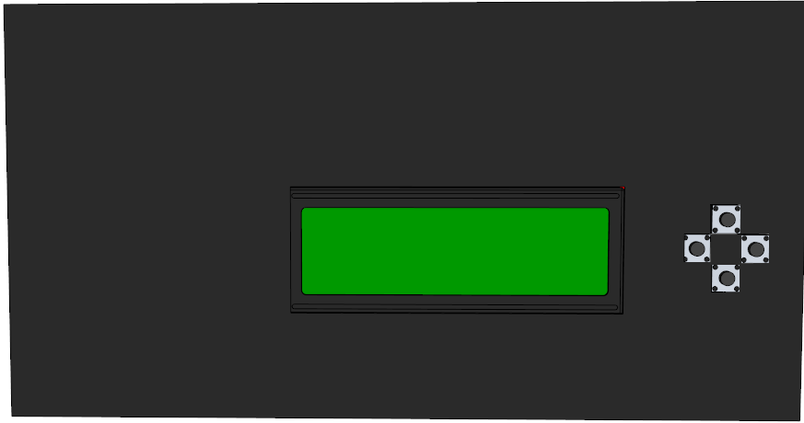
UI Model
3.5 inches
6.5 inches

Slide 63
Work Distribution
 | Neil (EE) | Jamie (CpE) | Daniel (CpE)
Sensor Configuration | X
Sub-System’s Circuitry | X | X | X
Weather/Water Algorithms | X
Wireless Communications |  |  | X
Power System |  | X | X
Housing Assembly | X | X | X
User Interface |  | X | X
Solenoid Controller | X | X
PCB Design | X
PCB Assembly |  | X | X

Slide 64
Bill of Materials

Slide 65
Demonstration

Slide 66
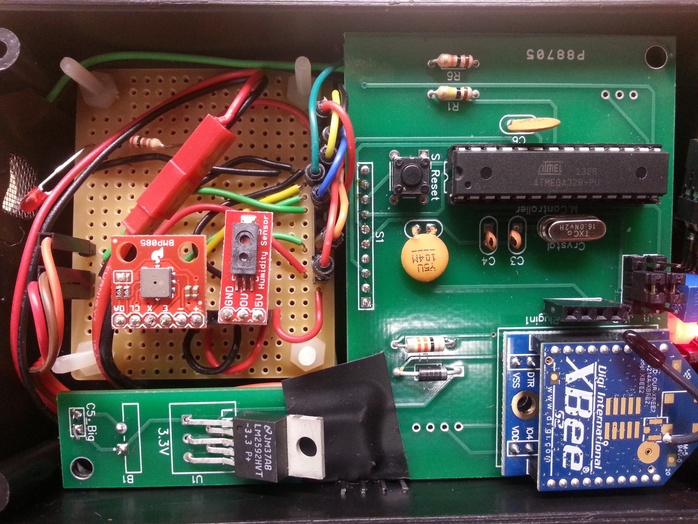

Slide 67
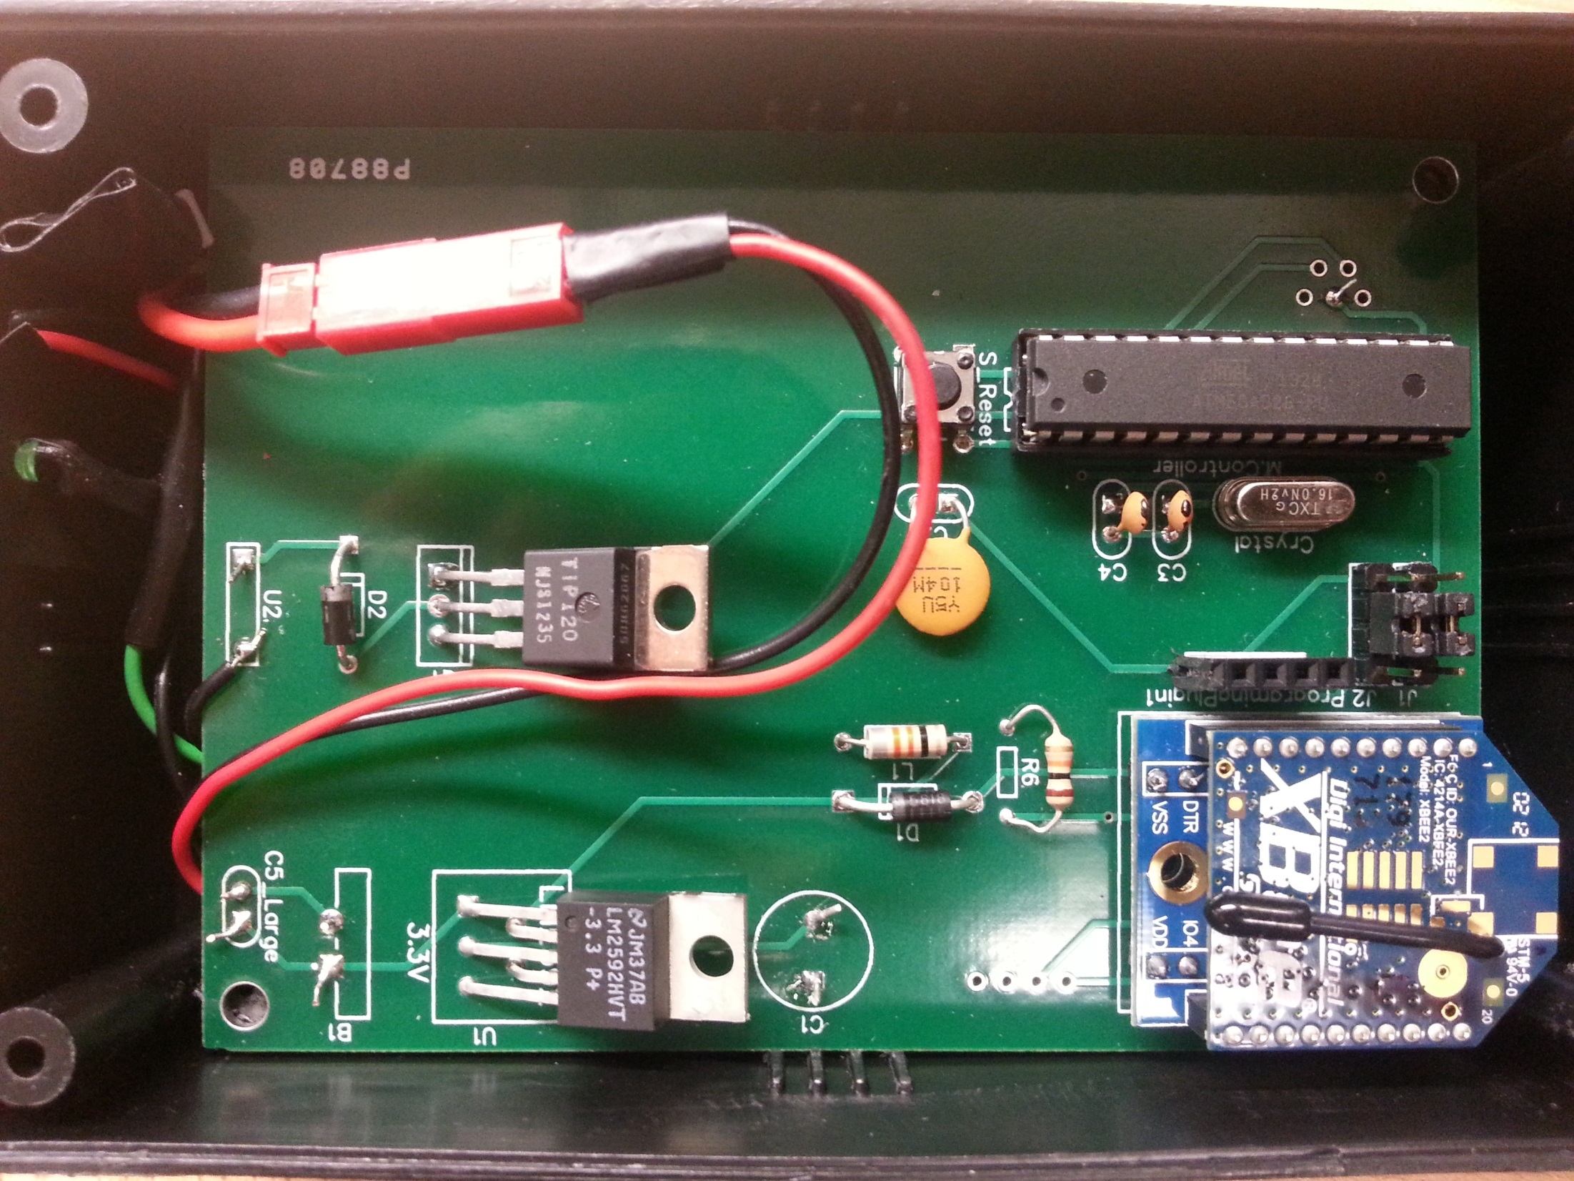

Slide 68
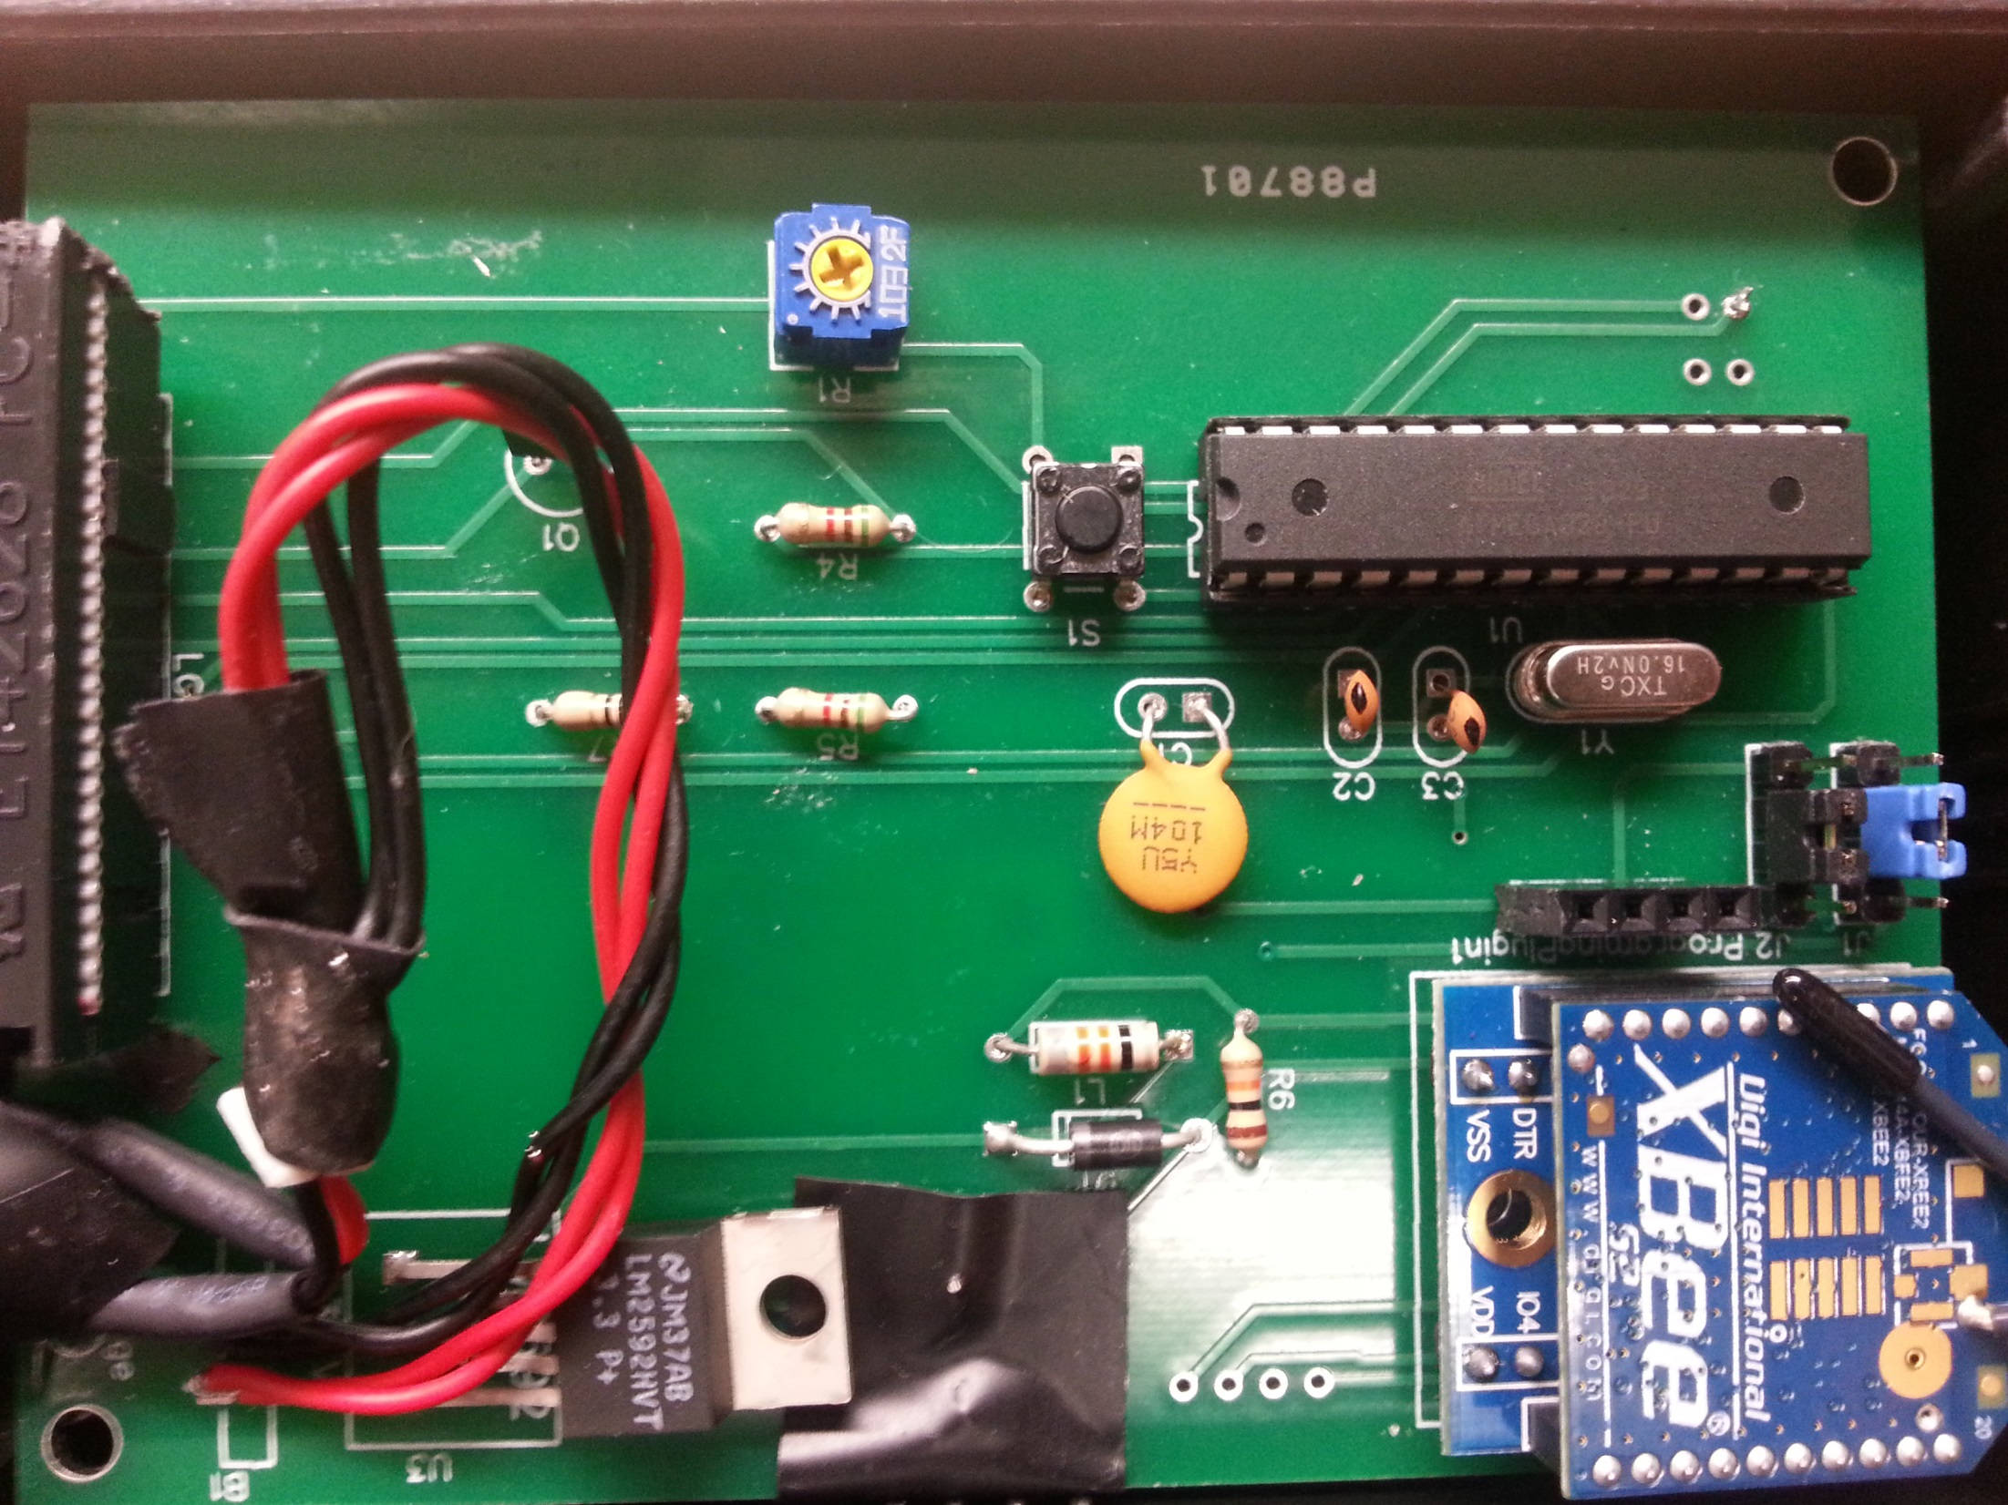

Slide 69
Test
Score
Did it rain?
Test
Score
Did it rain?
1
0.0%
No
21
33.0%
Yes
2
75.0%
Yes
22
4.0%
No
3
0.0%
No
23
4.0%
No
4
74.0%
Yes
24
0.0%
No
5
0.0%
No
25
38.0%
Yes
6
87.0%
Yes
26
0.0%
No
7
20.0%
No
27
30.0%
No
8
40.0%
Yes
28
0.0%
No
9
13.0%
No
29
12.0%
No
10
42.0%
Yes
30
33.0%
No
11
13.0%
No
31
30.0%
No
12
52.0%
Yes
32
4.0%
No
13
42.0%
Yes
33
30.0%
No
14
83.0%
Yes
34
61.0%
No
15
30.0%
No
35
42.0%
No
16
0.0%
No
36
30.0%
No
17
91.0%
Yes
37
48.0%
No
18
42.0%
Yes
38
30.0%
No
19
56.0%
Yes
39
12.0%
No
20
12.0%
Yes
40
30.0%
No

