Slide 1
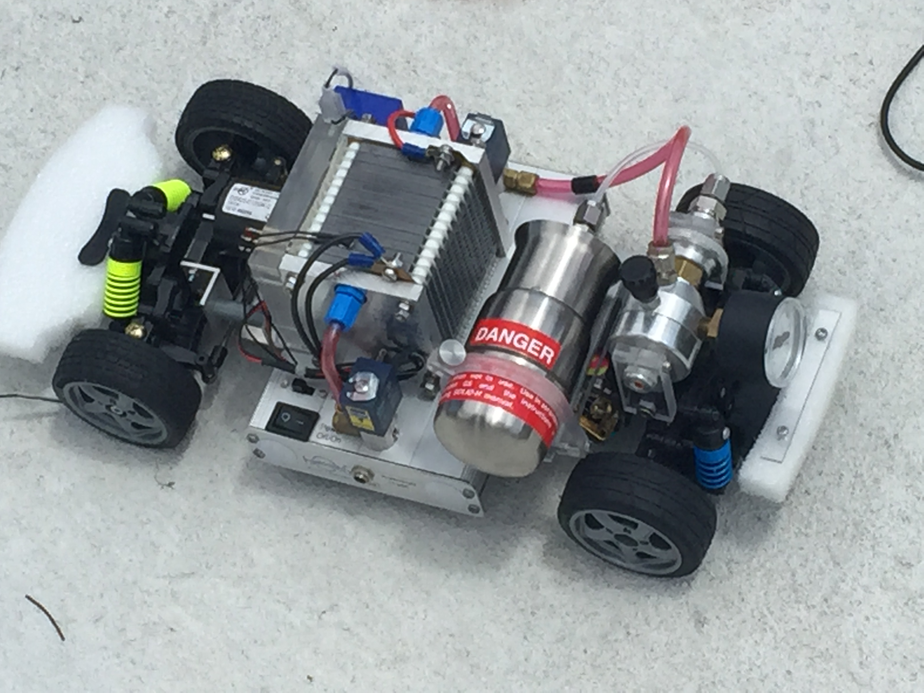
HydroCar
Group 1
Bruno Pegoraro (EE)
Andre Beckus (EE)
James Choi (CpE)
Edwin Perez (CpE)
Technical Advisor
Dr. Paul Brooker
Florida Solar Energy Center
Notes:
Bruno
Does anyone have a title they prefer

Slide 2
Motivation
We wanted to work with a fuel cell
  Fuel cells have a higher efficiency than diesel or gas engines
  Most fuel cells operate silently, compared to internal combustion engines
  The maintenance of fuel cells is simple since there are few moving parts in the system
Less air pollutants
Will be used for educational purposes by the Florida Solar Energy Center
Possibly have a concept that could be used in consumer vehicle
Notes:
Bruno

Slide 3
Goals and Objectives
The system will be capable of powering the RC car to achieve performance on par with consumer products
The fuel cell will be output power provided with a supply of hydrogen
The system will output power for external use
Continuously display measurements and information on a webpage with a modern UI
Notes:
Bruno

Slide 4
Specifications
Component | Parameter | Design Specification
Drive System | Maximum Speed | 5 miles per hour
Power System | External Output | 12 V, 0.5A DC
Power System | External input | ±12 V
Fuel Cell | Output | 6V to 10.5V
Notes:
Bruno

Slide 5
Overall Block Diagram
Notes:
Bruno

Slide 6
Fuel Cell System
Notes:
Bruno

Slide 7
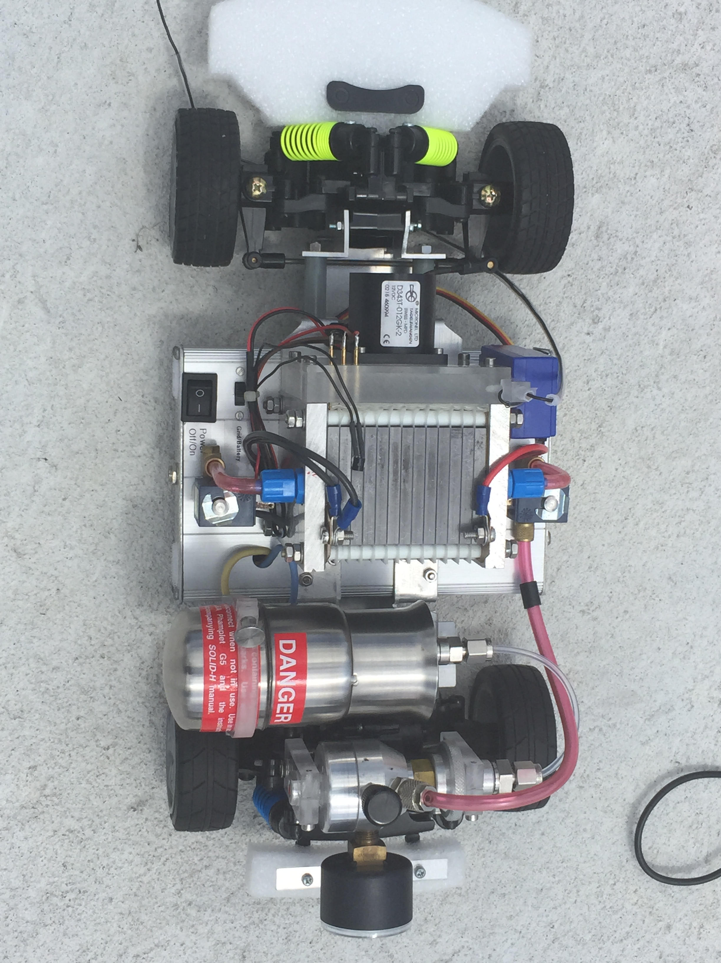
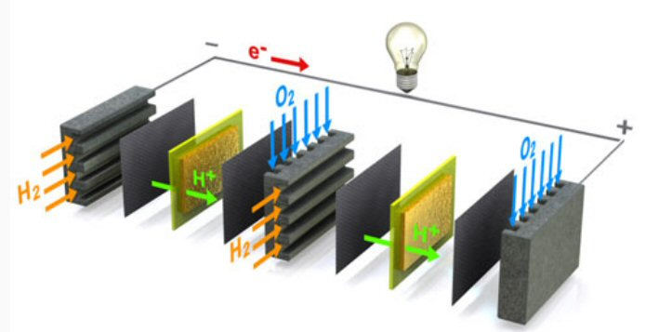
Fuel Cell
Proton Exchange Membrane (PEM) Fuel Cell
Cells | 12
Voltage Range (V) | 6 to 12
Power (W) | 60
Notes:
Bruno

Slide 8
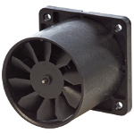
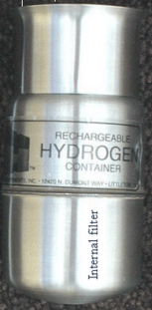
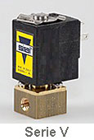
Fuel Cell Components
Hydrogen Tank
Fan
Valves
Notes:
Bruno

Slide 9
Fuel Cell Control Algorithm
Once fuel cell turns on the first inlet valve opens up to allow the hydrogen to pass through
Stack voltage > 6V, fuel cell becomes activated
Temperature < 45ºC to remain active
If the last two cells in the stack has a differential voltage > 50mV, purge valve begins to pulse
Notes:
Bruno

Slide 10
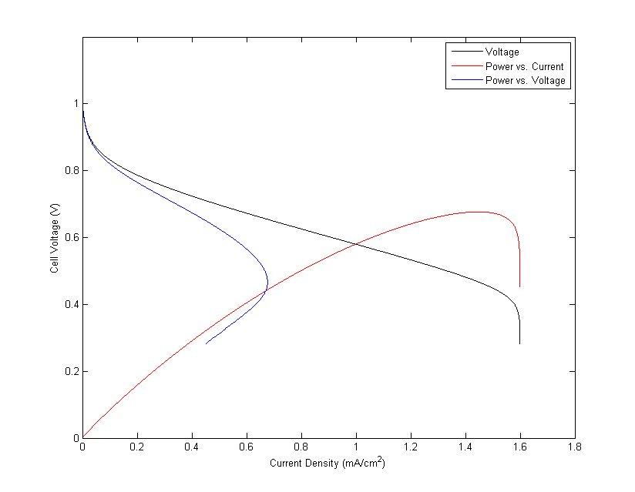
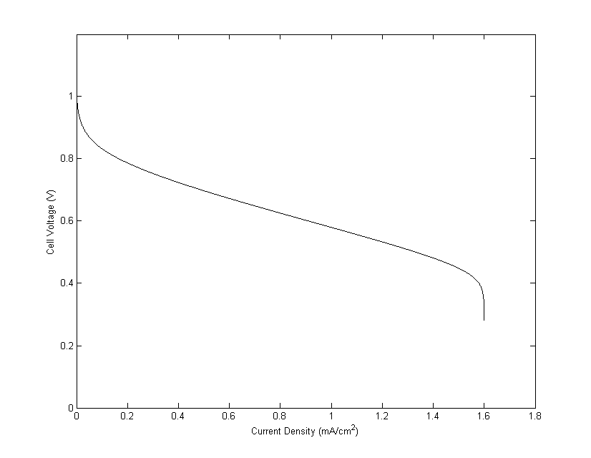
Polarization Curve
Determined by multiple types of internal resistances
Maximum power transfer
Notes:
Andre

Slide 11
Power System
Notes:
Andre

Slide 12
Power System Architecture
Notes:
Andre

Slide 13
Power Budget
Component | Voltage (V) | Idle Current (A) | Max Current (A) | Idle Power (W) | Max Power (W)
Valves | 12 | 0.1 | 0.2 | 1.2 | 2.4
External DC Output | 12 | 0 | 1 | 0 | 12
Fan | 12 | 0.08 | 0.08 | 0.96 | 0.96
Battery Charger | 12 | 0 | 1 | 0 | 12
Radio | 5 | 0.1 | 0.1 | 0.5 | 0.5
Steering Servo | 5 | 9 | 0.22 | 0.45 | 1.1
Beagle Bone | 5 | 0.1 | 0.46 | 0.5 | 2.3
Microcontroller | 3.3 | ≈ 0 | ≈ 0 | ≈ 0 | ≈ 0
Motor | 6 | 0 | 10 | 0 | 60
Total |  |  |  | ≈ 4 W | ≈ 92 W
Notes:
Andre

Slide 14
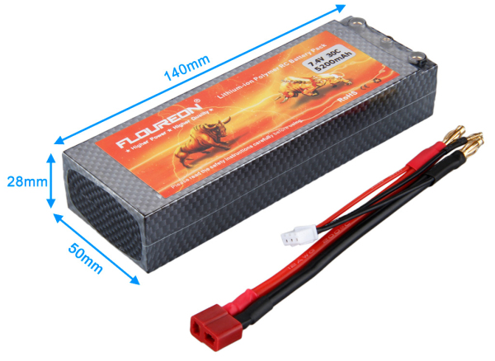
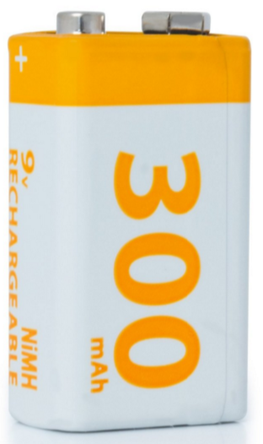
Battery
Originally: LiOH, 7.4 V nominal
Safety/space concerns
Now: 9V NiMH battery
Same as original car
Easily fits in box
Source: Floureon
Standards
UL 1642 | Lithium Batteries
UL 2595 | General Requirements for Battery Powered Appliances
J2929 | Electric and Hybrid Vehicle Propulsion Battery System Safety Standard—Lithium-based Rechargeable Cells
Source: SunLabz

Slide 15
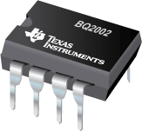
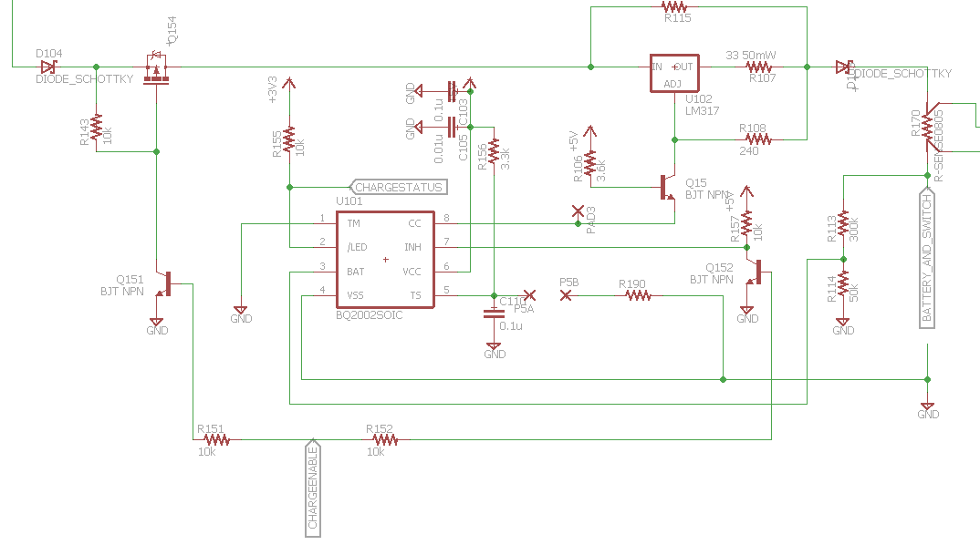
Battery Charger
Originally: BQ2057 LiOH Charger
Now: BQ2002 NiMH Charger IC
Determine state-of-charge through voltage
Microcontroller enable/status
Source: Texas instruments
Notes:
Andre

Slide 16
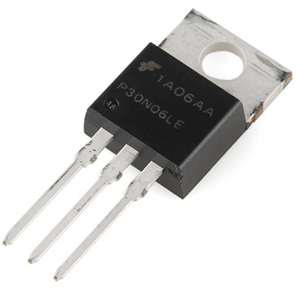
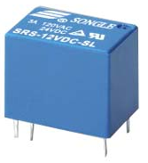
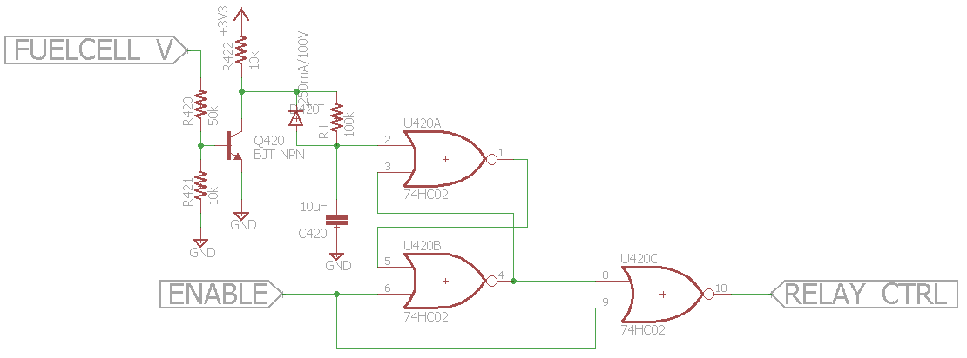
Main Bus Switch
Option 1: Transistor
  N-MOSFET (lower R_{ds})
LTC1154 gate driver IC
Back-to-back MOSFETs (reverse current protection)
Overcurrent protection
Source: sparkfun.com
Option 2: Relay
Higher drive current
Source:
Ningbo Songle Relay Co.
Notes:
Andre

Slide 17
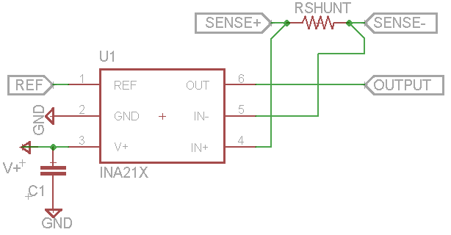
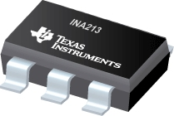
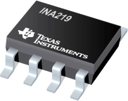

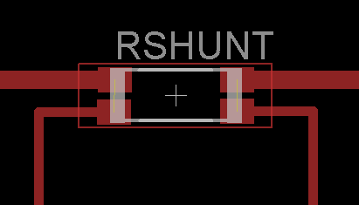
Current Measurement
High side current measurement
Shunt resistor
Bidirectional capability
Chip | Measurements | Output
INA213 | Current | Analog
INA219 | Voltage/Current/Power | I²C
Image Sources:
Texas instruments
Four Terminal / Kelvin Sensing
Avoids inaccuracies due to solder connection resistance
û
ü
In
Out
In
Out
Sense +
Sense -
Sense +
Sense -
Notes:
Andre

Slide 18
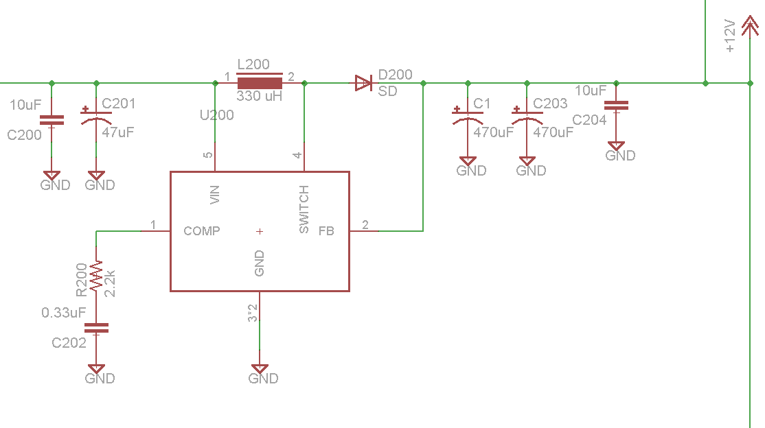
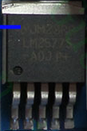
DC to DC Converter
Built a new boost converter with the LM2577 chip
Prototyping issues
Notes:
Edwin

Slide 19
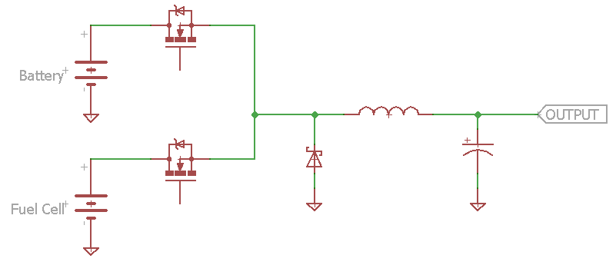
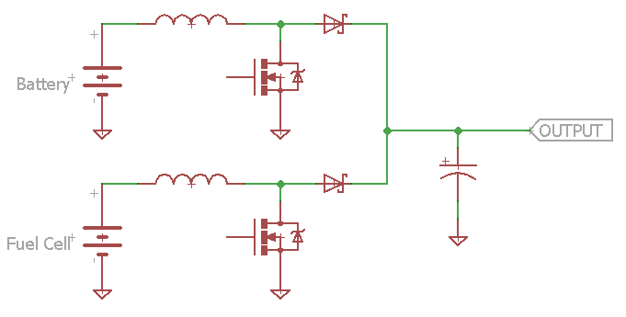
Power Source Balancing
  Use both sources at same time
  Can design multi-port DC-DC converters
Buck
Boost
  Active area of research in electric/hydrogen vehicles
  Boost converter can be made bidirectional
Disadvantages
  Large currents (mainly from motor)
  Custom control system
Source: Hongfei W, Junjun Z, Yan X. A Family of Multiport Buck–Boost Converters Based on DC-Link-Inductors (DLIs). IEEE Transactions On Power Electronics. (2015, Feb); 30(2): 735-746.
Notes:
Andre

Slide 20
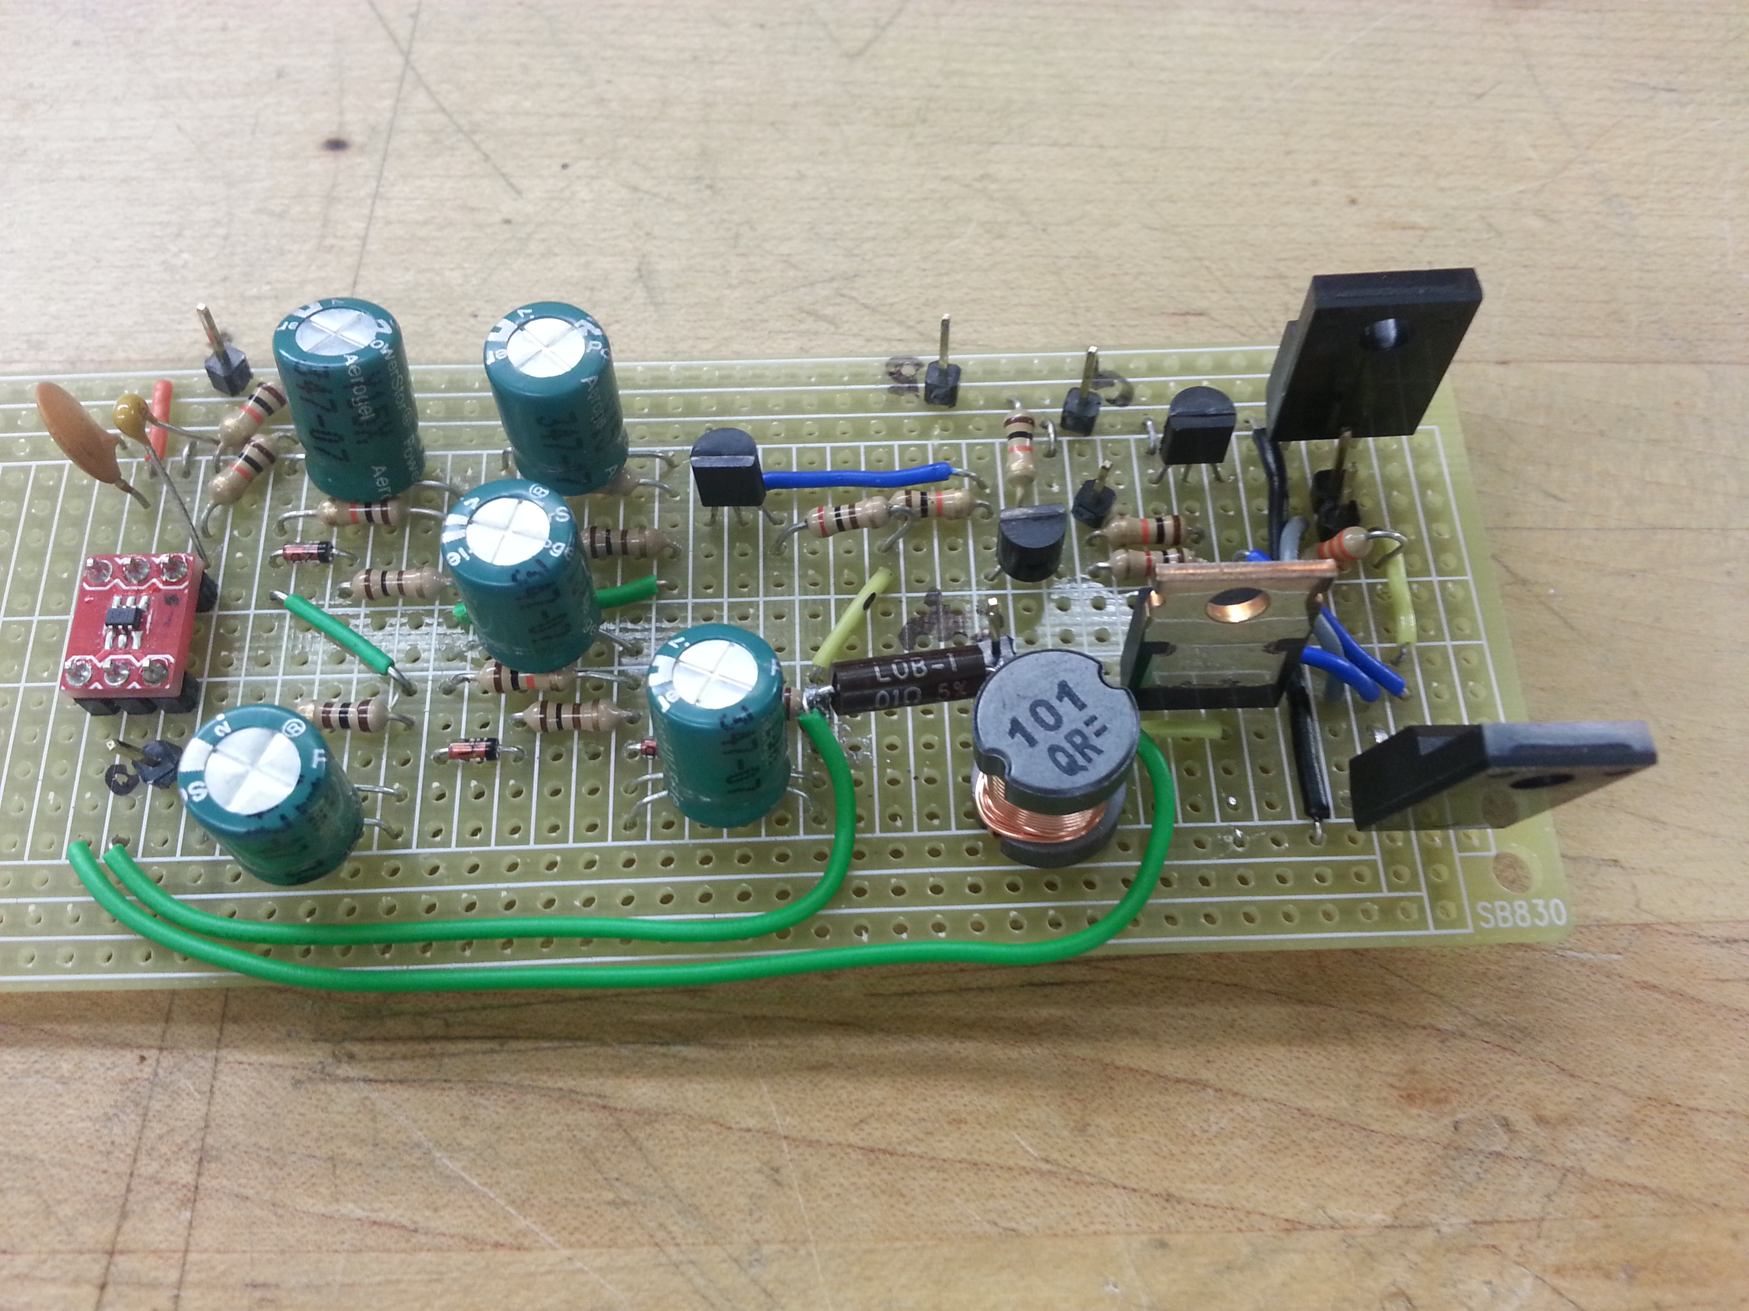
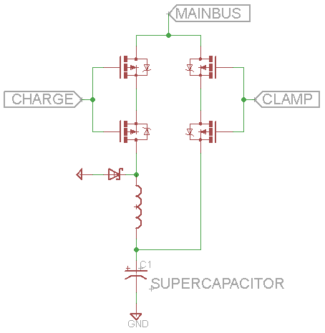
Supercapacitor Concept
  Provide quick source of energy
  Charge with buck converter (to limit current)
  Clamp to main bus once charged
  Challenges
    Control of buck converter
    Space

Slide 21
Controller System
Notes:
James

Slide 22
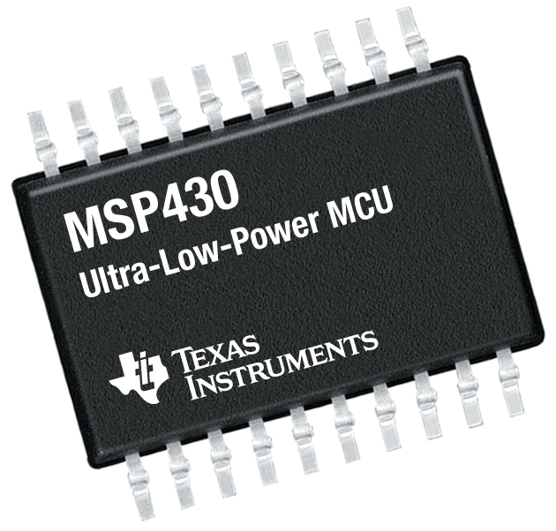
  Microcontroller limitations
  Limited number of I/O pins available
    Sensors (Input)
    Controlled devices (Output)
  Varying computation capabilities
    Deterministic computations only
  Memory limitations
    Data persistence unavailable
      Memory is volatile
  Common solutions require reimplementation
    Libraries to interface with sensors
    Libraries to configure hardware devices
  Runtime environment limitations
    Limited to binary
  Development environment restrictions
Notes:
James

Slide 23

SBC: Raspberry Pi
  Raspberry Pi unsuitable for use-case
    High power consumption
    Low-level optimizations abstracted by OS
      Power consumption optimizations limited
    Unused capabilities
      GPU; Multimedia-focused
    I/O limitations
      Number of I/O pins limited
    Data persistence latency
      SDCard used for data persistence result in slow read and write speeds.
      OS stored in SDCard as well
Notes:
James

Slide 24
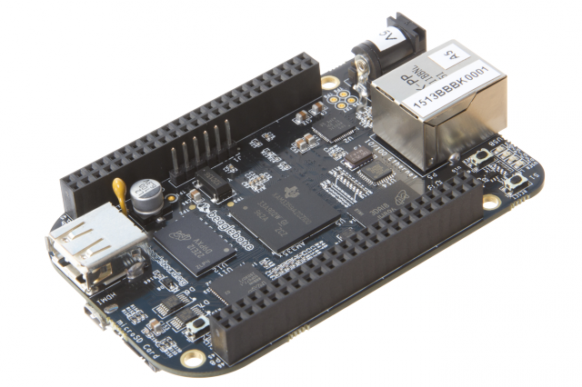

SBC: BeagleBone Black
2 programmable realtime units (PRU)
  Dedicated deterministic computations
  Power consumption optimizations
    Enable ARM/DSP CPU clock to sleep
    Wake CPU via interrupt
  Realtime I/O capabilities
  Shared memory access to onboard memory
Onboard 2GB eMMC
  Fast R/W speeds
  65 digital I/O pins
    8 PWM for analog I/O
    7 analog input
    2 I²C ports
    25 PRU I/O
  Code Composer Development Environment
  Runtime platform
    Polyglot Programming
Notes:
Input and Ouput
Efficient handling of system I/O events with realtime constraints
Power consumption
Problem
Single-board computer’s microprocessors consume more power than microcontroller
Solution
PRU enables ARM and DSP clocks in main CPU to be triggered off and on to maximize power downtime
Deterministic computations can be offloaded
PRU-to-PRU communication
PRU-to-CPU communication
CPU-to-PRU communication

Slide 25
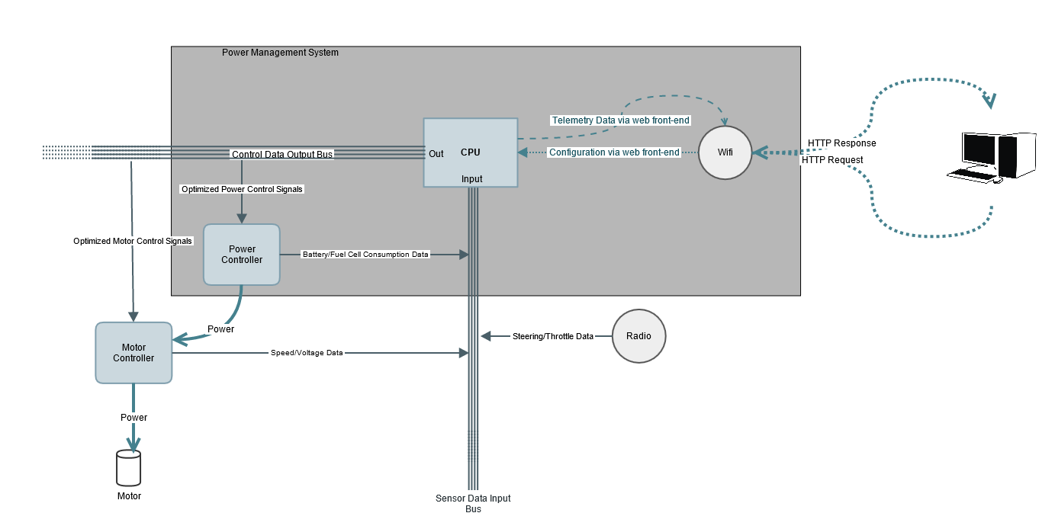
Software Architecture

Slide 26
Software Architecture
PRU# 0:
  Receives data sent from sensors connected to sensor data input bus (temperature, voltage, etc.)
  Computes response control signal (if required) using input data AND modifying parameter supplied by CPU.
  Stores response control signal in scratchpad registers (shared between PRUs) and then triggers an interrupt in PRU #1
  Stores response control signal in shared RAM address space to send to the CPU
PRU #1:
  The interrupt handler reads from the scratchpad memory registers and writes the data to output control data bus to control devices.
CPU (node.js runtime):
  Web server software for displaying real-time (live) web GUI
    Telemetry
    Configuration
  Watches for changes to shared RAM address space and updates persistent data to calculate new modifying parameter to write to shared address space.
Notes:
PRU #0 takes in sensor data and does three things.
First it calculates the response to send as output using the data supplied from input bus and a “modifying parameter” supplied by the CPU (more on that later) as function arguments.
Second it writes the computed value to the scratchpad register (shared between PRUs) and triggers a interrupt on PRU #1.
Third it writes the computed value to the shared RAM address space for use by the CPU which will calculate a new modifying parameter

Slide 27
Node.js Runtime Environment
System is “event-driven”
  Must handle I/O as fast as possible
Node.js – Originally meant to function as runtime environment for web applications.
  Web server software must be able to handle many requests for a web page from many different users with minimal latency.
    HTTP requests from clients are I/O calls to the server.
    Scalability – Requests per second as a function of the number simultaneous connections
  Capable of processing multiple I/O operations asynchronously and non-blocking
    Single threaded event loop
    Callback functions registered to automatically execute when I/O operation completes. Event loop continues processing next item instead of waiting.
C++ bindings
  Node.js is built on top of Google Chrome’s V8 Javascript engine written in C++. Compiles JS to machine code instead of interpreting.
  Capable of interfacing with C/C++ libraries via libuv

Slide 28
Drive System
Notes:
Edwin

Slide 29
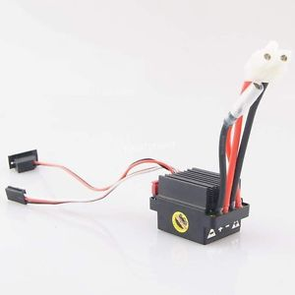
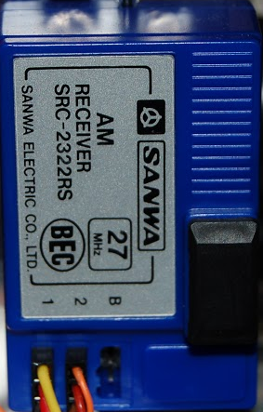
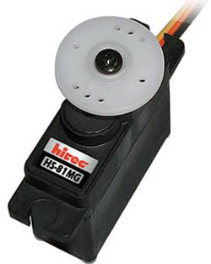
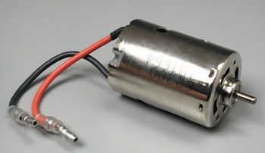
Car Components
Motor Controller (inside box)
Receiver
Motor
Steering Servo
Notes:
Edwin

Slide 30
Motor Controller
RC Car Brushed Speed Controller
Automatic Center calibration
We picked it for prototyping purposes because of it’s low-cost
We ended up using the motor controller already in the RC car as it works great and it meant reduced cost

Slide 31
Steering Servo
HS-82MG
Operates between 4.8V and 6V
It sits underneath the fan at the front of the car
Requires three connections: a power line, a ground line, and a signal line.
We used a 1 ohm current sense resistor in the power line to measure currents pulled by the servo.
Voltage | Torque | Speed | Current
4.8V | 36.1 oz-in / 2.60 kg-cm | 0.11 sec / 60 | 8.8 mA (idle) 220 mA (no load)
6V | 41.6 oz-in / 3 kg-cm | 0.09 sec / 60 | 9.1 mA (idle) 280 mA (no load)

Slide 32
Radio Receiver
Motor
AM receiver
27 MHz BEC (power is supplied by the ESC)
Binding is used to pair the receiver with a transmitter
Brushed Motor
It sits underneath the inlet valve in the back of the car

Slide 33
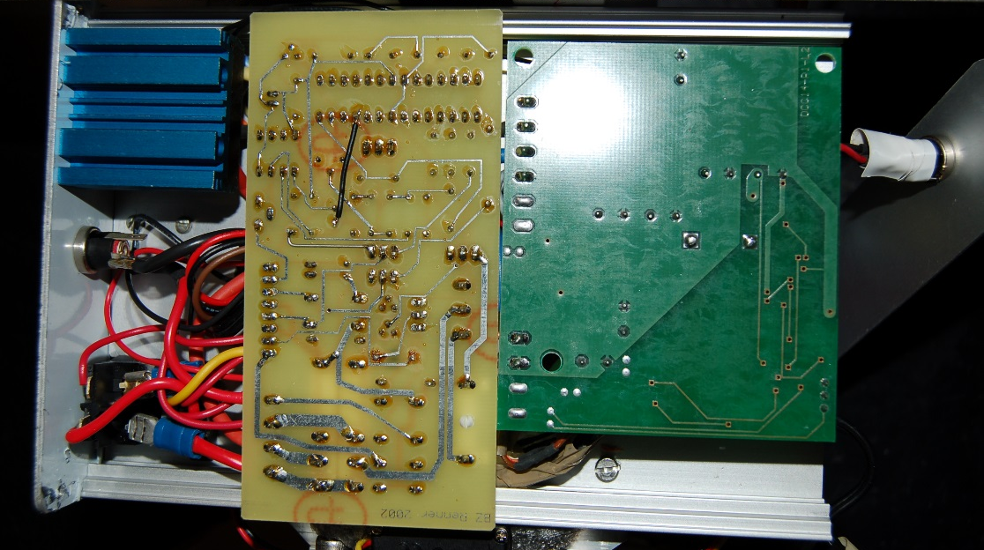
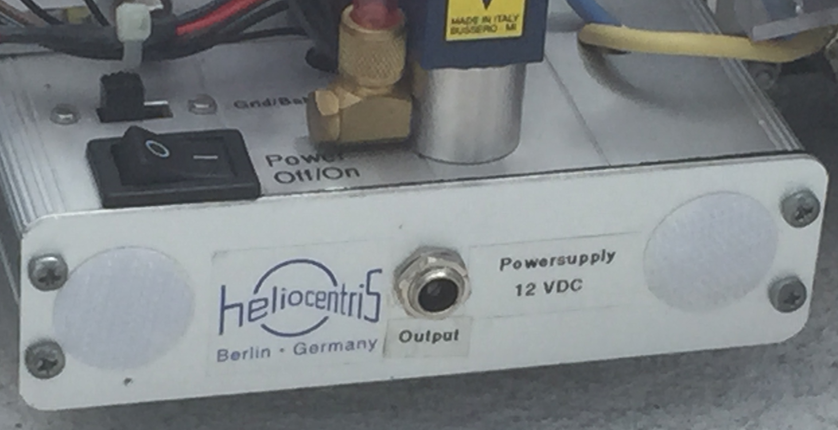
Circuit Board Enclosure
Circuit boards
Speed Controller
Battery
Switches and Power Jacks
Components less than 1 inch high
6”
4.1”
1.25”
Notes:
Edwin

Slide 34
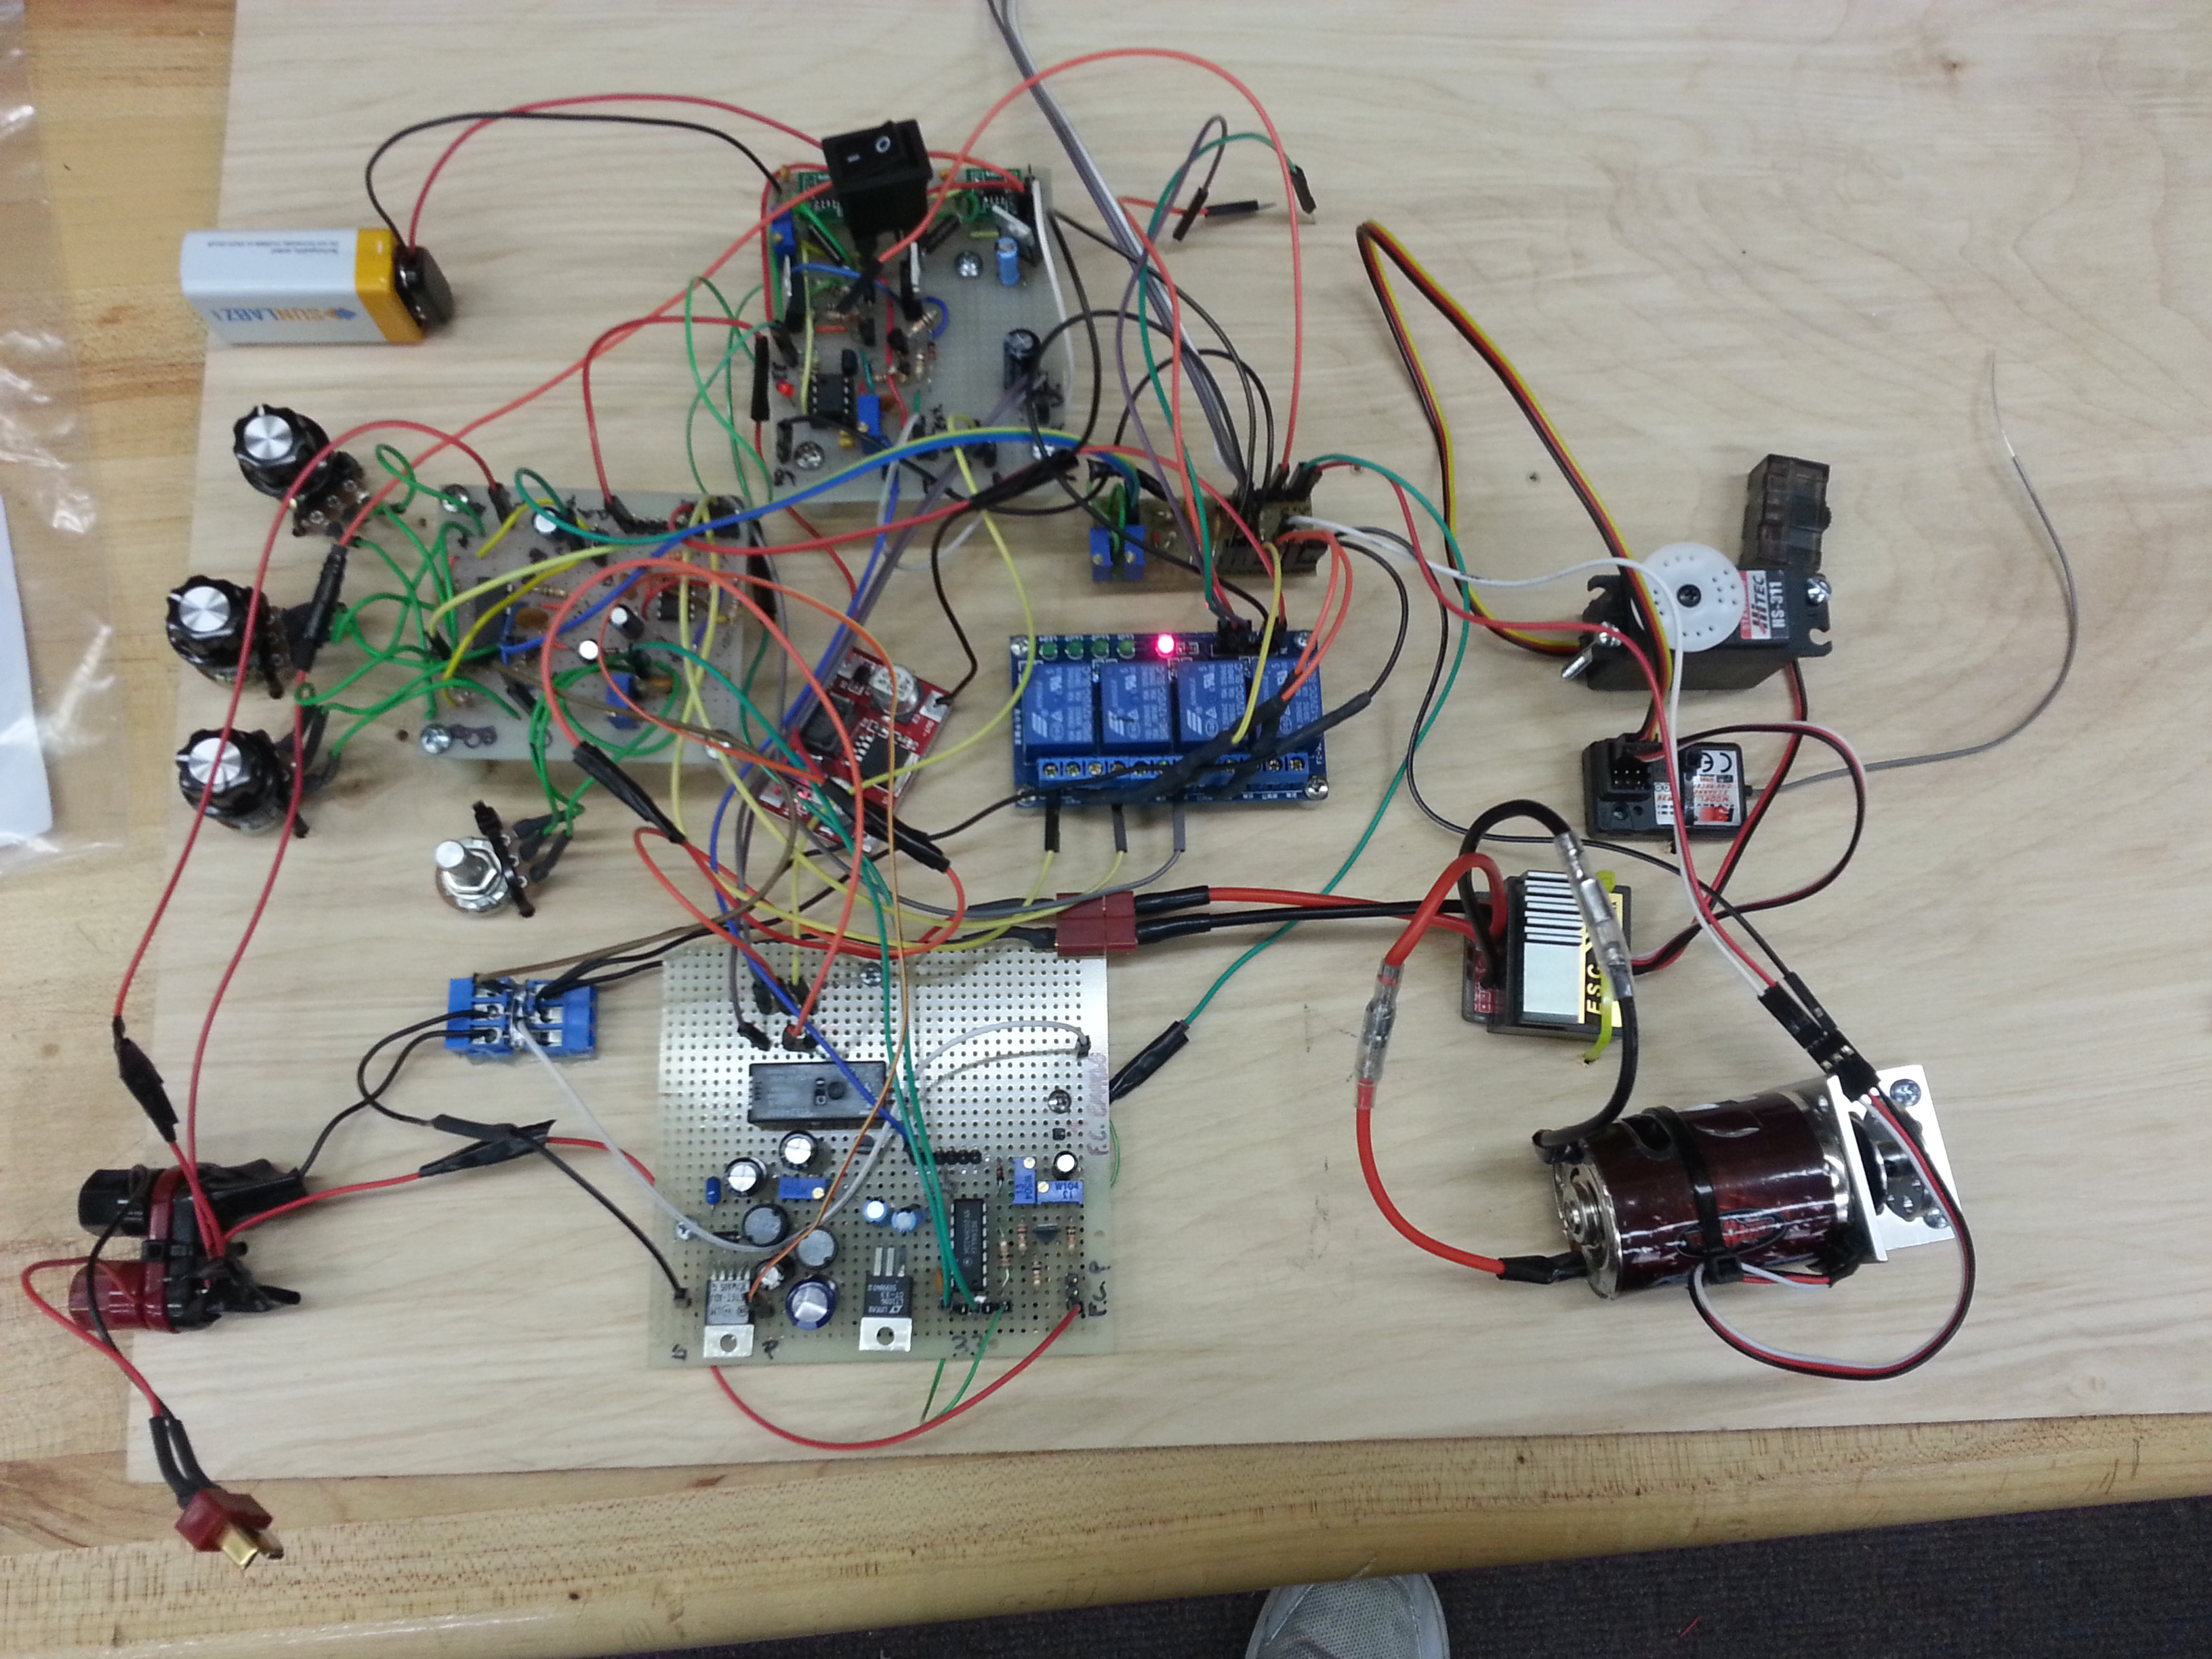
Prototype Board

Slide 35
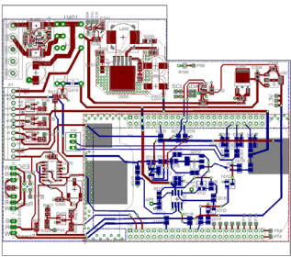
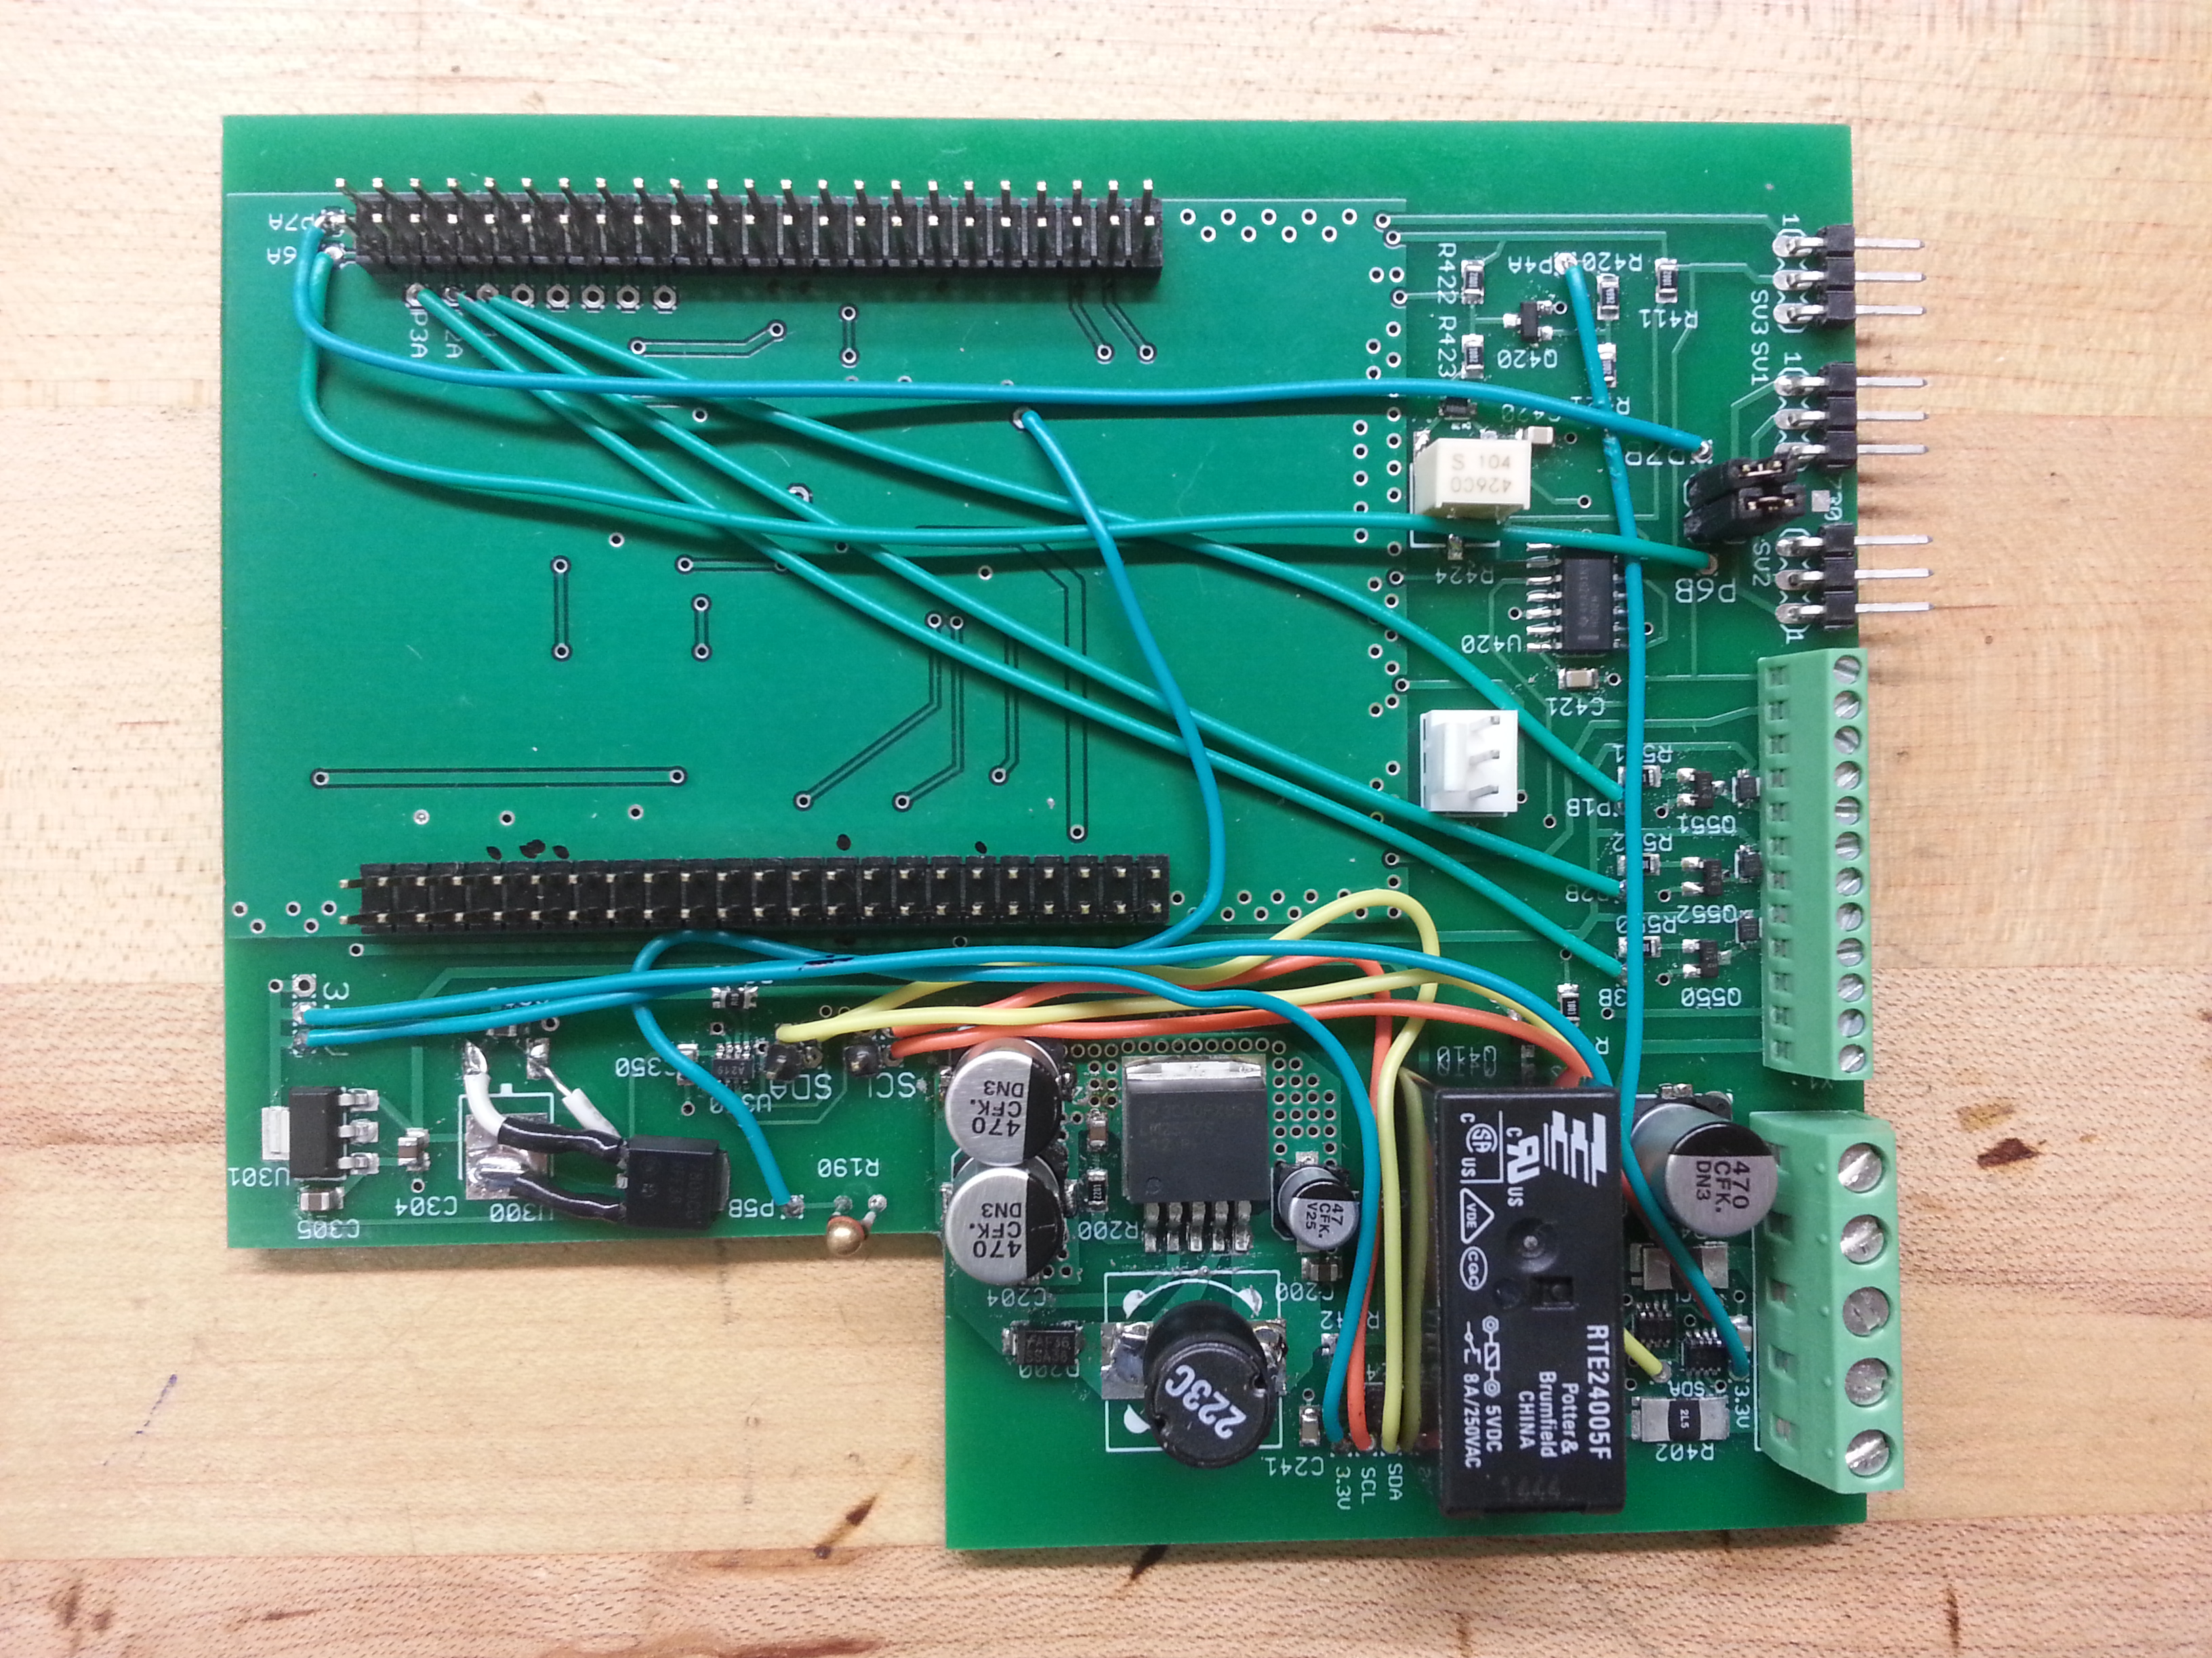
Final Circuit Board
4PCB, Advanced Circuits

Slide 36
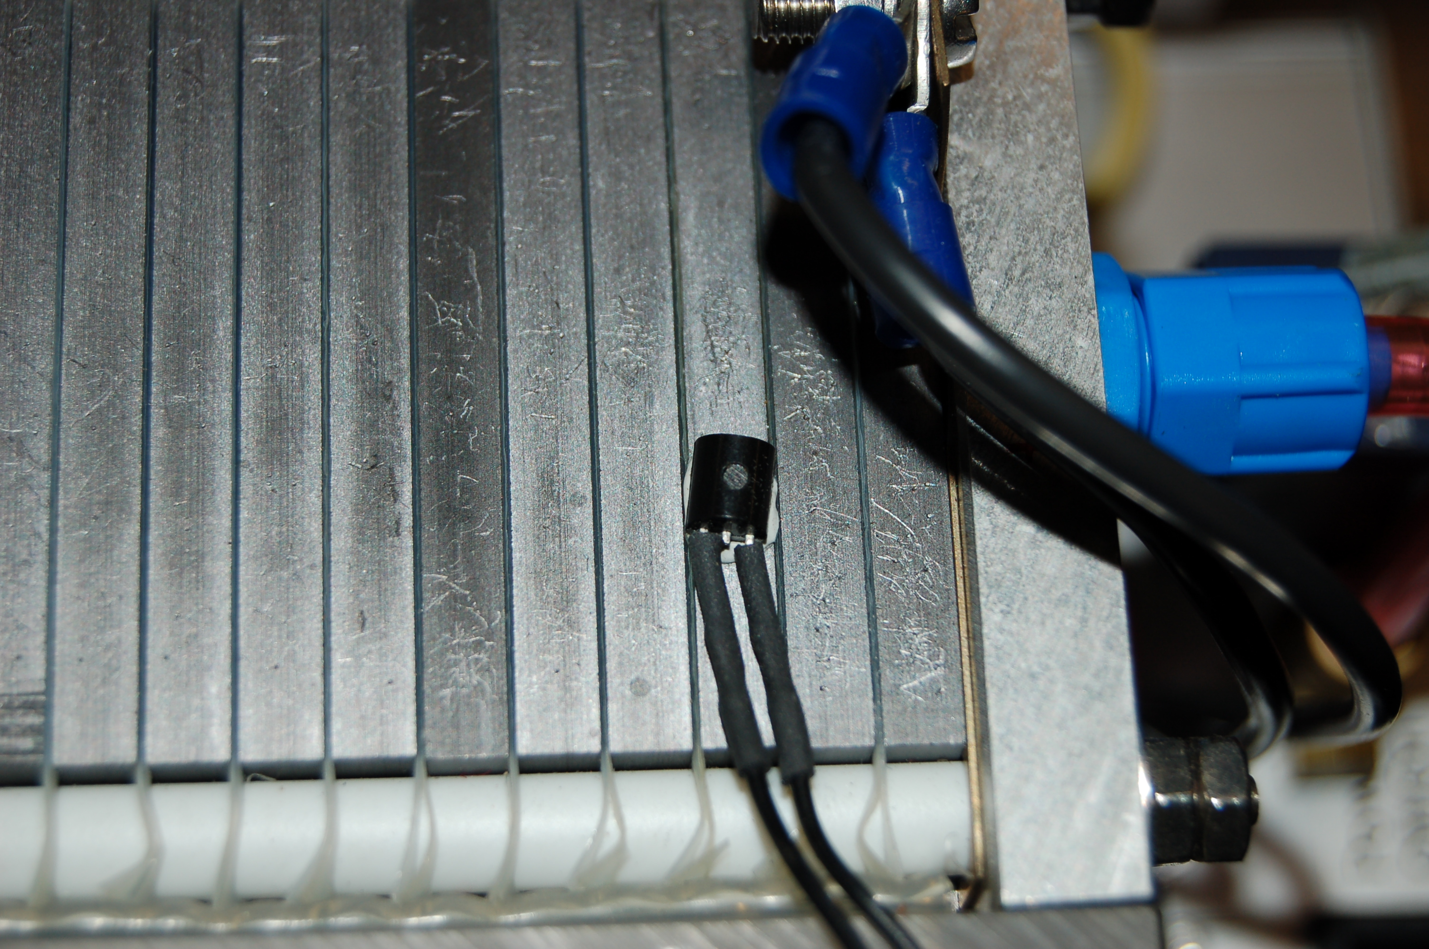
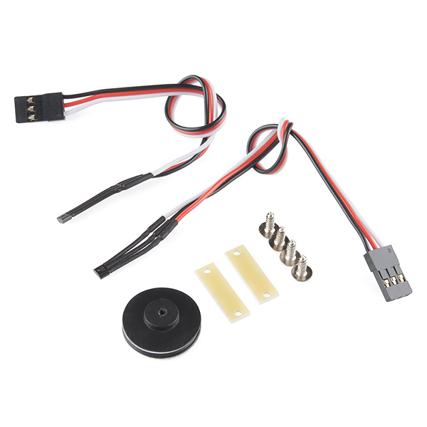
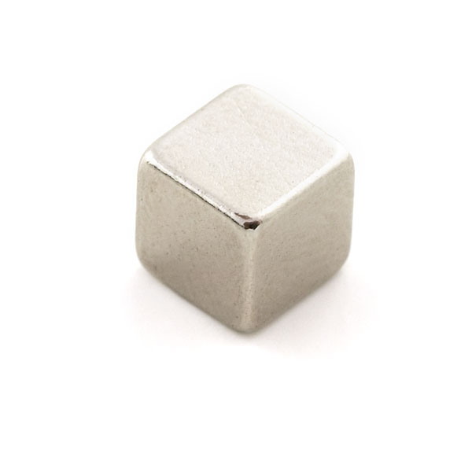
Sensors
Temperature
  Negative temperature coefficient (NTC) thermistor to monitor fuel cell temperature
Differential voltage sensor
  Monitor voltage between last two cells to activate purge valves
Speed Encoder
  Wheel Encoder to measure the speed and distance traveled
Source: Sparkfun
Notes:
Bruno

Slide 37
Schedule
 | Sep 25 | Oct 2 | Oct 9 | Oct 16 | Oct 23 | Oct 30 | Nov 6 | Nov 13 | Nov 20 | Nov 27 | Dec 4
Prototype - Standalone
Prototype - Integrated
Final Build
Integration
Testing
Notes:
Andre
Need notes

Slide 38
Work Distribution
 | James | Edwin | Bruno | Andre
MCU | X | X
12V Power Supply |  | X | X | X
Battery Charger |  |  | X | X
MCU/Radio Power Supply |  |  | X | X
Web UI | X | X
Notes:
Bruno

Slide 39
Budget
Description | Distributor | Qty | Unit Cost ($) | Total Cost ($)
CONTROLLER
Beagle Bone |  | 3 | 50.00 | 150.00
BATTERY SYSTEM
Battery
Charger IC | Mouser | 2 | 2.12 | 4.24
P-MOSFET | Mouser | 2 | 0.82 | 1.64
POWER SUPPLY
High Side Gate Driver | Digikey | 2 | 3.82 | 7.64
N MOSFET | Mouser | 4 | 1.29 | 5.16
Zener Diode 15V | Mouser | 2 | 0.10 | 0.20
Current Limit Resistor |  | 2 |  | 0.00
Current Measure IC | Mouser | 1 | 2.15 | 2.15
Current Sense Resistor |  | 2
Reverse Current Protection Diode | Mouser | 2 | 1.47 | 2.94
Boost Converter | Mouser | 1 | 5.19 | 5.19
Toroid Inductor |  | 1 | 4.00 | 4.00
MISCELLANEOUS
Wheel Encoder Kit | Sparkfun
PCB Manufacturing |  |  |  | 100.00
Supercapacitor (1F 2.7V) | Mouser | 4 | 0.96 | 3.84
Supercapacitor Protection Diode (2.5V) | Mouser | 4 | 0.13 | 0.52
Miscellaneous Components | Mouser |  |  | 20.00
PCB
Prototype Board | Mouser | 2 | 6.50 | 13.00
PCB | Advanced Circuits |  | 2 | 35
Surface Mount Adapters | Sparkfun |  |  | 5.00
RC Components | Amazon |  |  | 150.00
TOTAL |  |  |  | 545.52
Total | 545.52
Notes:
Source: Excel spreadsheet
Edwin

Slide 40
Progress
Notes:
James

Slide 41
Issues and Challenges
Beagle Bone damage during power up
Valves require more current than expected
Miscellaneous issues
  Battery connector/Switch issues

Slide 42
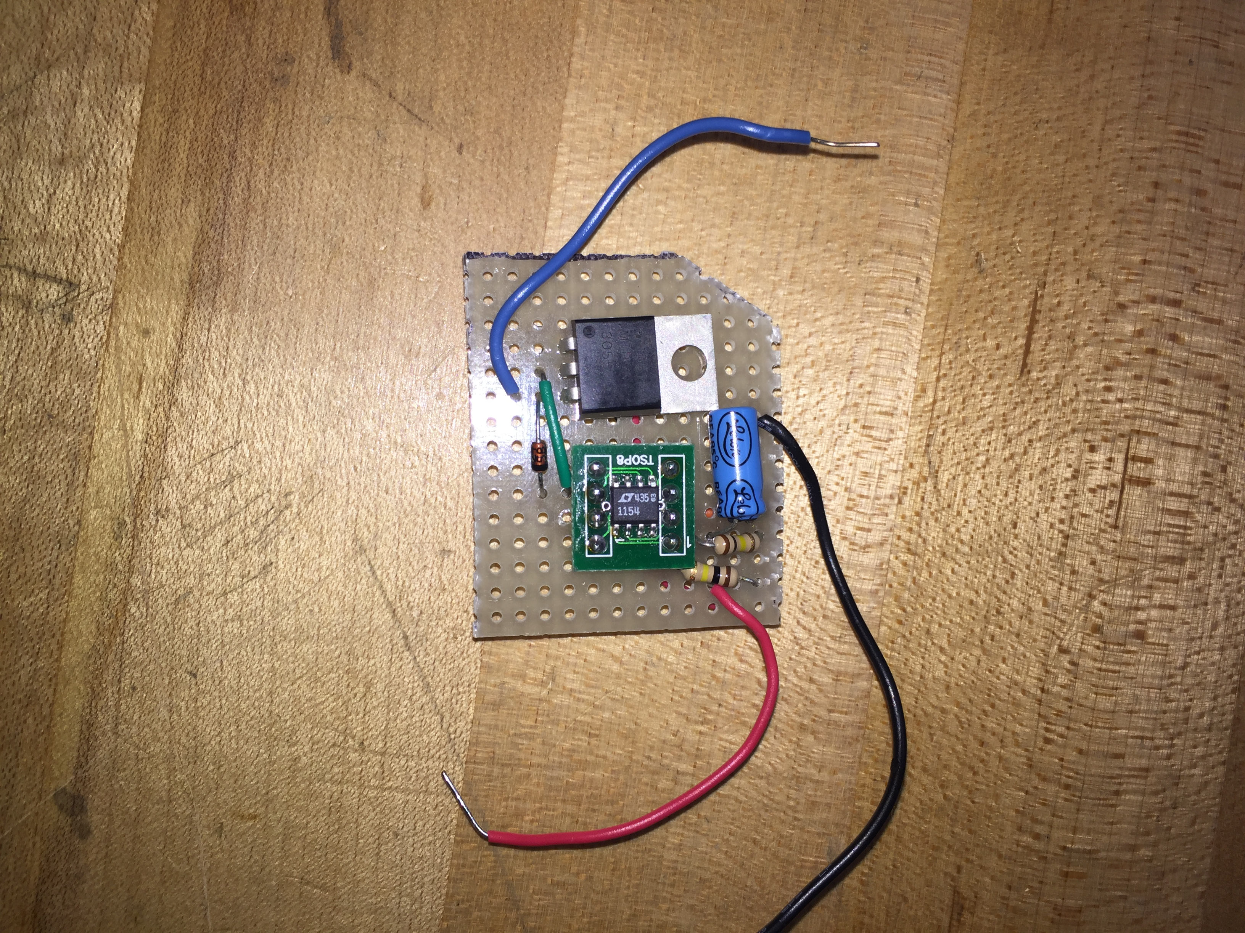
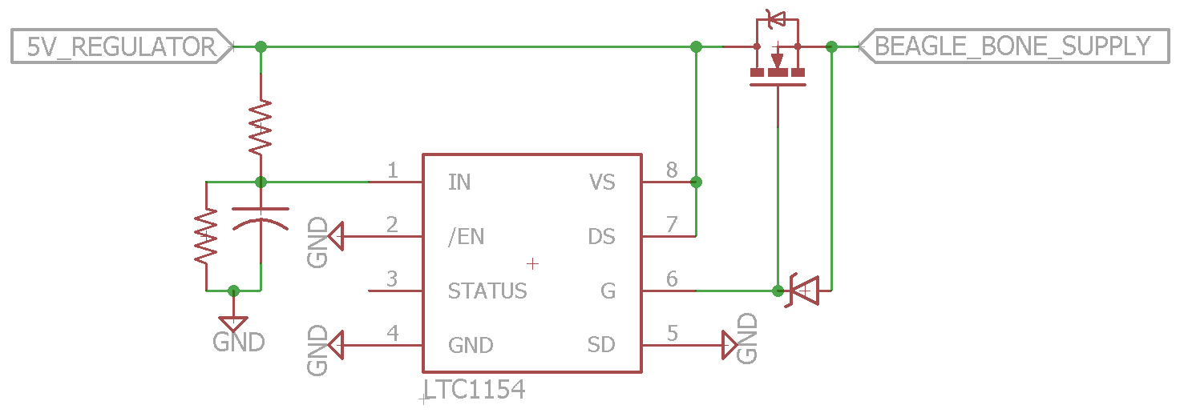
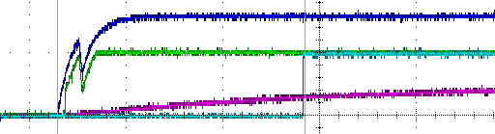
Controller Power-up Delay
  LTC1154 MOSFET Driver
  Beagle Bone damage during power up (despite power management chip)
Some Beagle Bones have overvoltage/undervoltage chip?
Delay start circuit for 5V supply to Beagle Bone
Piggybacked on PCB

Slide 43
Questions?

