Slide 1
COP 4331 Recitation #1
Department of Electrical Engineering and Computer Science
University of Central Florida
Fall 2014

Slide 2
Unified Modeling Language
Use Case Diagrams

Slide 3
Use Case Diagram
Depicts observable, user-initiated functions in terms of interactions of the system and its environment
Describes the relationship between “actors” and use cases
An actor is something that interacts with the system
Actors

Slide 4
Use Case Diagram
A use case represents some action that takes place within the system
Represents a major required functionality of the system
Use cases are not meant to model all tasks that the system provides
They specify user views of essential system behavior
Login

Slide 5
Use Case Diagram
Additionally:
A large rectangle box denotes the system boundary
A line between an actor and use case denotes that the actor participates in the use case
Login
Student

Slide 6
Use Case Diagram
<<include>>
A use case includes the functionality described in the previous one
Represented by a directed arrow having a dotted shaft, labeled with <<include>>
Pay Fines
Check Fines
<<include>>

Slide 7
Use Case Diagram
<<extend>>
A use case may include the functionality described in another use case
Find Item
Borrow Item
<<extend>>

Slide 8
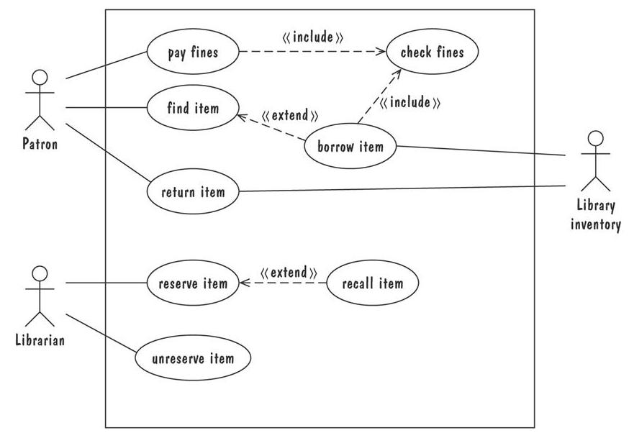

Slide 9
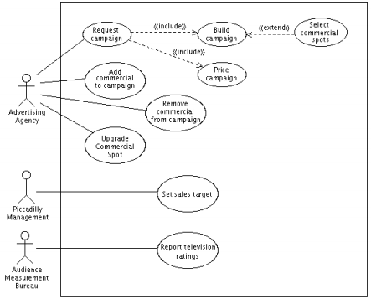

Slide 10
References
Shari Lawrence Pfleeger and Joanne M. Atlee, "Software Engineering: Theory and Practice", 4th Edition, Prentice Hall, 2010.
Prepared/modified by
Kia Manoochehri
kiam@knights.ucf.edu
Gurkan Solmaz
gsolmaz@knights.ucf.edu

