Slide 1
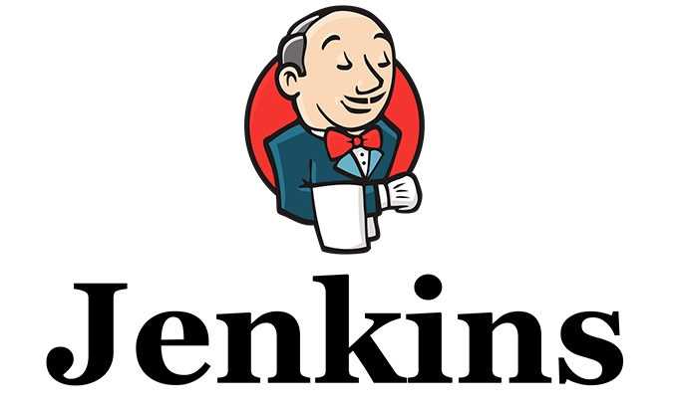

Slide 2
Trends like agile development and continuous integration speak to the modern enterprise’s need to build software hyper-efficiently
Jenkins: a highly popular open source tool for managing the software development process.
from source code management to delivering code to production
a continuous integration (CI) and continuous delivery (CD) solution.
CI: merge code from individual developers into a project multiple times per day and test continuously.
CD: a step further to ensure that all merged code is always in a production-ready state.

Slide 3
Why CI server:
Developer might forgot to run the test
Might take too long to run the test
We might need to test in various environment
Different architecture
32/64 bit intel, PowerPC
Different platforms
Windows, linux, etc.

Slide 4
"production-ready":
it runs
it satisfies the project requirements
it's stable
it's maintainable
correct defects or their cause, repair or replace faulty components without having to replace still working parts
it's scalable
it's documented
Etc.

Slide 5
An open source automation server.
Accelerate the software development process through automation.
Manage and control development lifecycle processes of all kinds,
build
document
test
deployment
static analysis
etc.

Slide 6
watch for any code changes
SVN, Git, etc.
Automatically do a build
Ant, Maven, Make etc.
Jenkins offer over 1,000 plugins that allow Jenkins to integrate with almost any popular technology
https://wiki.jenkins-ci.org/display/JENKINS/Plugins

Slide 8
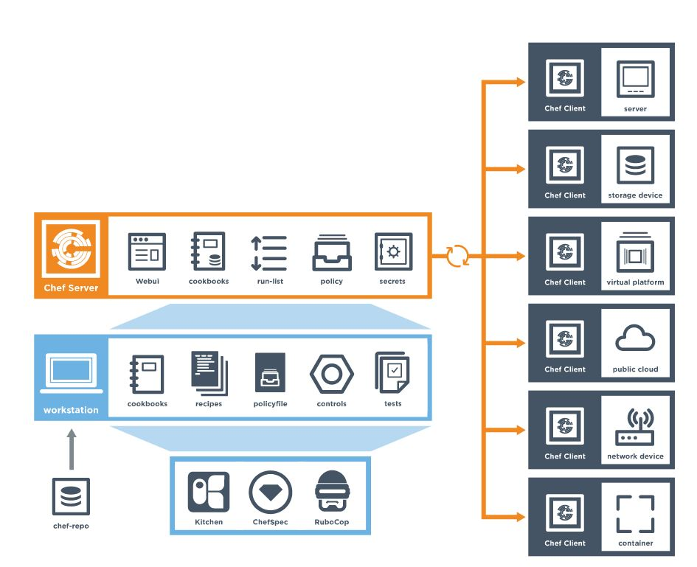

Slide 9
Without Jenkins
Commit code
Project manager should ask programmer for latest version
Programmer asks tester to put the files on the dev server
Test the programmer and show to the project manager
With Jenkins
Writing the code and committing it.
5 minutes later the code is on dev environment without anyone having to do anything.
The project manager can look at the dev environment knowing it has the latest work.
When something breaks you can look at the dev environment to check the latest version.
When the project manager is happy with the build on dev, they click a button to deploy it to staging.

Slide 10
Automated testing
Scheduling building
Notification:
email notification for a build project.
Reporting
Reporting plugins such as Junit
Code Analysis
Code Analysis plugin. The various plugins can be found at https://wiki.jenkins-ci.org/display/JENKINS/Static+Code+Analysis+Plugins
Distributed Builds
Jenkins slave machines

Slide 11
Automated Deployment
plugins available to transfer the build files after a successful build to the respective application/web server
Metrics & Trends
plugin available to calculate the following metrics for all of the builds once installed
Mean Time To Failure (MTTF)
Mean Time To Recovery (MTTR)
Standard Deviation of Build Times
Server Maintenance
Shutdown, Restart, reload the configuration, Backup
Security:
having the ability to setup users and their relevant permissions on the Jenkins instance
Remote Testing
tests can be run on remote slave machines via the master slave

Slide 12
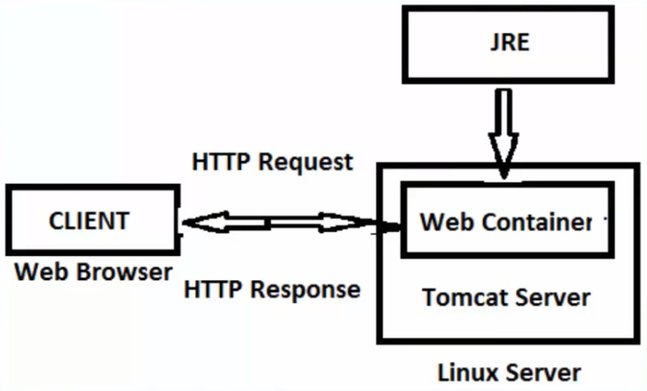

Slide 13
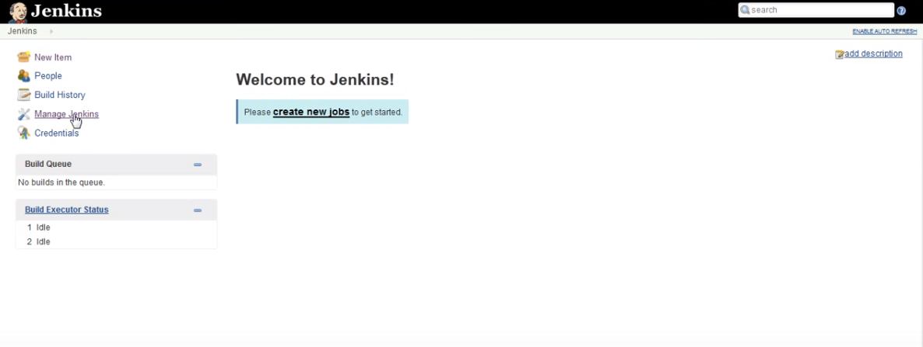
Go to https://jenkins.io/index.html
Click on latest and greatest

Slide 15
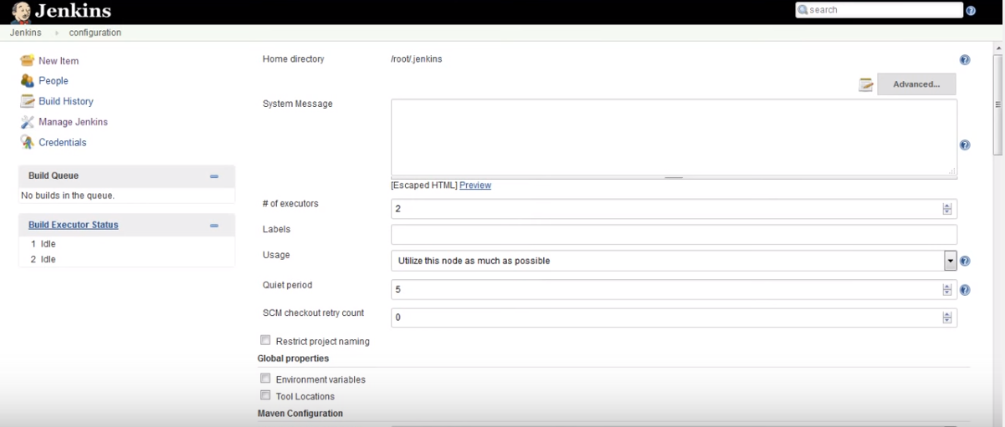

Slide 16
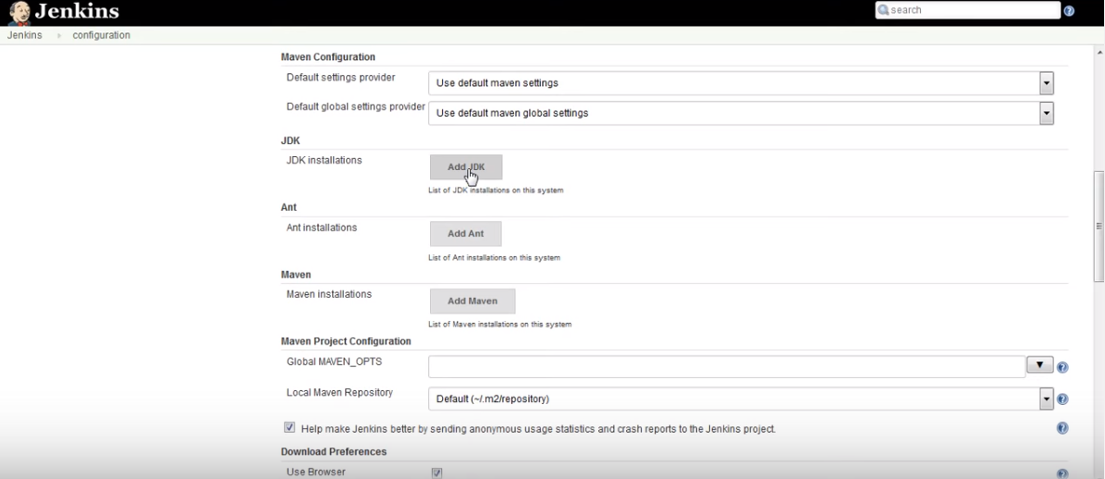

Slide 25
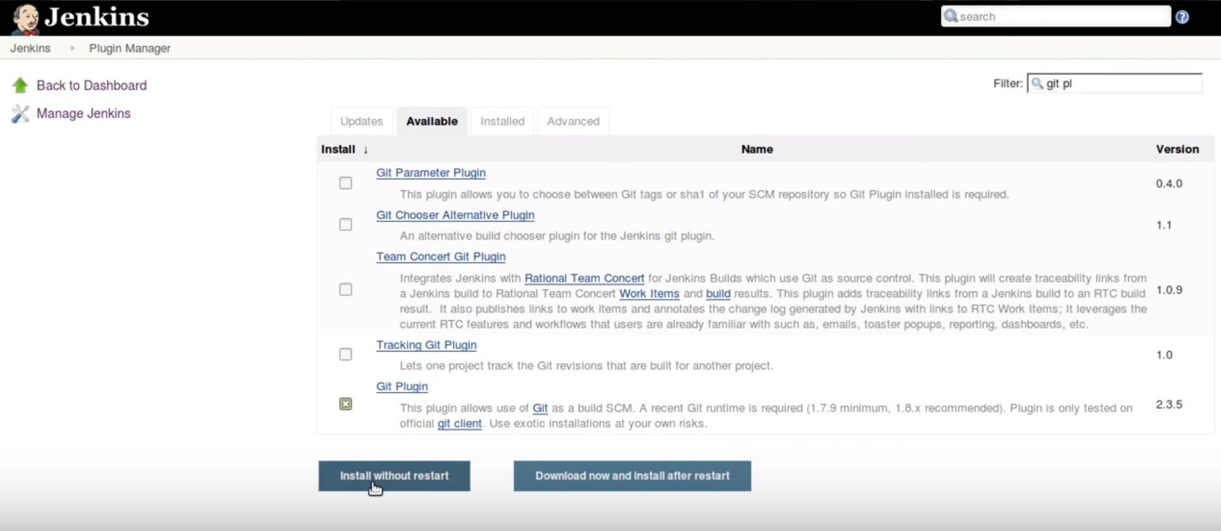

Slide 27
Do not forget to restart after installing plugins.

Slide 29
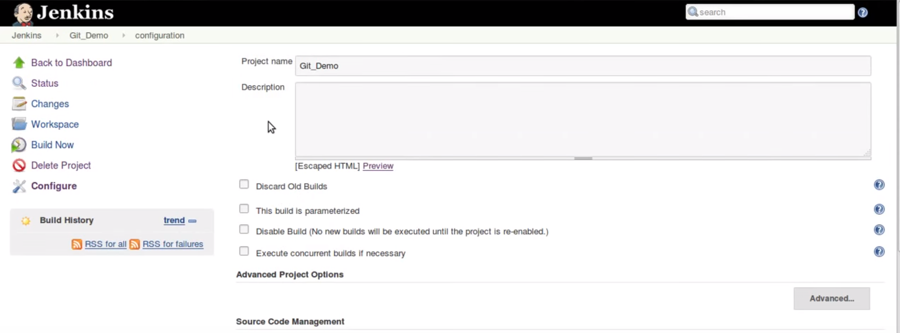
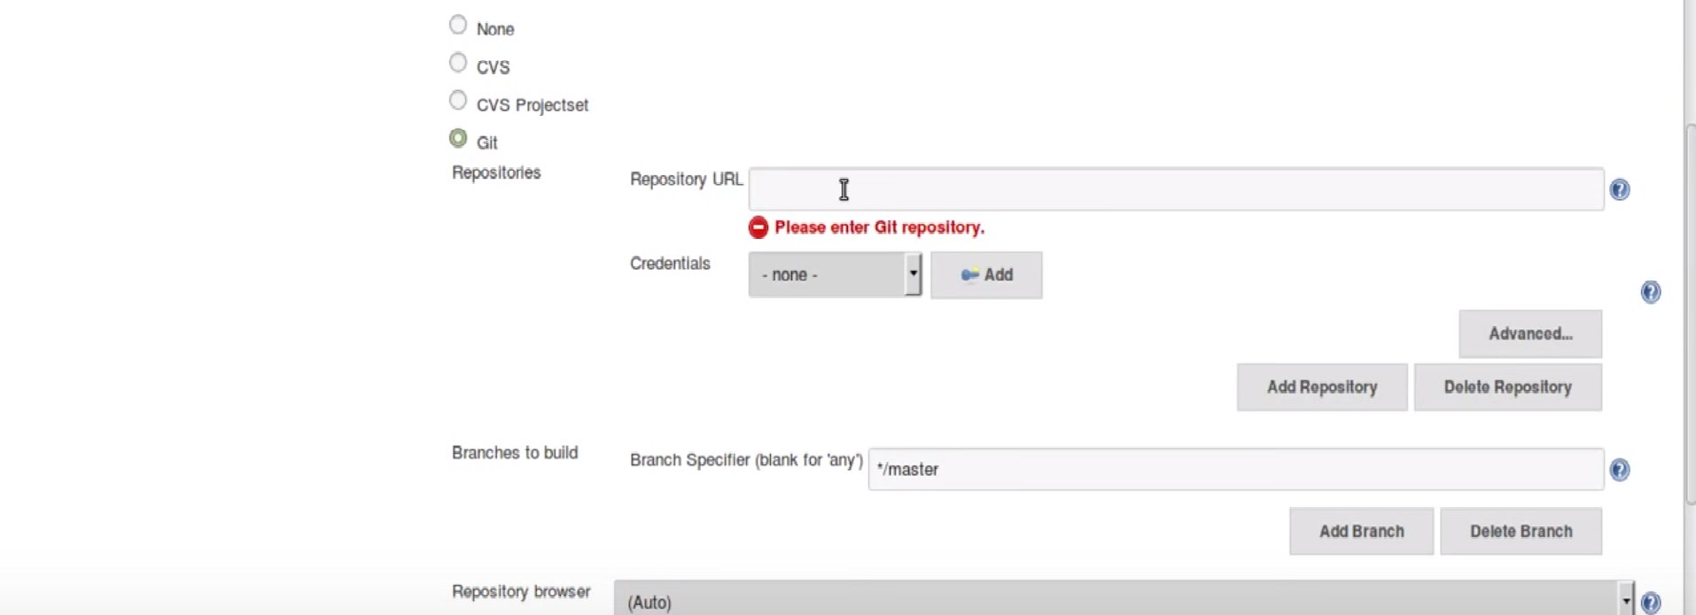

Slide 33
References
http://www.tutorialspoint.com/jenkins/
https://wiki.jenkins-ci.org/display/JENKINS/Beginners+Guide+to+Contributing
http://www.infoworld.com/article/3046038/application-development/why-jenkins-is-becoming-the-engine-of-devops.html
http://www.specialmoves.com/research-and-development/articles/jenkins-and-continuous-integration.html
https://www.youtube.com/watch?v=XY-ZB3FRnxw
https://www.youtube.com/watch?v=EOp2VVRHrKQ

Slide 34
hajiakhoond@knights.ucf.esu

